Slide 1
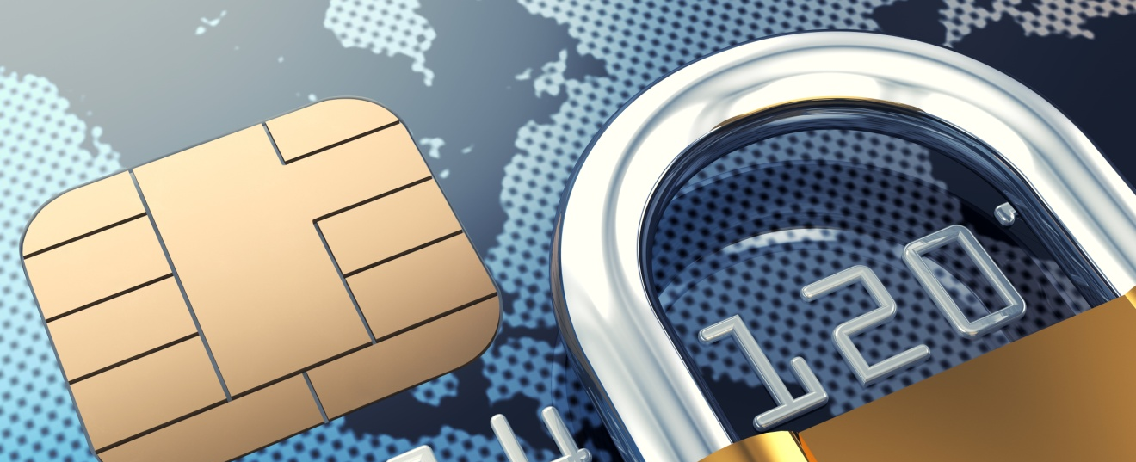
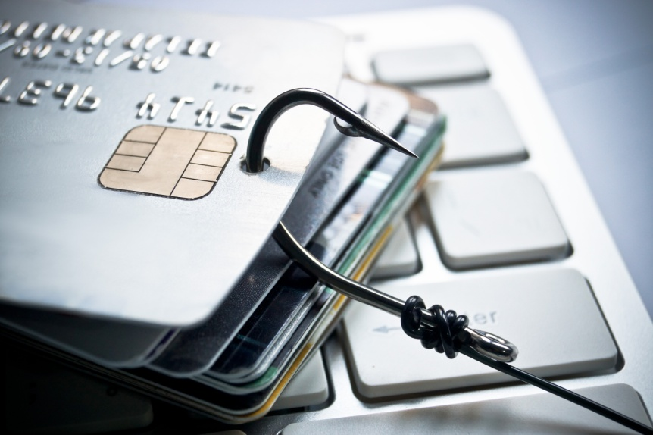





Credit/Debit Card Fraud
This project was supported by Cooperative Agreement Number 2013-CK-WX-K027 awarded by the Office of Community Oriented Policing Services, U.S. Department of Justice. The opinions contained herein are those of the author(s) and do not necessarily represent the official position or policies of the U.S. Department of Justice. Reference to specific agencies, companies, products, or services should not be considered an endorsement by the author(s) or the U.S. Department of Justice. Rather, the references are illustrations to supplement discussion of the issues.
Notes:
Notes

Slide 2

Meet Dave and Linda
Married 20 years
Family of four
Financially stable
Have recently taken on the responsibility of Dave’s parents’ finances
Notes:
Meet Dave and Linda Sampson. Dave and Linda have been married 20 years and have two children. Dave has recently taken on the responsibility of being power of attorney for his elderly parents. While his parents are still able to live on their own, they asked Dave to help keep track of their finances and help them make financial decisions.

Slide 3

Missing mail
Dave picks up his parents’ mail every other day
He has been expecting a piece of mail from the courthouse
He contacts the courthouse and they assure him it was sent last week
Notes:
In addition to looking over his parents’ finances, Dave stops by every other day to get the mail for his parents. With their age it has been too much for them to get down to the bottom of the driveway. He has been expecting a piece of mail from the courthouse to be delivered to his parents’ address. After a week he begins to question whether it was sent. He contacts the courthouse and they assure him they sent the document out last week. During his conversation with the clerk, she promises to mail out another copy.

Slide 4

Unauthorized charges
Unauthorized transactions detected
Out of state grocery stores
Out of state restaurants
One online purchase
Dave contacts the bank to put a hold on their account and disable their debit cards
Bank advises Dave to run a credit report
Notes:
Dave suspects that someone may have taken some of his parents’ mail but isn’t positive that is what happened. Later that evening Dave decides to sit down with his wife and go through his parents’ monthly online bank statement. As he goes through the transactions he notices a string of purchases over the past few days at stores and restaurants that he doesn’t recognize.
Dave immediately gets on the phone with the bank to put a freeze on his parent’s account and have their cards disabled. While on the phone with the bank, he is advised to run a credit report and possibly even freeze his parents’ credit until he can be sure what information was obtained by the scammer.

Slide 5

Credit report checked
Dave runs a credit report for each of his parents
annualcreditreport.com
No suspicious activity found in the report
Credit bureaus contacted to freeze credit
Equifax.com
Experian.com
TransUnion.com
Notes:
After speaking with the bank, Dave decides to go to annualcreditreport.com and run a credit check on both his parents. Fortunately there is no suspicious activity found on in their credit reports, at least at this point. Just to be safe Dave decides to contact the credit bureaus to put a temporary freeze on his parents’ credit.

Slide 6


What is credit/debit card fraud?
IC3 – Fraudulent unauthorized charging of goods and services to a victim’s credit/debit card.
FTC – Account or billing issues, including interest rate changes, late fees, credit disputes, and overcharges; fraudulent credit card offers/phishing attempts; etc.
www.ic3.gov
www.ftc.gov
Notes:
There are a number of agencies and entities that have defined Credit/Debit Card Fraud, but we chose to present you with the definitions used by the Internet Crime Complaint Center (IC3) and the Federal Trade Commission (FTC). As you can see in both definitions it comes down to the illicit taking of another’s credit card information for the purpose of charging purchases or making cash withdrawals from the victim’s account.

Slide 7
How the card/information is obtained
Simple thievery
Burglary of a residence, a vehicle, hotel room, etc.
Pick-pocketing and other forms of larceny.
Dumpster diving
Process of going through trash to look for valuable items or information.
Access to records
Anyone in a position to obtain the personally identifiable information (PII) of another is in a position to perpetrate credit card fraud.
Notes:
There are a multitude of ways for thieves to gain access to credit/debit cards and/or the information needed to clone them. The next few slides will cover some of the more common ways that credit/debit cards are stolen or cloned. Once we have covered these topics we will take a look at some ways we can protect ourselves against this type of fraud.
Credit Card Cloning (skimming)- is a technique whereby someone obtains your credit card details, copies them onto a bogus card and begins using the card.
Simple thievery: Thieves can steal credit cards, statements, or other documents containing account information in a number of ways. Burglary of a residence, a vehicle, a briefcase, a hotel room, a gym locker; pickpocketing; theft of mail from a mailbox; and other forms of larceny all fall into this category. Once the card or information is obtained, the thief can successfully impersonate the legal owner of the credit card and run up charges.
Dumpster diving: Often information we receive in the mail from our credit card company, contains enough sensitive information to provide an identity thief the information needed to gain access to the account. One good place for a thief to look for this information is the trash. Unless the owner of the accounts is diligent about shredding documents like credit card statements, etc. they leave themselves vulnerable to having their account information compromised by any thief willing to sift through the garbage.
Access to records: Essentially anyone in a position to obtain the personally identifiable information (PII) of another is in a position to perpetrate credit card fraud. The secretary at the personnel office, the records clerk at the hospital or doctor’s office, a bank teller, the clerical worker at your child’s school, a pharmacist or a clerical employee at a credit agency will have access to huge quantities of PII.

Slide 8
How the card/information is obtained
Shoulder surfing
The practice of looking over someone’s shoulder when they are at the ATM, or when they happen to be using their laptop to order something.
Social media
People who fill in too much detail in their personal profiles in whatever version of social media they may be using, often unwittingly provide some or all of the PII needed.
Change of address
Most credit card statements contain a box to check to request a change of address and/or a second card for a family member.
Notes:
Shoulder surfing: This process can often produce enough information to gain access to a credit card or debit card account.
Social media: Social media profiles can provide a substantial amount of information. One need not specifically state their date of birth in a profile form, if they post pictures of their latest birthday celebration for all their “friends” to see online. Other information that can be obtained even if it’s not explicitly listed in the profile includes school and employment history, as well as family members’ names (including mother’s maiden name—commonly used as a verification question by credit card companies). A thief may even actively engage a target in online conversations, befriending them and persuading the target to provide the additional information needed to commit credit/debit card fraud.
Change of address:.Once a thief has a credit card statement, they submit a change of address request and request a second card be issued. Credit card companies will often honor requests for a spouse’s card, and even solicit customers to include other family members on their account. Such a request would typically not be investigated or verified by the credit agency and the thief would receive the new card and future statements at the new address. Unless the legal card holder happened to notice the absence of monthly statements, it’s unlikely that they would notice what had taken place in time to prevent serious damage to their account.

Slide 9
How the cards/information is obtained
Hotel scams
Guests receive a call from the front desk stating the hotel computer is reported to have crashed and the guest is asked to verify their credit card information so the account can be updated.
Routine everyday use
Credit card information can be obtained by virtually any business by using a simple, commercially-available, palm-sized device that can read and record the information on the magnetic strip of most credit cards.
Hidden fees/Free trial offers
People who fill in too much detail in their personal profiles in whatever version of social media they may be using, often unwittingly provide some or all of the PII needed.
Notes:
Hotel scam: The hotel scam is an emerging form of credit card fraud. A hotel guest receives a call on the hotel room phone from a person claiming to be the desk clerk. The caller claims that the hotel computer has crashed, and asks the guest to verify his or her credit card information. Many victims simply retrieve their cards and provide the caller with the account number and three-digit key on the back.
Routine everyday use: Most people use their credit and debit cards many times a day for grocery shopping, gas for the car, or just lunch or a coffee at the local coffee house. Simple palm sized devices are commercially available, that can read and record the information on the magnetic strip of most credit cards. Waitstaff and retail workers have been known to use these devices to obtain the information from customers’ credit cards when they pay for their purchases. The thief can swipe the card through the device so quickly and discreetly that few victims are able to catch the act. Once they have the information they can either use it to take over that person’s account or they can make their money by selling large quantities of PII to organized groups specializing in trafficking such information. Thieves can also quickly photograph both sides of a credit card using a smartphone.
Hidden fees/Free trial offers: Credit card companies may advertise services like identity theft protection, reputation scanning, and cash back offers that require a reply in the negative if the cardholder wishes to avoid being enrolled—and incurring the costs. Warranties and service contracts can also involve continuing fees at the end of an introductory period if the cardholder fails to notify the company that the service is not desired. Cardholders can be hit with hidden shipping, handling, and packaging fees if they are not careful to read the fine print when making a purchase or participating in an online auction.

Slide 10
Credit/debit card fraud prevention
Could Dave have prevented the theft of his parents’ credit card information?
Maybe
Check the mail daily
Shred any documents or mail that contains personal identifiable information
Notes:
Let’s go back and take a look at Dave’s situation. Is there anything he could have done to prevent his parents from being victimized? YES. As you can see on the screen there are a few specific things he could have done that may have prevented this from occurring.
He could have:
Checked the mail daily versus every other day.
He could have shredded any documents or mail that contained personal identifiable information.

Slide 11

TIPS to avoid victimization
Shred documents containing Personally Identifiable Information
Be aware of when bills are due and if a statement seems late, call the credit card company and inquire.
Scrutinize all credit card statements when they arrive and be sure you know what every charge is for and that it’s something you charged.
Look for discrepancies, i.e. things that you don’t recognize as resulting from something you purchased or a service you signed up for.
Be sure to shred any statements when you are through with them, especially those that contain offers to transfer balances on document that look like pre-printed checks.
Notes:
Now that we have covered some of the ways that your information can be obtained, let’s look at some tips to avoid credit/debit card fraud.
Be aware that credit card statements often contain the necessary information for a thief to contact the card issuer, report the old card stolen, change the billing address, request a new card and exhaust your credit line before you are aware of the action.

Slide 12
TIPS to avoid victimization
Other fraud protection practices
Never give your account number to anyone on the phone unless you’ve made the call to a company you know to be reputable. If you’ve never done business with them before, do an online search first for reviews or complaints.
Carry your cards separately from your wallet. It can minimize your losses if someone steals your wallet or purse.
During a transaction, keep your eye on your card. Make sure you get it back before you walk away.
Report any questionable charges to the card issuer.
Notify your card issuer if your address changes or if you will be traveling.
Don’t write your account number on the outside of an envelope.
Notes:
Never give account information to anyone over the phone unless you have initiated the call.
Carry only the cards you need to use when going out to the mall, store, or restaurant.
Keep a close eye on your card when it is being used for a transactions.
Always keep a close eye out for questionable charges on your card statements and online banking.
Inform your bank or card issuer if you will be traveling.
Best practice is to not write your account information down on loose paper, envelopes, statements, etc.

Slide 13
How to report a lost or stolen card
Lost card
Call the card issuer as soon as you realize your card has been lost.
Stolen card and/or fraud
Call the card issuer as soon as you realize your card has been stolen.
Report the incident to your local law enforcement agency.
File a complaint with Internet Crime Complaint center @ www.ic3.gov.
Notes:
This slide covers what you should do if you have a lost or stolen card. As you can see there are different measures to take for both. If you have lost your card, it is best practice to immediately call the bank or card issuer as soon as you realize you have lost your card.
For a stolen card or fraud, first call the bank to have the card disabled and then file a report with your local law enforcement. After those two tasks have been completed you should also file a complaint with Internet Crime Complaint Center.

Slide 14

QUESTIONS
Photo Credits: “94686637 Copyright fotographic 1980, 2015 Used under license from Shutterstock.com“, “214296676 Copyright master_art, 2015 Used under license from Shutterstock.com“, "79512706 Copyright nobeastsofierce, 2015 Used under license from Shutterstock.com“, "223094779 Copyright wk1003mike, 2015 Used under license from Shutterstock.com“, "184849844 Copyright Monkey Business Images, 2015 Used under license from Shutterstock.com“, “131073617 Copyright Valentina Razumova, 2015 Used under license from Shutterstock.com“, "184855364 Copyright Monkey Business Images, 2015 Used under license from Shutterstock.com“, "85123540 Copyright ALMAGAMI, 2015 Used under license from Shutterstock.com“, " 155742992 Copyright albund, 2015 Used under license from Shutterstock.com“, " 134731886 Copyright style-photography, 2015 Used under license from Shutterstock.com“, “153213146 Copyright garriphoto, 2015 Used under license from Shutterstock.com“
Notes:
**Instructor Note: Ask the participants if they have any questions about credit/debit card fraud, prevention tips, or how to report this type of fraud.**

