Slide 1
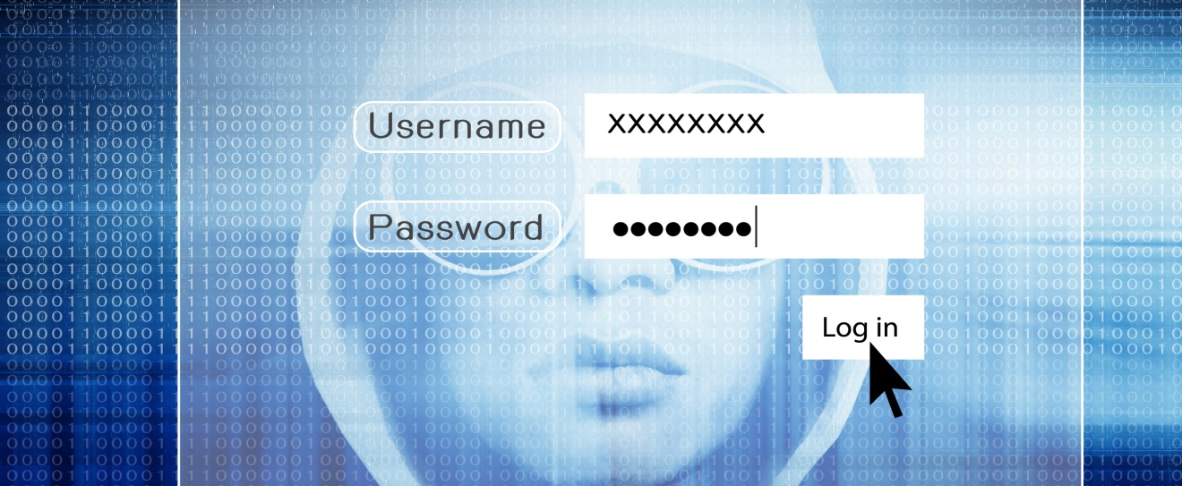






Identity Theft
This project was supported by Cooperative Agreement Number 2013-CK-WX-K027 awarded by the Office of Community Oriented Policing Services, U.S. Department of Justice. The opinions contained herein are those of the author(s) and do not necessarily represent the official position or policies of the U.S. Department of Justice. Reference to specific agencies, companies, products, or services should not be considered an endorsement by the author(s) or the U.S. Department of Justice. Rather, the references are illustrations to supplement discussion of the issues.

Slide 2



Meet Jonathan
Investment Advisor
  10 years with a local
  investment firm
Highly educated
  Master’s Degree in Finance and Risk Management
Tech savvy
Hobbies
  Photography
  Wine collecting
Notes:
Meet Jonathan McCutchin. Jonathan is an Investment Advisor at Smith & Jackson, a local investment firm. He is highly educated, he has a master’s degree in finance and risk management and has been with the firm for 10 years. He is very tech savvy and has a number of hobbies including photography and wine collecting.

Slide 3


Email notification received
Dear Valued Customer,
Due to the recent amount of fraudlent messages that targeted our customers. West National Bank has decided to upgrade the security of our online banking digital system. To do this we need proper verification of each and everyone of our customers. We were unable to reach you by phone thereby sending this email as an alternative to please verify you’re account information by clicking on the Login button below
Failure to do this within 24hrs will lead to restricted access to your account
Notes:
Last week while Jonathon was on lunch break, he received an email from his bank stating they were in the process of updating security measures and he would need to log on and update his personal account information. Not questioning the email, he quickly logged on to his account and updated all of his personal account information which included his current password and username.

Slide 4


Bank card declined
Jonathan and his fiancée attend a wine tasting event
Before leaving the event Jonathan pays for their drinks and appetizers
Waitress informs Jonathan that his card was declined
Jonathan provides a credit card and the transaction was approved
Notes:
Later that evening, Jonathan and his fiancé go to a wine tasting event at a local restaurant. After participating in the tasting and having some appetizers, Jonathan asks the waitress for the bill. The waitress comes back and informs him that his card was declined. She apologizes and suggests that there may be something wrong with their system. He then hands her his credit card. She comes back and says it went through and everything was fine. Jonathan doesn’t think anything more about it.

Slide 5

Bank contacted
Checking account has a negative balance
The email he received was not from the bank
An attempt to transfer his Home Equity Line of Credit (HELOC)
Notes:
The next morning on his commute to work, Jonathan starts to think a little bit more about his card being declined the previous night. He decided to contact the bank while sitting in traffic. He wanted to ask them about the email he received and to check on the balance of his account. After just a few minutes on the phone, he finds out his bank account has a negative balance and there was an attempt to transfer his Home Equity Line of Credit.

Slide 6

Credit report checked
Obtain Credit Report:
Annualcreditreport.com
Freeze Credit:
Equifax.com
Experian.com
TransUnion.com
New accounts have been opened in Jonathan’s name
  Amazon Prime
  PayPal
Credit card applications have been submitted in his name
Notes:
Jonathan has been advised by the bank to check his credit report and potentially have his credit temporarily froze. After obtaining a credit report from Annualcreditreport.com, he notices that there has been some activity over the past couple of days. He sees that a new account has been opened through Amazon and that there have been credit card applications submitted using his name and personal information.
As you can see on the left of the screen, a good way to obtain a free credit report is through Annualcreditreport.com. Also, if you think your identity has been compromised, you should immediately contact either Equifax, Experian, Transunion or all of the above and have your credit frozen.

Slide 7
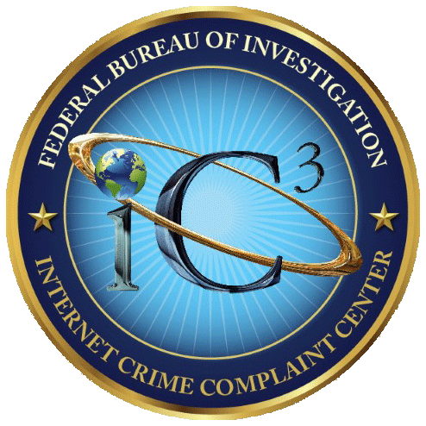

What is identity theft?
IC3 – Identity theft occurs when someone appropriates another's personal information without their knowledge to commit theft or fraud.
FTC – When someone uses your Social Security number or other personal information to open new accounts, make purchases, or get a tax refund.
www.ic3.gov
www.ftc.gov
Notes:
There are a number of agencies and entities that have defined Identity Theft, but we chose to present you with the definitions used by the Federal Trade Commission and the Internet Crime Complaint Center. As you can see in both definitions, it comes down to the illegal use of another person’s identifying information (such as name, date of birth, social security number, etc.)
(Accessed on September 18, 2019)
https://www.ic3.gov/crimeschemes.aspx#item-9
www.ftc.gov

Slide 8
Common identity theft schemes
Guaranteed loans, easy credit offers
Promises low interest rates or easy credit to those who otherwise may not qualify
The victim is convinced that they need to divulge their personal identifying information to obtain the offering
New Account Fraud
In 2018, new account fraud accounted for $3.4 billion in losses, up from $3 billion in 2017
The most common targets for new account fraud are mortgages, student loans, car loans and credit cards
Notes:
Guaranteed loans or easy credit offers: Promising low interest rates or easy credit to those who may not otherwise qualify. The victim is then convinced that critical personal identifying information is needed to open a credit account in his or her names. This scam is also know to involve an advance fee for the service thereby victimizing the target of the scheme twice.
New account fraud is up 13%
In 2018, new account fraud accounted for $3.4 billion in losses, up from $3 billion in 2017, according to Javelin Strategy. The most common targets for new account fraud are mortgages, student loans, car loans and credit cards.
(Accessed on September 18, 2019)
https://www.consumeraffairs.com/finance/identity-theft-statistics.html#
https://www.idtheftcenter.org/data-breaches/
https://www.identityforce.com/blog/2019-data-breaches

Slide 9
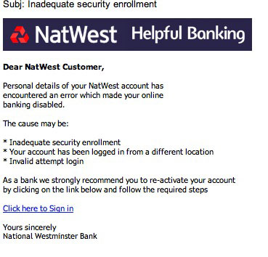
Common identity theft schemes
Work-at-home
Involves the offer of easy money working from home (stuffing envelopes, repackaging and reshipping merchandise, etc.)
Often requires the victim to submit critical identification information often including bank account numbers to facilitate payment
Lost account information
Phone call or email from someone claiming to represent the bank or credit card company claiming their computer systems have crashed
Victim is then directed to call a particular phone number or a website to update their personal information
Notes:
Work-at-home: A classic example of a fraud that involves multiple types of scams, this fraud involves the offer of easy money working from home stuffing envelopes, assembling products, re-packaging and reshipping merchandise, or typing and billing for medical facilities. It often requires the victims to submit critical identification information including bank account numbers and passwords, allegedly to facilitate payment for their services. The scammer may send payment in the form of a check or money order (counterfeit or altered) for more than the contracted amount, then require the victim to deposit it and immediately wire the balance back to the scammer (counterfeit check scam). The scammer may even claim they need detailed personal information to perform credit checks on the victim before allowing them to take advantage of these work-at-home opportunities. In addition to the PII the victim provides to the scammer, they may be required to purchase items up front (advance fee scam) to perform the tasks they are being “employed” to perform. The work they are employed to perform may involve repackaging and reshipping (often stolen property or property purchased with stolen credit cards). The true injustice of this form of fraud is that it leaves the victim actually liable for having facilitated a crime (receiving and concealing stolen property and/or conspiracy.
Lost account information: The victim of this scam receives a phone call or an email from someone claiming to represent a bank or credit card company that has suffered a computer crash and needs account information of the victim updated so their accounts can remain open and useable. The email may direct the victim to call a particular phone number, or it may direct them to a web page set up to look like their banking institution, designed to gather their personal information.
In one variation, a guest at a hotel receives a call allegedly from the front desk claiming that the computer lost their credit card information and requesting the victim provide it over the phone.
(Accessed on October 2, 2019)
https://ivetriedthat.com/work-at-home-scams/
https://www.cnbc.com/2017/05/12/this-growing-fraud-will-drain-your-bank-account.html

Slide 10
Other ways identities are compromised
February 2018, Partners HealthCare, announced that a 2017 data breach may have exposed the personal information of 2,600 patients.
April 2018, owner of retail stores Saks Fifth Avenue and Lord & Taylor, Hudson’s Bay Company (HBC), confirmed that hackers stole the data of more than 5 million credit and debit cards.
June 2018, TaskRabbit confirmed that they experienced a data breach affecting more than 3.75 million users and compromising the names, birth dates, Social Security numbers, and bank account numbers of both customers and laborers.
September 2018, Cancer Treatment Centers of America notified almost 42,000 patients of possible access to their protected health information.
November 2018, Marriott announced a 2014-18 breach had exposed the records of up to 500 million customers in its Starwood hotels reservation system.
2018 Data Breaches IdentityForce
Notes:
In addition to the methods previously mentioned, there are also those who possess the skills to hack into systems and steal the PII of millions of people at a time such as the data breaches occurring in 2017 and 2018 making headlines and affecting victims across the country.
In these types of cases, there is not much individuals can do to protect themselves from falling victim to identity theft.
(Accessed on September 18, 2019)
https://www.databreaches.net/cancer-treatment-centers-of-america-notifies-almost-42000-patients-of-possible-access-to-their-protected-health-information/
https://www.identityforce.com/blog/2018-data-breaches
https://www.consumer.ftc.gov/blog/2017/09/equifax-data-breach-what-do
https://enterprise.verizon.com/resources/reports/2019-data-breach-investigations-report.pdf

Slide 11

Identity theft prevention
Could Jonathan’s situation have been prevented?
YES
Before clicking the link, he could have verified the email by calling the bank.
He could have looked for red flags.
  The email was addressed to
  Valued Customer.
  The email stated they had tried to reach him by phone.
  There were misspellings and grammatical errors in the email.
    This will depend on the sophistication of the scammer.
Notes:
Let’s go back and take a look at Jonathan’s situation. Is there anything he could have done to prevent being victimized? YES. As you can see on the screen there are a few specific things he could have done that could have prevented this from occurring.
He first could have called his bank to verify that the email was from them.
He could have looked for red flags
The email was addressed to Valued Customer rather than using his name.
The email stated that they tried to reach him by phone. He could have checked to see if he had a missed call.
He could have looked a little closer at the email. There were a couple of grammatical errors and misspellings.

Slide 12

Original email from the bank
Dear Valued Customer,
Due to the recent amount of fraudlent messages that targeted our customers. West National Bank has decided to upgrade the security of our online banking digital system. To do this we need proper verification of each and everyone of our customers. We were unable to reach you by phone thereby sending this email as an alternative to please verify you’re account information by clicking on the Login button below (lack of punctuation)
Failure to do this within 24hrs will lead to restricted access to your account
Notes:
This is the original email that Jonathan received from the bank. As you can see, we have pointed out a couple of the misspellings and grammatical errors that were in the body of the email. More than likely an email from a financial institution will be well written and grammatically sound. People do make mistakes but this is just one of many red flags to look for when receiving an email that is requesting you to update and account or provide personal information.

Slide 13
TIPS to avoid victimization
Keep your personal information secure offline
Keep your personal information secure: Make sure sensitive records are locked away and in your home.
Shred any non essential papers, credit card solicitations, bank statements, monthly bills, and any account transfer offers.
Only carry what you need on your person.
When filling out forms at work, your children's school, doctor’s office etc. ask specifically if social security numbers are essential.
Destroy labels: Labels on prescription medications can provide information of use to a potential identity thief.
Notes:
In addition to the methods previously mentioned, there are also those who possess the skills to hack into systems and steal the PII of millions of people at a time such as the data breaches most recently occurring in 2017 and 2018 making headlines and affecting victims across the country. In these types of cases, there isn’t a lot an individual can do to protect themselves from falling victim to Identity Theft.
(Accessed on October 2, 2019)
https://us.norton.com/internetsecurity-privacy-what-personal-information-should-you-safeguard.html

Slide 14
TIPS to avoid victimization
Keep electronic devices secure
Security software is of primary importance: In order to be as secure as possible, be sure to keep a good malware/security program on your computer and keep it updated.
Beware of emails from unknown sources: Make it a practice to carefully scrutinize all incoming emails. If you do not recognize the source of the email or if it has an attachment that you do not recognize, do not open it.
Use caution around public Wi-Fi sources. Avoid online banking or online bill pays while on public network.
Safeguard your electronic equipment: Laptops, tablets or smartphones should never be left unguarded. There is a large amount of personal information stored on these types of devices.
Notes:
Read through bullets on the slide
(Accessed on October 2, 2019)
https://www.uclahealth.org/compliance/is-tips

Slide 15
TIPS to avoid victimization
Keep your personal information secure online
Know who you share your information with. Store and dispose of your personal information securely.
Make sure you know who is getting your personal or financial information. Don’t give out personal information on the phone, through the mail or over the internet unless you’ve initiated the contact or know who you’re dealing with.
Keep your browser secure. To guard your online transactions, use encryption software that scrambles information you send over the internet. A “lock” icon on the status bar of your internet browser means your information will be safe when it’s transmitted.
Don’t over-share on social networking sites. If you post too much information about yourself, an identity thief can find information about your life, and use it to answer ‘challenge’ questions on your accounts.
Notes:
Read through the bullet points on the slide.
(Accessed on October 2, 2019)
https://us.norton.com/internetsecurity-privacy-what-personal-information-should-you-safeguard.html

Slide 16
What to do if you are a victim
Report the incident to your local law enforcement agency.
File a complaint with Internet Crime Complaint center @ www.ic3.gov.
Submit a consumer complaint with the Federal Trade Commission @ www.ftc.gov/complaint.
If you were scammed by someone claiming to represent a business, be sure to notify the actual business (bank, credit card company, etc).
Notes:
If you or someone close to you believes their personal information or identity has been compromised, here is a list of ways to report identity theft.

Slide 17

QUESTIONS
Photo Credits: “94686637 Copyright fotographic 1980, 2015 Used under license from Shutterstock.com“, “214296676 Copyright master_art, 2015 Used under license from Shutterstock.com“, " 191299145 Copyright Hyena Reality, 2015,Used under license from Shutterstock.com“, "145450405 Copyright Brian A. Jackson, 2015 Used under license from Shutterstock.com“, " 129348527 Copyright Minerva Studio , 2015 Used under license from Shutterstock.com“, " 217088476 Copyright Minerva Studio, 2015Used under license from Shutterstock.com“, " 127867649 Copyright Minerva Studio, 2015 Used under license from Shutterstock.com“, " 174681002 Copyright Minerva Studio, 2015 Used under license from Shutterstock.com“, " 123746440 Copyright Minerva Studio, 2015 Used under license from Shutterstock.com“, " 238393882 Copyright Minerva Studio, 2015 Used under license from Shutterstock.com“, " 123720997 Copyright Minerva Studio, 2015 Used under license from Shutterstock.com“, “122983663 Copyright alexskopje, 2015 Used under license from Shutterstock.com“, “113493313Copyright bannosuke, 2015 Used under license from Shutterstock.com“, “153213146 Copyright garriphoto, 2015 Used under license from Shutterstock.com“
Notes:
**Instructor Note: Ask the participants if they have any questions about identity theft, prevention tips, or how to report this type of crime.**

Slide 18
Bibliography
“Cancer Treatment Centers of America Notifies Almost 42,000 Patients of Possible Access to Their Protected Health Information.” Data Breaches.net, WordPress. Accessed on September 18, 2019. https://www.databreaches.net/cancer-treatment-centers-of-america-notifies-almost-42000-patients-of-possible-access-to-their-protected-health-information
“Data Breaches”. Identity Theft Resource Center. Identity Theft Resource Center, Accessed on September 18, 2019. https://www.idtheftcenter.org/data-breaches/
“2019 Data Breach Investigations Report.” Verizon. Verizon, 2019. Accessed on September 18, 2019. https://enterprise.verizon.com/resources/reports/2019-data-breach-investigations-report.pdf
Douglas, Rob. “2019 Identity theft statistics. Trends and statistics about identity theft.” Consumers Affairs, Consumers Unified LLC, 6 June, 2019. Accessed on September 18, 2019. https://www.consumeraffairs.com/finance/identity-theft-statistics.html#
Federal Bureau of Investigation. “Internet Crime Schemes.” Internet Crime Complaint Center (IC3). Accessed on September 18, 2019. https://www.ic3.gov/crimeschemes.aspx#item-9
Federal Trade Commission Consumer Information. Federal Trade Commission, Accessed on September 18, 2019. www.ftc.gov
“Information Security Tips.” UCLA Health. Accessed on October 2, 2019. https://www.uclahealth.org/

Slide 19
Bibliography
Grant, Kelli. “This growing fraud will drain your bank account.” CNBC. CNBC LLC, 2019. Accessed on October 2, 2019. https://www.cnbc.com/2017/05/12/this-growing-fraud-will-drain-your-bank-account.html
Gressin, Seena. “The Equifax Data Breach: What to Do.” Federal Trade Commission Consumer Information. Federal Trade Commission, 8 September, 2017. Accessed on September 18, 2019. https://www.consumer.ftc.gov/blog/2017/09/equifax-data-breach-what-do
Turner, Steve. “2018 Data Breaches- The Worst of Last Year.” Identity Force. Identity Force Inc., 27 December, 2017. Accessed in September 18, 2019. https://www.identityforce.com/blog/2018-data-breaches
“What personal Information should you safeguard?” Norton. Symantec Corporation 1995-2019. Accessed on October 2, 2019. https://us.norton.com/internetsecurity-privacy-what-personal-information-should-you-safeguard.html
Razinski, Steve. “10 Work at Home Scams That Still Exist Today.” ivetriedthat. 28 August, 2018. Accessed on October 2, 2019. https://ivetriedthat.com/work-at-home-scams/

