Slide 1

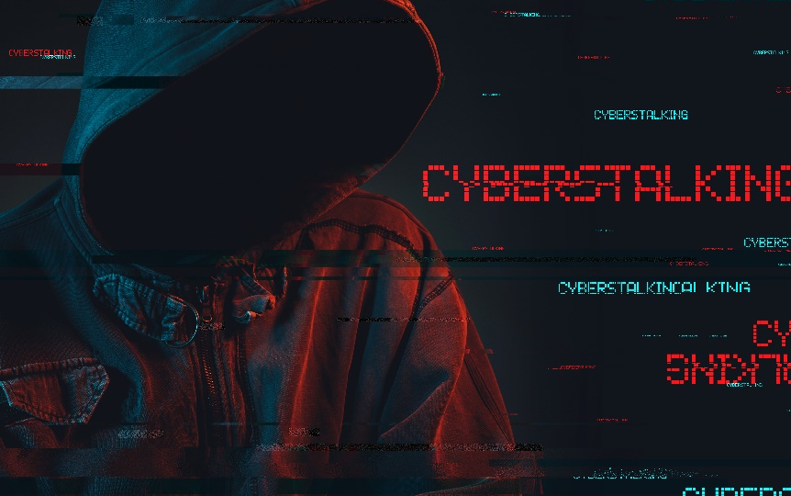





Cyberstalking
This project was supported by Cooperative Agreement Number 2013-CK-WX-K027 awarded by the Office of Community Oriented Policing Services, U.S. Department of Justice. The opinions contained herein are those of the author(s) and do not necessarily represent the official position or policies of the U.S. Department of Justice. Reference to specific agencies, companies, products, or services should not be considered an endorsement by the author(s) or the U.S. Department of Justice. Rather, the references are illustrations to supplement discussion of the issues.
Notes:
Over the next 15-20 minutes I will be covering the topic of cyberstalking. With the proliferation of social media, online dating, and other communication platforms, cyberstalking is becoming more and more prevalent. During this presentation I will cover what is and what isn’t cyberstalking, tips to avoid being cyberstalked, what to do if you are cyberstalked, and some resources for those who have fallen victim.

Slide 2

Meet Sarah
Pastry chef
32 years old
Recently broke up with long-term boyfriend
Utilizing online dating sites to find someone new
Culinary school graduate
Hobbies
Baking
Sewing
Gardening
Notes:
First let’s start the presentation by meeting Sarah James. Sarah is a pastry chef at a local shoppe called Sweets & Eats. She graduated from culinary school 8 years ago and has been in her current position ever since. Sarah just came out of a long-term relationship of 6 years. After taking a few month hiatus from men, she was ready to start dating again. Still residing in her small hometown, Sarah new there weren’t any guys she was interested in. Sarah recently started to utilize online dating sites to seek her next partner.
Sarah is an avid baker and loves to sew. She also spends time in her garden where she grows fresh fruits and vegetables for her home-baked sweets.

Slide 3


Dating profile created
Hi Sarah! My name is Jonathan. Based on your profile and hobbies, it seems we have a lot in common.
Wanna chat?
Sarah creates a profile on Match.com
Within 24 hours of creating an account she gets a message from a guy named Jonathan
Based on Jonathan’s profile, it appears they have a lot in common
Sarah replies to his message and that led to regular conversations
Hi Jonathan! It sure does seem like we have a lot in common. I am a little busy over the next few days, but maybe I’ll message you Tuesday.
Sounds good! Looking forward to it!
Yeah me too! I’m free at 9pm.
Does that time work?
Perfect for me!
OK!
TTYL
Notes:
Now that Sarah has moved past her last relationship, she feels she is ready to start dating again. She creates an account on Match.com to see if she can find someone within a drivable distance. Two days after creating her account she gets a message from a guy named Jonathan. Based on Jonathan’s profile, it appeared as thought they had a lot in common.
Class participation
With a show of hands, how many of you have used online dating sites?
If you are willing to share, was it a good experience or bad experience?

Slide 4




Things get weird
After a few weeks of talking Jonathan became possessive
Wants to know who Sarah is hanging out with
Starts sending friend requests to Sarah’s friends
Sarah decides to end their communication and not meet Jonathan offline
Notes:
After a few weeks of chatting online, Jonathan’s conversations with Sarah started getting weird. He seemed to become very possessive and was questioning who she is hanging out with. He then started messaging people she was friends with on Facebook and sending out friend requests.
Sarah didn’t like the behavior that Jonathan was starting to display so she decides to end their communication and not meet Jonathan offline.

Slide 5

Sarah contacts law enforcement
Jonathan continues to contact her despite her telling him to stop
Sarah starts receiving threatening messages
Sarah starts getting phone calls soliciting her for sex
Notes:
After attempting to cut off communication with Jonathan, he continued to contact Sarah and started acting very possessive. Sarah started receiving threatening text messages and random calls from guys and girls enquiring about sex. Sarah decided to contact law enforcement as she was starting to fear for her safety.

Slide 6
What is cyberstalking?
The act of cyberstalking is committed when an individual repeatedly uses the internet, computers, or other electronic devices to engage in threatening or harassing behavior.
6-7.5 million people are stalked in a one year period in the United States.
- Stalking Prevention, Awareness, and Resource Center (SPARC)
Notes:
Cyberstalking is defined as the repeated use of the internet, computers, or other electronic devices to engage in threatening or harassing behavior.
According to the Stalking Prevention, Awareness and Resource Center (SPARC), 6-7.5 million people are stalked in a one year period in the United States.
Class participation
Have any of you or someone you know, been cyberstalked?
(Source Accessed on 5/22/19)
https://www.justice.gov/usao/file/851856/download
https://www.stalkingawareness.org/wp-content/uploads/2019/01/SPARC_StalkngFactSheet_2018_FINAL.pdf

Slide 7
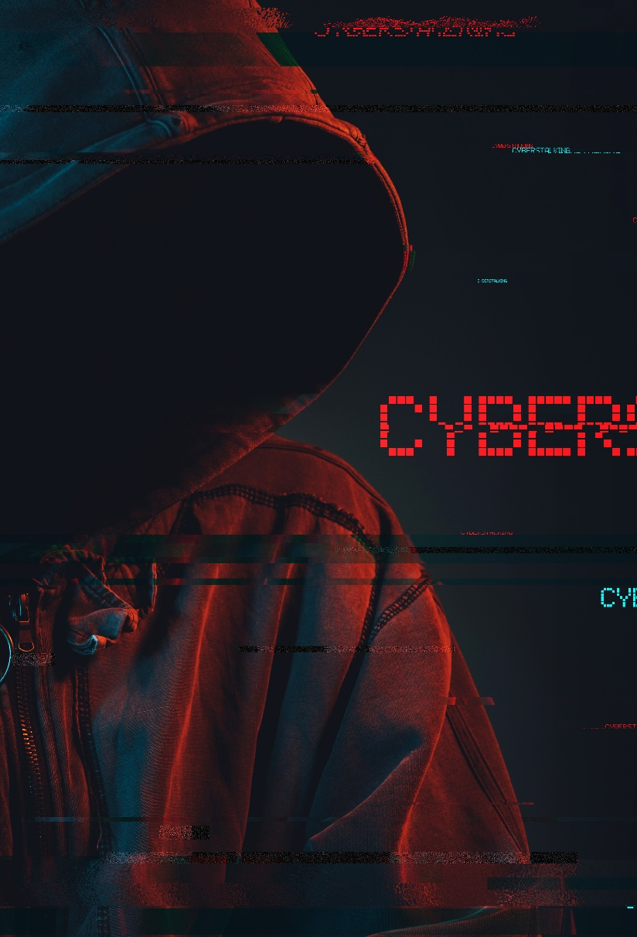
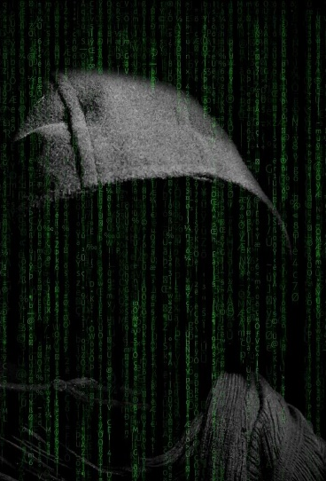
What is not cyberstalking?
Repeatedly visiting a social media page
Saving pictures that have been posted
Collecting data regarding a person or their activities is not enough to constitute cyberstalking
Notes:
While it is important to understand what cyberstalking is, it is just as important to understand what it isn’t.
The act of repeatedly visiting a social media page, saving pictures that have been posted, or collecting data regarding a person or their activities is not enough to constitute cyberstalking.
Intent, willingly, and knowingly are all key words when considering cyberstalking situations.

Slide 8
Tips to avoid being cyberstalked
Limit the amount of personal information you share online.
Create a separate email account when creating online accounts.
Don’t feel obligated to complete all fields when creating online profiles.
Update account passwords after ending a relationship.
Search your name regularly to see what information can be found about you on the internet.
Be aware of any identifying information your family and friends are posting about you.
Notes:
There are a number of ways to avoid being cyberstalked, but on this slide we have just listed a few of the major ways to avoid victimization.
Read through each of the bullet points listed on the slide.
(Source Accessed on 5/23/19)
https://www.apc.org/en/pubs/issue/how-avoid-becoming-cyberstalking-victim
https://us.norton.com/internetsecurity-how-to-how-to-protect-yourself-from-cyberstalkers.html

Slide 9
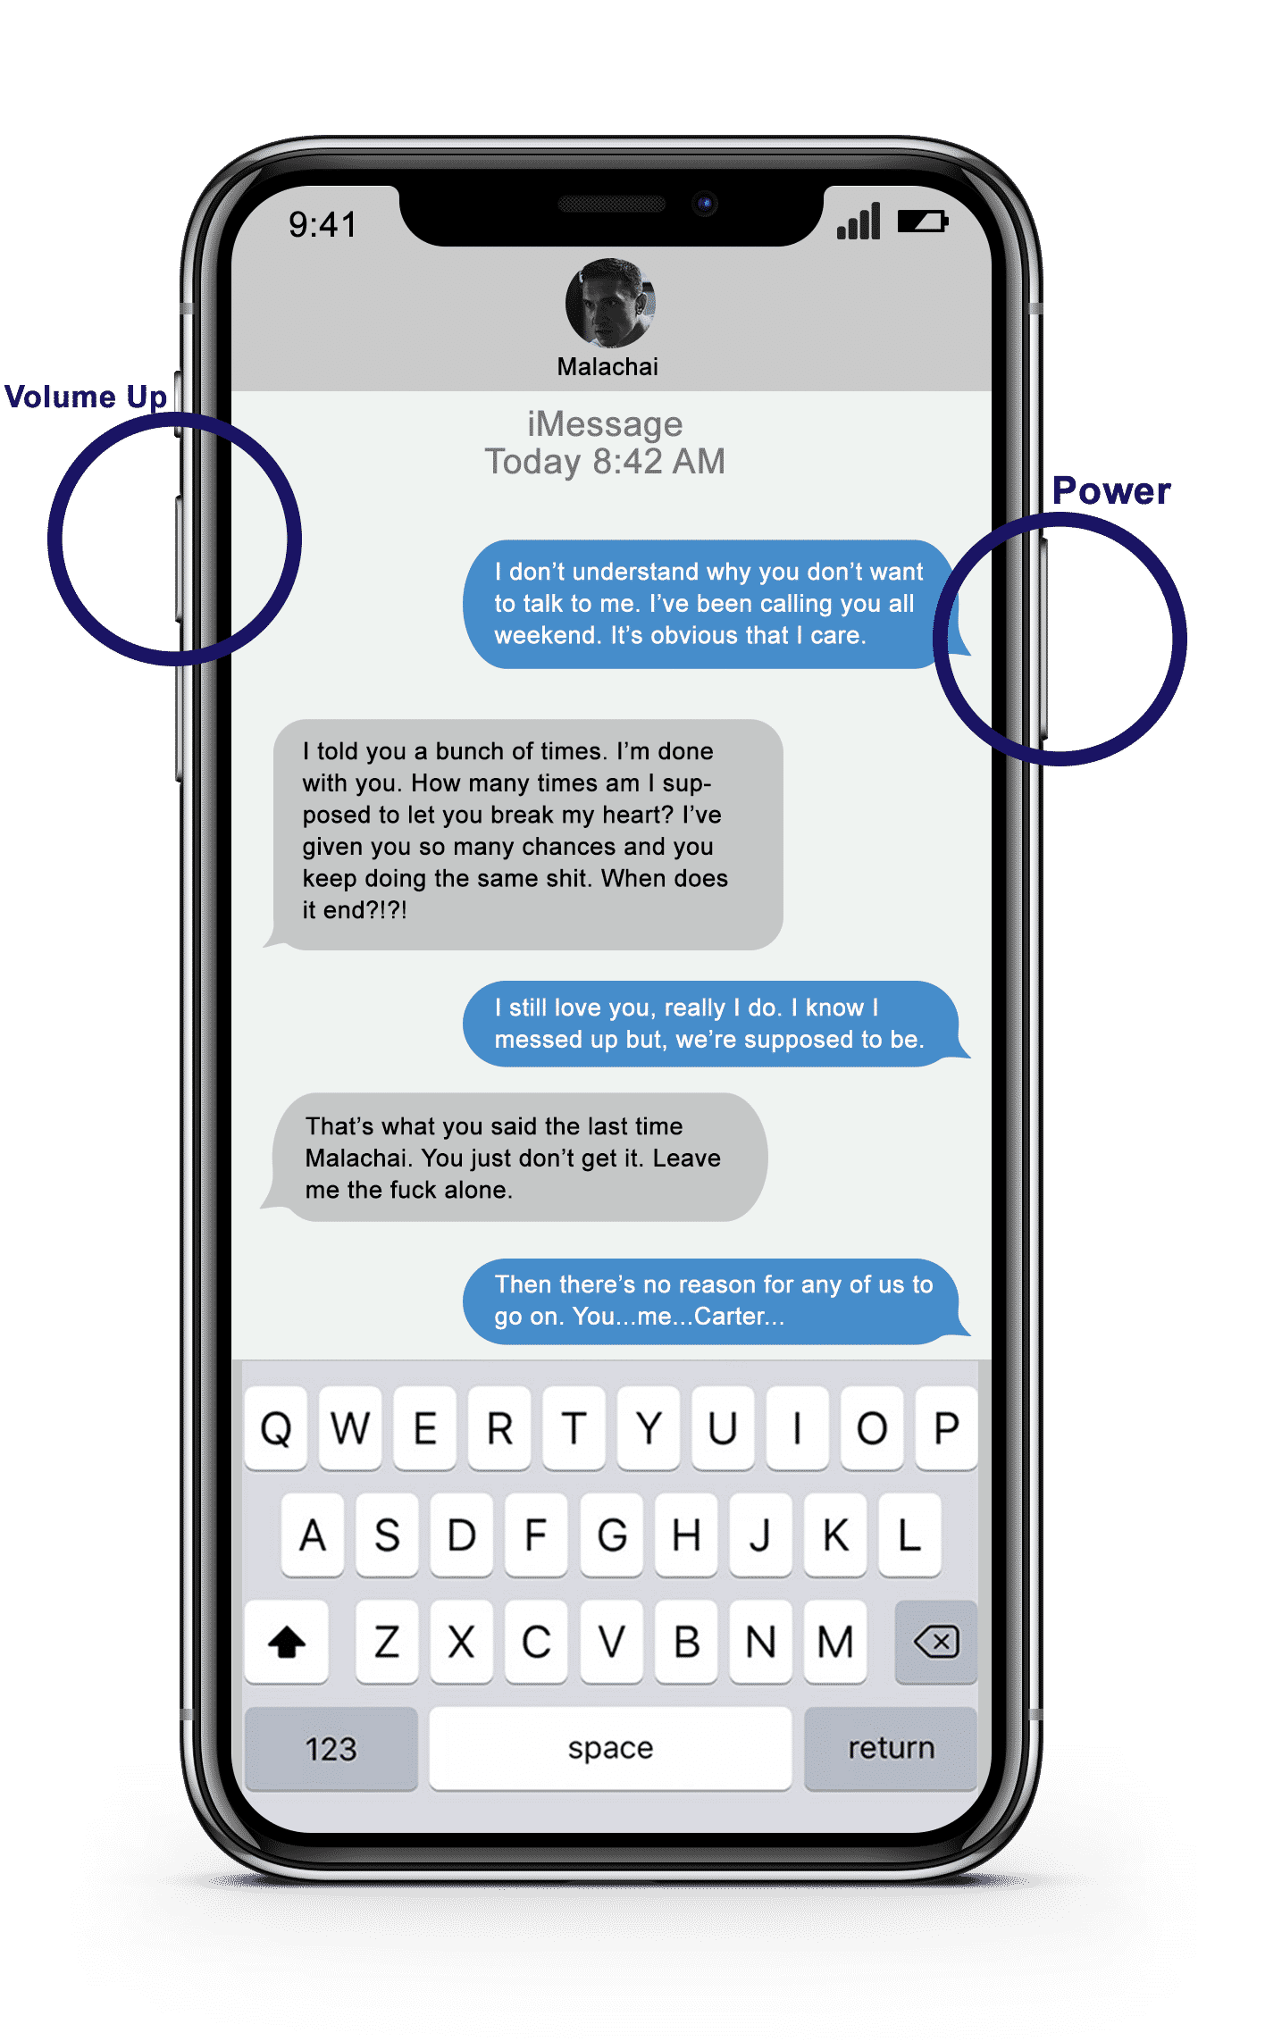
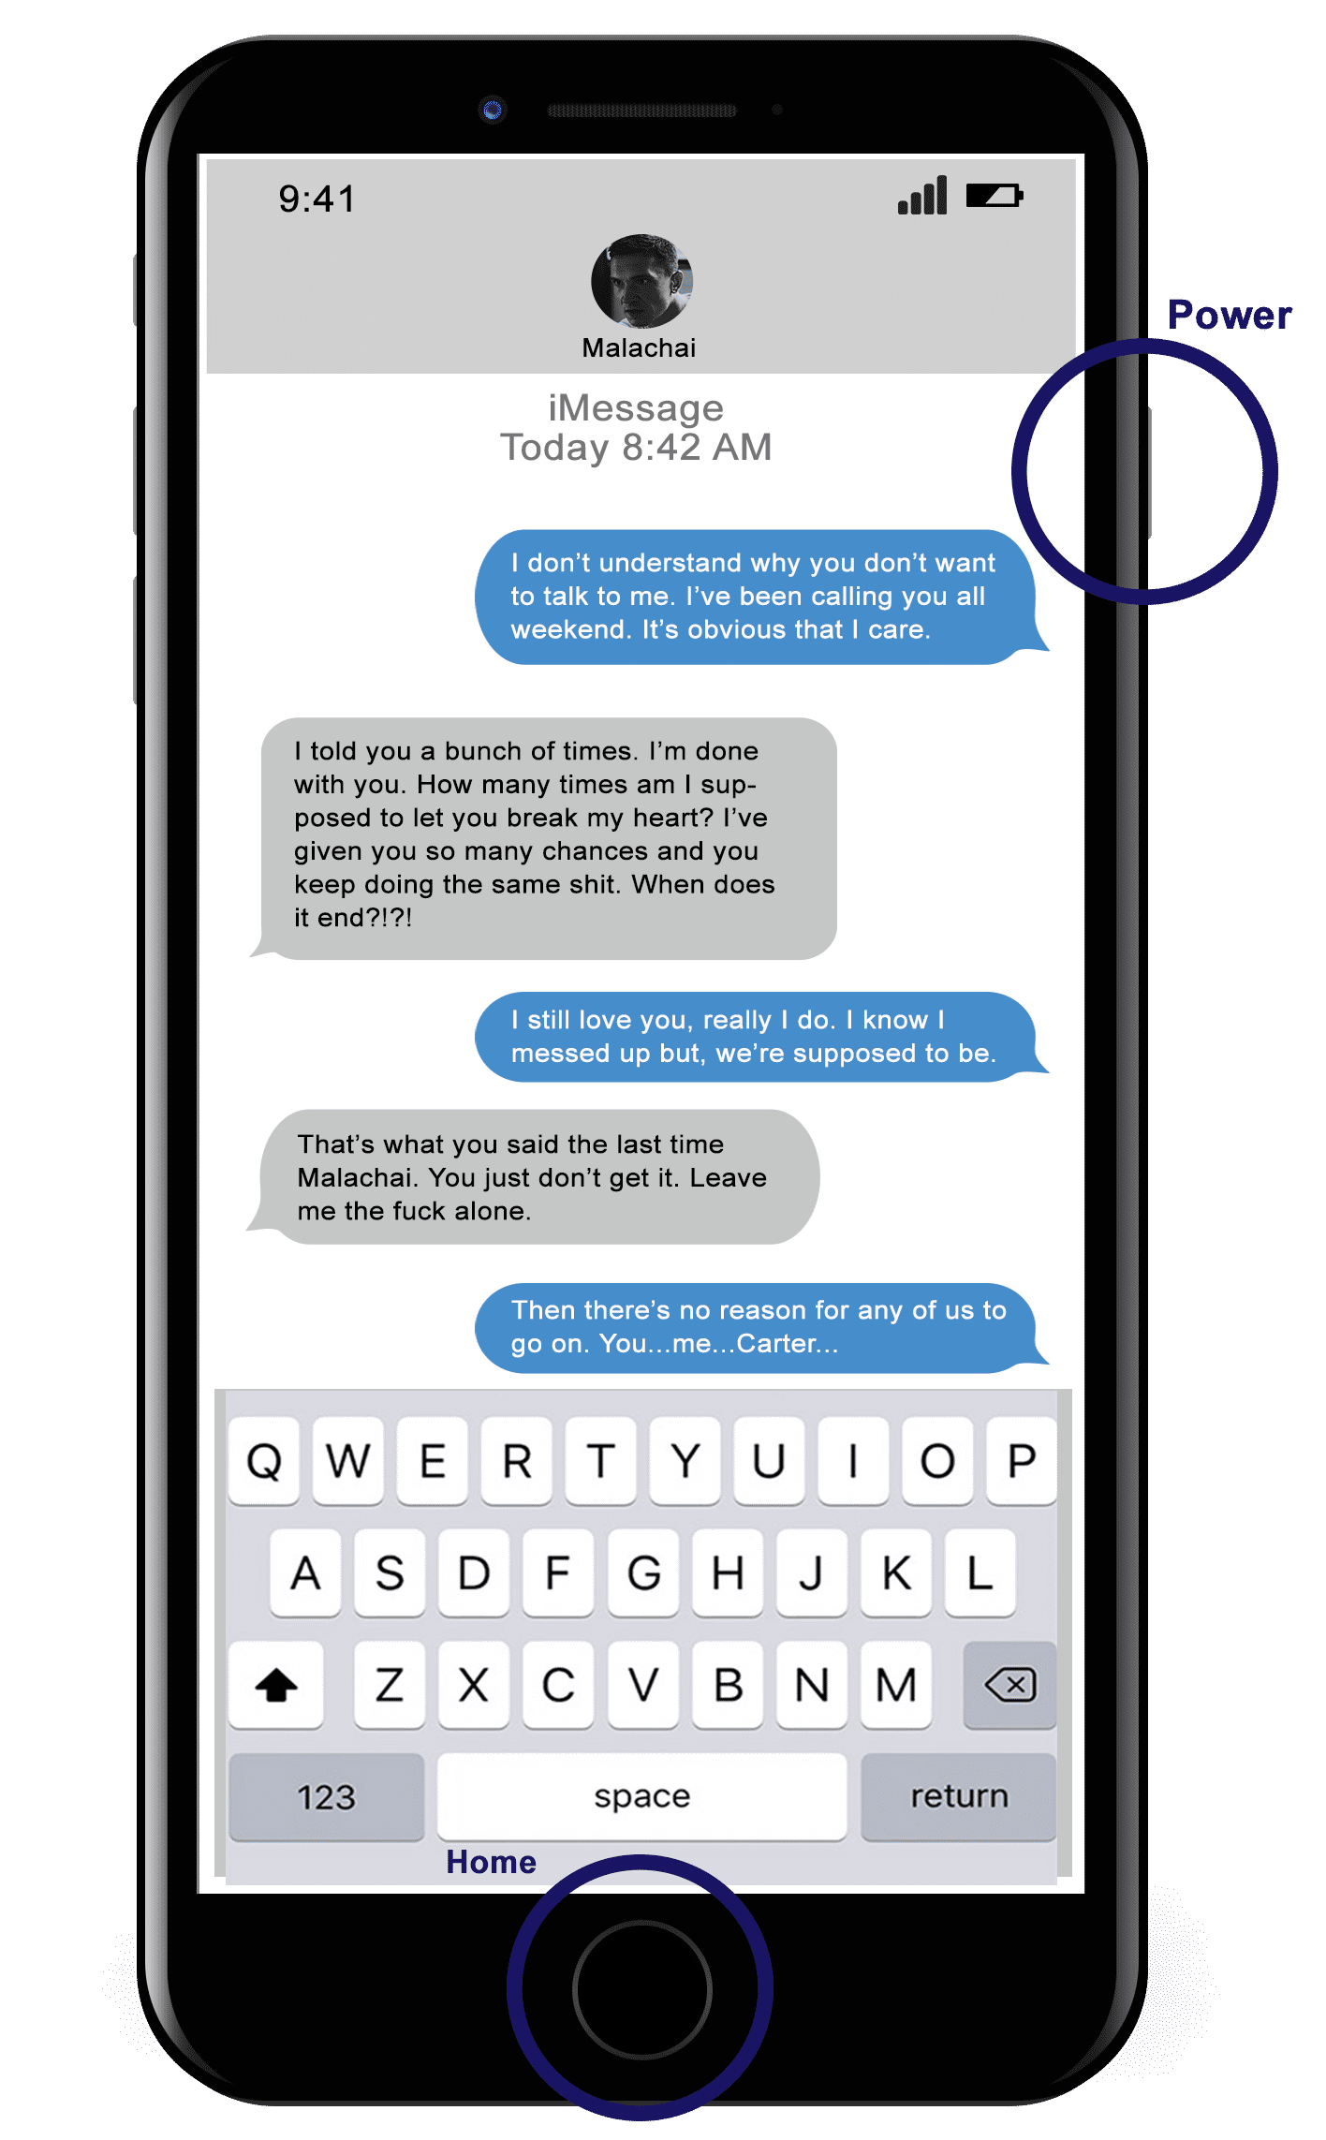
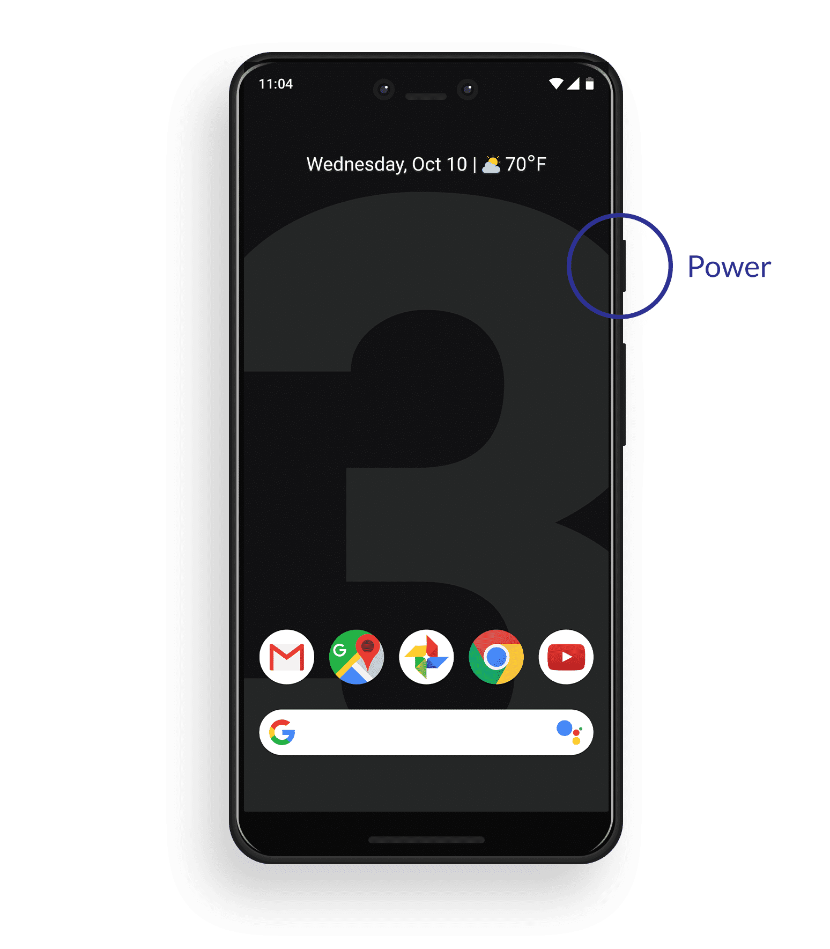
What to do if you are being stalked
Trust your instincts. Don’t let friends and family downplay a stalking situation.
Contact law enforcement if you fear for your safety.
Document everything.
Screenshot interactions
Take photos
Save emails
Log timeline of events
Notes:
Here are some things to consider in the event that you are being cyberstalked. Trust your instincts. Never let friends or family downplay your feelings about being cyberstalked. Cyberstalking can escalate from online harassment to physical violence. You can never be too cautious when it comes to cyberstalking.
Again, trust your instincts! The moment you start to fear for your safety because of a threatening message, phone call, or siting of the harasser, it is time to get law enforcement involved.
Document everything. Anything that will solidify your case with law enforcement will prove beneficial. Screenshot your text messages and other interactions. Take photos of letters sent or evidence that someone has been in your personal spaces. Save emails and other interaction types if possible. Create a timeline of events and keep a log of events that surround your cyberstalking experience.
(Source Accessed on 5/22/19)
https://www.stalkingawareness.org/what-to-do-if-you-are-being-stalked/

Slide 10
How to take a screenshot
iPhone X and new models
Open the app or screen you want to capture.
Set up everything exactly the way you want it for the shot.
Press and hold the Side button on the right side of iPhone X, iPhone XS, iPhone XS Max, or iPhone XZR.
Click the Volume Up button at the exact same time. (This replaces the Home button step from previous iPhones.)
The screen will flash white and you'll hear the camera shutter sound (if your sound is enabled).
The screenshot will be saved in your Albums Folder under "screenshots."
Notes:
I know most of you probably know how to take screenshots, but over the next few slides we will have a refresher on how to collect screenshots on some of the more common smart phones. The steps listed on this slide are specifically for the iPhone X and newer models.
Note: Talk through each of these steps with participants.

Slide 11
How to take a screenshot
iPhone 8 and older models
Open the app you want to screenshot and go to the exact screen you want to capture.
Press and hold the Power button on the right side and click the Home button at the exact same time. (This helps ensure you don't activate Touch ID or Siri by accident while trying to take your screenshot.)
The screen will flash white and you'll hear the camera shutter sound (if your sound is enabled).
If you're on iOS 10 or earlier, the screenshot will be saved to your All Photos album (or Camera Roll if you're not using iCloud Photo Library). If you're using iOS 11, this process will be slightly different.
Notes:
The steps listed on this slide are specifically for the iPhone 8 and older models.
Note: Talk through each of these steps with participants.

Slide 12
How to take a screenshot
Android Phones
Open the app or screen you want to capture.
Set up everything exactly the way you want it for the shot.
Press and hold the Power and Home buttons until a screenshot option appears or the screen flashes white.
When the screen flashes white, you'll hear the camera shutter sound (if your sound is enabled).
The screenshot will be saved to the internal memory on the device (location may vary).
Notes:
The steps listed on this slide are specifically for some of the more common Android phones.
Note: Talk through each of these steps with participants.

Slide 13
Do you feel Sarah was cyberstalked?
Yes or No
If yes, why?
If no, why?
Notes:
Now that we have covered some of the basics in terms of what is cyberstalking and what isn’t cyberstalking, do you feel Sarah was being cyberstalked?
Class participation
Facilitate a group discussion to determine if cyberstalking was present in their communications.
Do you feel Sarah was cyberstalked?
What steps could Sarah have taken to avoid being cyberstalked?
What could Sarah have done to document the events?

Slide 14



Victim Resources
National Center for Victims of Crime
victimsofcrime.org
Victim Connect Resource Center
victimconnect.org
Stalking Prevention and Resource Center
stalkingawareness.org
Notes:
There are a number of online resources that will assist victims of cyberstalking. On this slide we have listed a few. The National Center for Victims of Crime, the Victim Connect Resource Center, and the Stalking Prevention and Resource Center all have a lot of resources and contacts for those who are being cyberstalked. The links will take your directly to each of their homepages. All of these sites have a ton of resources, so please utilize these sites and navigate to the resource that best meets your needs.

Slide 15

QUESTIONS
Notes:
**Instructor Note: Ask the participants if they have any questions about cyberstalking, prevention tips, or how to report this type of crime.**

Slide 16
Graphics Credit
279655054 Copyright Pang-rum, 2019 Used under license from bigstockphoto.com
237667324 Copyright igor stevanovic, 2019 Used under license from bigstockphoto.com
272904592 Copyright photoguns, 2019 Used under license from bigstockphoto.com
175461025 Copyright Dean Drobot, 2019 Used under license from bigstockphoto.com
272904598 Copyright photoguns, 2019 Used under license from bigstockphoto.com
241343413 Copyright vmargineanu, 2019 Used under license from bigstockphoto.com

Slide 17
Bibliography
StalkingAwareness.org. “What to do if you are being stalked.” Accessed on 5/22/19. https://www.stalkingawareness.org/what-to-do-if-you-are-being-stalked/
Association for Progressive Communications. “How to avoid becoming a cyberstalking victim.” Accessed on 5/23/19. https://www.apc.org/en/pubs/issue/how-avoid-becoming-cyberstalking-victim
NORTON. “Cyberstalking: How to protect yourself against cyberstalking.” Accessed on 5/23/19. https://us.norton.com/internetsecurity-how-to-how-to-protect-yourself-from-cyberstalkers.html
US Department of Justice. Cyber Misbehavior. Accessed on 5/26/2019. https://www.justice.gov/usao/file/851856/download
StalkingAwareness.org. “Stalking Fact Sheet.” Accessed on 5/22/19. https://www.stalkingawareness.org/wp-content/uploads/2019/01/SPARC_StalkngFactSheet_2018_FINAL.pdf

