Slide 1








Internet of Things
This project was supported by Cooperative Agreement Number 2013-CK-WX-K027 awarded by the Office of Community Oriented Policing Services, U.S. Department of Justice. The opinions contained herein are those of the author(s) and do not necessarily represent the official position or policies of the U.S. Department of Justice. Reference to specific agencies, companies, products, or services should not be considered an endorsement by the author(s) or the U.S. Department of Justice. Rather, the references are illustrations to supplement discussion of the issues.
Notes:
Over the next 15-20 minutes I am going to be addressing the topic of the internet of things with a focus on smart homes and associated risks. With the growing number of smart homes, and smart devices within our homes, the risk of our personal data and safety being compromised increases. During this presentation I will discuss the Internet of Things, smart devices, the ways data can be compromised, and what we can do to protect our data and personal information.

Slide 2

Meet Wyatt
Graphic Designer
  45 years old
  Computer Savvy
  Recently built a smart home
College graduate
Hobbies
  Rebuilding computers
  Sketching/painting
  Playing guitar
Notes:
First let’s start the presentation by meeting Wyatt. Wyatt is a Graphic Designer at for a fortune 500 company. He graduated college with Bachelor’s degree in visual design. Wyatt recently relocated to take a new position at corporate headquarters. When he and his wife decided they would relocate for his new position, they also made the decision to build a new home rather than buy.
Wyatt has a number of hobbies, but he really enjoys rebuilding computers, sketching/painting, and playing the guitar.

Slide 3

Wyatt builds smart home
Wyatt’s home features the following smart devices:
  Lights
  Sound system
  Security system
  Thermostat
  Smoke and carbon monoxide detectors
  Appliances
Hi Jonathan! It sure does seem like we have a lot in common. I am a little busy over the next few days, but maybe I’ll message you Tuesday.
Sounds good! Looking forward to it!
Yeah me too! I’m free at 9pm.
Does that time work?
Perfect for me!
OK!
TTYL
Notes:
Wyatt’s new home features a number of smart features including lights, sound system, home security, thermostat, smoke detectors, and appliances.
Class participation
With a show of hands, how many of you have smart homes?
How many of you have smart devices in your home that assist you in daily life?

Slide 4
Wyatt’s home gets robbed
Wyatt contacts law enforcement
  Provides a list of missing items
  Details the events leading up to the robbery
  Informs officers about his smart home security
Wyatt never received any notifications from his home security
Wyatt did receive an email earlier in the day from Google Nest
Hi Jonathan! It sure does seem like we have a lot in common. I am a little busy over the next few days, but maybe I’ll message you Tuesday.
Sounds good! Looking forward to it!
Yeah me too! I’m free at 9pm.
Does that time work?
Perfect for me!
OK!
TTYL
Notes:
Unfortunately, after only living in his home for 6 months, Wyatt comes home from work to find his home has been burglarized. Wyatt immediately calls the police. After law enforcement arrives, he provides them with a list of missing items and the details leading up to the robbery. Wyatt also tells the responding officer about his home security system and that he never received any notifications of the break in. Wyatt then recalls he got an email about updating his Google Nest information. Google Nest is the system that controls all of the smart devices in his home.

Slide 5
Email from Google Nest
From: “Nest” <eddie@nestemail.com
Date: May 22, 2019 at 9:38 AM EST
Subject: Nest Security Alert
Someone is attempting to login to your Nest account.
Dear Customer,
Our records indicate that someone is attempting to hack your account. We recommend you login to your account and update your account settings. We have also added additional security setting that you can utilize to add extra layers of security to your account and home.
Visit the link below to update your account.
https://nestsecurityupdate.com/logininfo
Wyatt receives an email from Google Nest
Email indicates that someone is attempting to hack his account
Wyatt clicks the link in the email and provides his username and password
Hi Jonathan! It sure does seem like we have a lot in common. I am a little busy over the next few days, but maybe I’ll message you Tuesday.
Yeah me too! I’m free at 9pm.
Does that time work?
OK!
Notes:
The email Wyatt received from Nest indicated someone was attempting to hack his account and that he needed to login and change his password. Through a link in the email, Wyatt entered his current password and believed he was updating his account. Wyatt didn’t think anything else about it until he came home to find his home had been burglarized.

Slide 6
What is the Internet of Things (IoT)?
The internet of things (IoT) is a computing concept that describes the idea of everyday physical objects being connected to the internet and being able to identify themselves to other devices.
The term is closely identified with RFID as the method of communication, although it also may include other sensor technologies, wireless technologies or QR codes.
Notes:
What is the Internet of Things (IoT)?
Techopedia defines it as a computing concept that describes the idea of everyday physical objects being connected to the internet and being able to identify themselves to other devices. The term is closely identified with RFID as the method of communication, although it also may include other sensor technologies, wireless technologies or QR codes.
Most people don’t realize just how tied in they are to the “Internet of Things.” From the time we wake up from the alarm on our smart phone, to catching daily news feeds on their tablets, asking Alexa to play their wakeup playlist, then traveling to work in their smart vehicle. And that is just a start. On the next slide we will discuss some of the major smart devices that connect us to the internet.
Source accessed (5/21/19)
https://www.techopedia.com/definition/28247/internet-of-things-iot

Slide 7
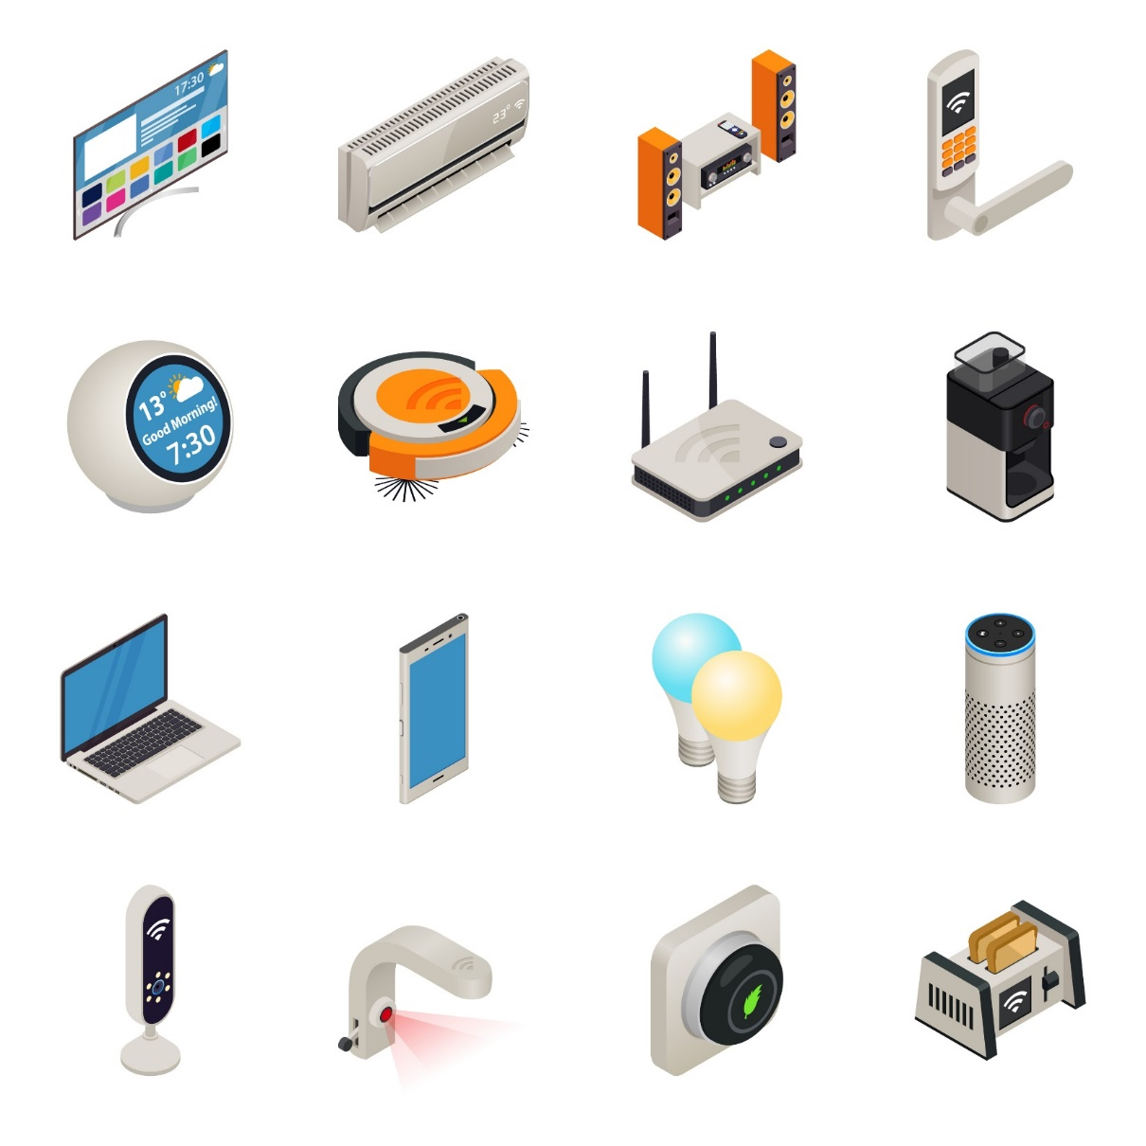
Smart Devices
Electronic devices that connect to other devices or networks using wireless protocols such as:
Bluetooth
Wi-Fi
NFC
LTE, 3G, 4G, 5G
Security
Television
Heating/Cooling
Stereos
Thermometers
Robots
Routers
Coffee Pot
Computers
Phones
Lights
Speakers
Cameras
Faucets
Thermostats
Appliances
Notes:
Smart devices are electronic devices that connect to other devices or networks using wireless protocols such as Bluetooth, WiFi, NFC, LTE, 3G, 4G, and 5G. On the right of the screen you will see some of the more common smart devices that we use and interact with in our lives daily.
Class participation
Can you think of any other smart devices that weren’t included in this list?
Vehicles/Cars
Wearable technology such as watches, glasses, fitbits, etc.
Medical devices such as insulin pumps, devices for monitoring asthma, pacemakers

Slide 8


to secure your smart devices
Give your router a name.
Use a strong encryption method for Wi-Fi.
Set up a guest network
Change default usernames and passwords
Use strong unique passwords for Wi-Fi networks and devices.
Disable features you aren’t using like remote access
Keep software up to date.
Monitor devices on your home network. Look for newer and more secure versions.,
Watch for outages that might affect the security of your smart home.
12 TIPS
Notes:
There are a number of things you can do to be proactive in securing your smart devices. Symantec released a list of some steps individuals can take to secure their smart devices.
1. Give your router a name.
Don’t stick with the name the manufacturer gave it — it might identify the make or model. Give it an unusual name not associated with you or your street address. You don’t want your router name to give away any personal identifiers.
2. Use a strong encryption method for Wi-Fi.
In your router settings, it’s a good idea to use a strong encryption method, like WPA2, when you set up Wi-Fi network access. This will help keep your network and communications secure.
3. Set up a guest network.
Keep your Wi-Fi account private. Visitors, friends and relatives can log into a separate network that doesn’t tie into your IoT devices.
4. Change default usernames and passwords.
Cybercriminals probably already know the default passwords that come with many IoT products. That makes it easy for them to access your IoT devices and, potentially, the information on them. Are you considering a device that doesn’t allow you to change the default password? Then consider a different one.
5. Use strong, unique passwords for Wi-Fi networks and device accounts.
Avoid common words or passwords that are easy to guess, such as “password” or “123456.” Instead, use unique, complex passwords made up of letters, numbers, and symbols. You might also consider a password manager to up your security game.
6. Check the setting for your devices.
Your IoT devices might come with default privacy and security settings. You might want to consider changing them, as some default settings could benefit the manufacturer more than they benefit you.
7. Disable features you may not need.
IoT devices come with a variety of services such as remote access, often enabled by default.
If you don’t need it, be sure to disable it.
8. Keep your software up to date.
When your smart phone manufacturer sends you a software update, don’t put off installing it. It might be a patch for a security flaw. Mobile security is important, since you may connect to your smart home through mobile devices. Your IoT device makers also may sent you updates — or you might have to visit their websites to check for them. Be sure to download updates and apply them to your device to help stay safe.
9. Audit the IoT devices already on your home network.
It could be time to upgrade that old security camera. Take time to check if newer models might offer stronger security.
10. Do the two-step.
We’re talking authentication. Two-factor authentication — such as a one-time code sent to your cellphone — can keep the bad guys out of your accounts. If your smart-device apps offer two-factor authentication, or 2FA, use it.
11. Avoid public Wi-Fi networks.
You might want to manage your IoT devices through your mobile device in a coffee shop across town. If you’re on public Wi-Fi — generally not a good idea — use a VPN. For instance, Norton Secure VPN offers a number of privacy and security features for both public and home Wi-Fi.
12. Watch out for outages.
Ensure that a hardware outage does not result in an unsecure state for the device.
No doubt more IoT devices are coming and will angle for a place in your home. If they make your life more convenient — even happier — great. But don’t forget to secure your increasingly smart home and your IoT devices.
Sources accessed (5/21/19)
https://us.norton.com/internetsecurity-iot-smart-home-security-core.html

Slide 9
Tips to protect your smart home
Use multifactor authentication
  Verification text messages
  Verification email messages
Complete security updates on all smart devices
Install malware protection
Don’t use public Wi-Fi
  Turn off “automatically connect” settings
Don’t keep your devices on the same network as your main computer
Change default usernames and passwords
Notes:
On the previous slide we listed some tips to secure your smart devices, now let’s focus specifically on protecting your smart home. If the option is available always opt to use a multifactor authentication such as text messages or emails. Be sure to keep up with security updates to your smart devices and home hub. Install malware protection to add another layer of security to your devices and home. Never connect your smart devices or hub to a public WiFi connection and be sure to disable the “automatically connect” settings. If possible, avoid keeping your devices on the same network as your main computer and always be sure to change your usernames and passwords from the default ones assigned by service providers.
Source Accessed on 5/21/19
https://www.marketwatch.com/story/7-ways-to-keep-your-smart-home-from-being-hacked-2016-10-17

Slide 10

Could Wyatt have prevented his situation?
Yes or No
If yes, why?
If no, why?
Notes:
Now that we talked about the internet of things and ways to protect yourself, do you feel Wyatt could have avoid?
Class participation
Facilitate a group discussion to determine if there were additional precautionary things Wyatt could have done to avoid his situation.
Do you feel that Wyatt could have avoided his smart home being compromised?
If yes, what could Wyatt have done differently?
If no, what appropriate measures did Wyatt take to secure his smart home and smart devices?

Slide 11



Resources
TechTarget – Definitions and Articles
Whatis.Techtarget.com
Latest Consumer Electronics
Cnet.com/smart-home
Consumer reports and product reviews
Consumerreports.org
Notes:
There are a number of online resources that will assist you in understanding IOT technology.
www.TechTarget.com
www.CNET.com
www.consumerreports.org
www.howstuffworks.com/home&garden/home improvement/alternative homes
On this slide we have listed a few. The National Center for Victims of Crime, the Victim Connect Resource Center, and the Stalking Prevention and Resource Center all have a lot of resources and contacts for those who are being cyberstalked. The links will take your directly to each of their homepages. All of these sites have a ton of resources, so please utilize these sites and navigate to the resource that best meets your needs.

Slide 12

QUESTIONS
Notes:
**Instructor Note: Ask the participants if they have any questions about IOT devices.

Slide 13
Graphics Credit
“94686637 Copyright fotographic 1980, 2015 Used under license from Shutterstock.com“, “214296676 Copyright master_art, 2015 Used under license from Shutterstock.com“,
“191298941 Copyright JENG_NIAMWHAN, 2015 Used under license from Shutterstock.com“, “224800615 Copyright JMiks, 2015 Used under license from Shutterstock.com“, “54522421 Copyright Alexander Raths, 2015 Used under license from Shutterstock.com“, " 214833409 Copyright jannoon028, 2015 Used under license from Shutterstock.com“, " 83947003 Copyright T33kid, 2015 Used under license from Shutterstock.com“, “108587627 Copyright chuckstock, 2015 Used under license from Shutterstock.com“, “110402225 Copyright Stokkete, 2015 Used under license from Shutterstock.com“, “186368387 Copyright bochimsang12, 2015 Used under license from Shutterstock.com“, “93881164 Copyright ULKASTUDIO, 2015 Used under license from Shutterstock.com“, “179022608 Copyright Steve Cukrov, 2015 Used under license from Shutterstock.com“, “180412982Copyright Hurst Photo, 2015 Used under license from Shutterstock.com“, “100466146 Copyright Kzenon 2015 Used under license from shutterstock.com“, “163888526 Copyright Peter Waters, 2015 Used under license from shutterstock.com“, “226628770 Copyright Rawpixel, 2015 Used under license from shutterstock.com“, “153213146 Copyright garriphoto, 2015 Used under license from Shutterstock.com“”4474129 Copyright Amy Dunn, 2018 Used under license from Bigstock.com”

Slide 14
Bibliography
NORTON. “IOT Smart Home Security.” Accessed on 5/21/19.
https://us.norton.com/internetsecurity-iot-smart-home-security-core.html
Paul, Kari. “7 ways to keep your smart home from being hacked.” MarketWatch. 7 July, 2018. Accessed on 5/21/19. https://www.marketwatch.com/story/7-ways-to-keep-your-smart-home-from-being-hacked-2016-10-17
Technopedia. “What is IOT?” Accessed on 5/21/19.
https://www.techopedia.com/definition/28247/internet-of-things-iot

