Slide 1
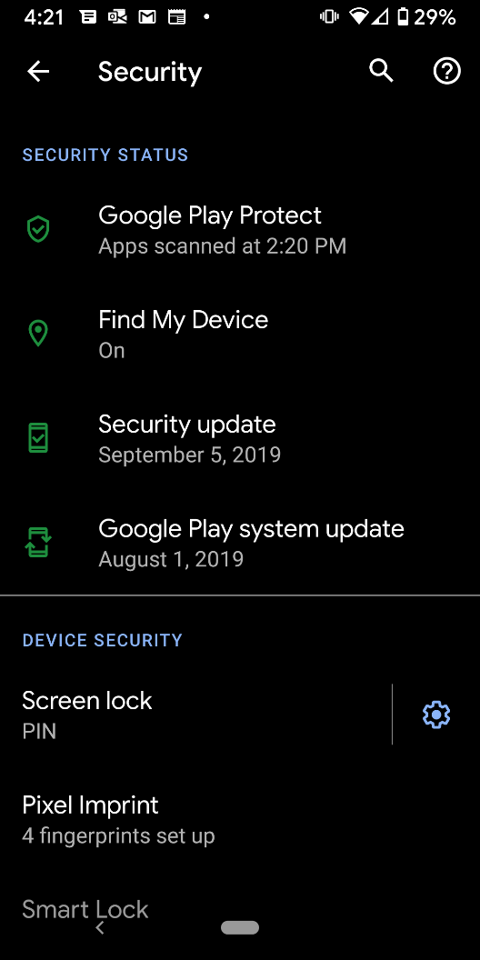
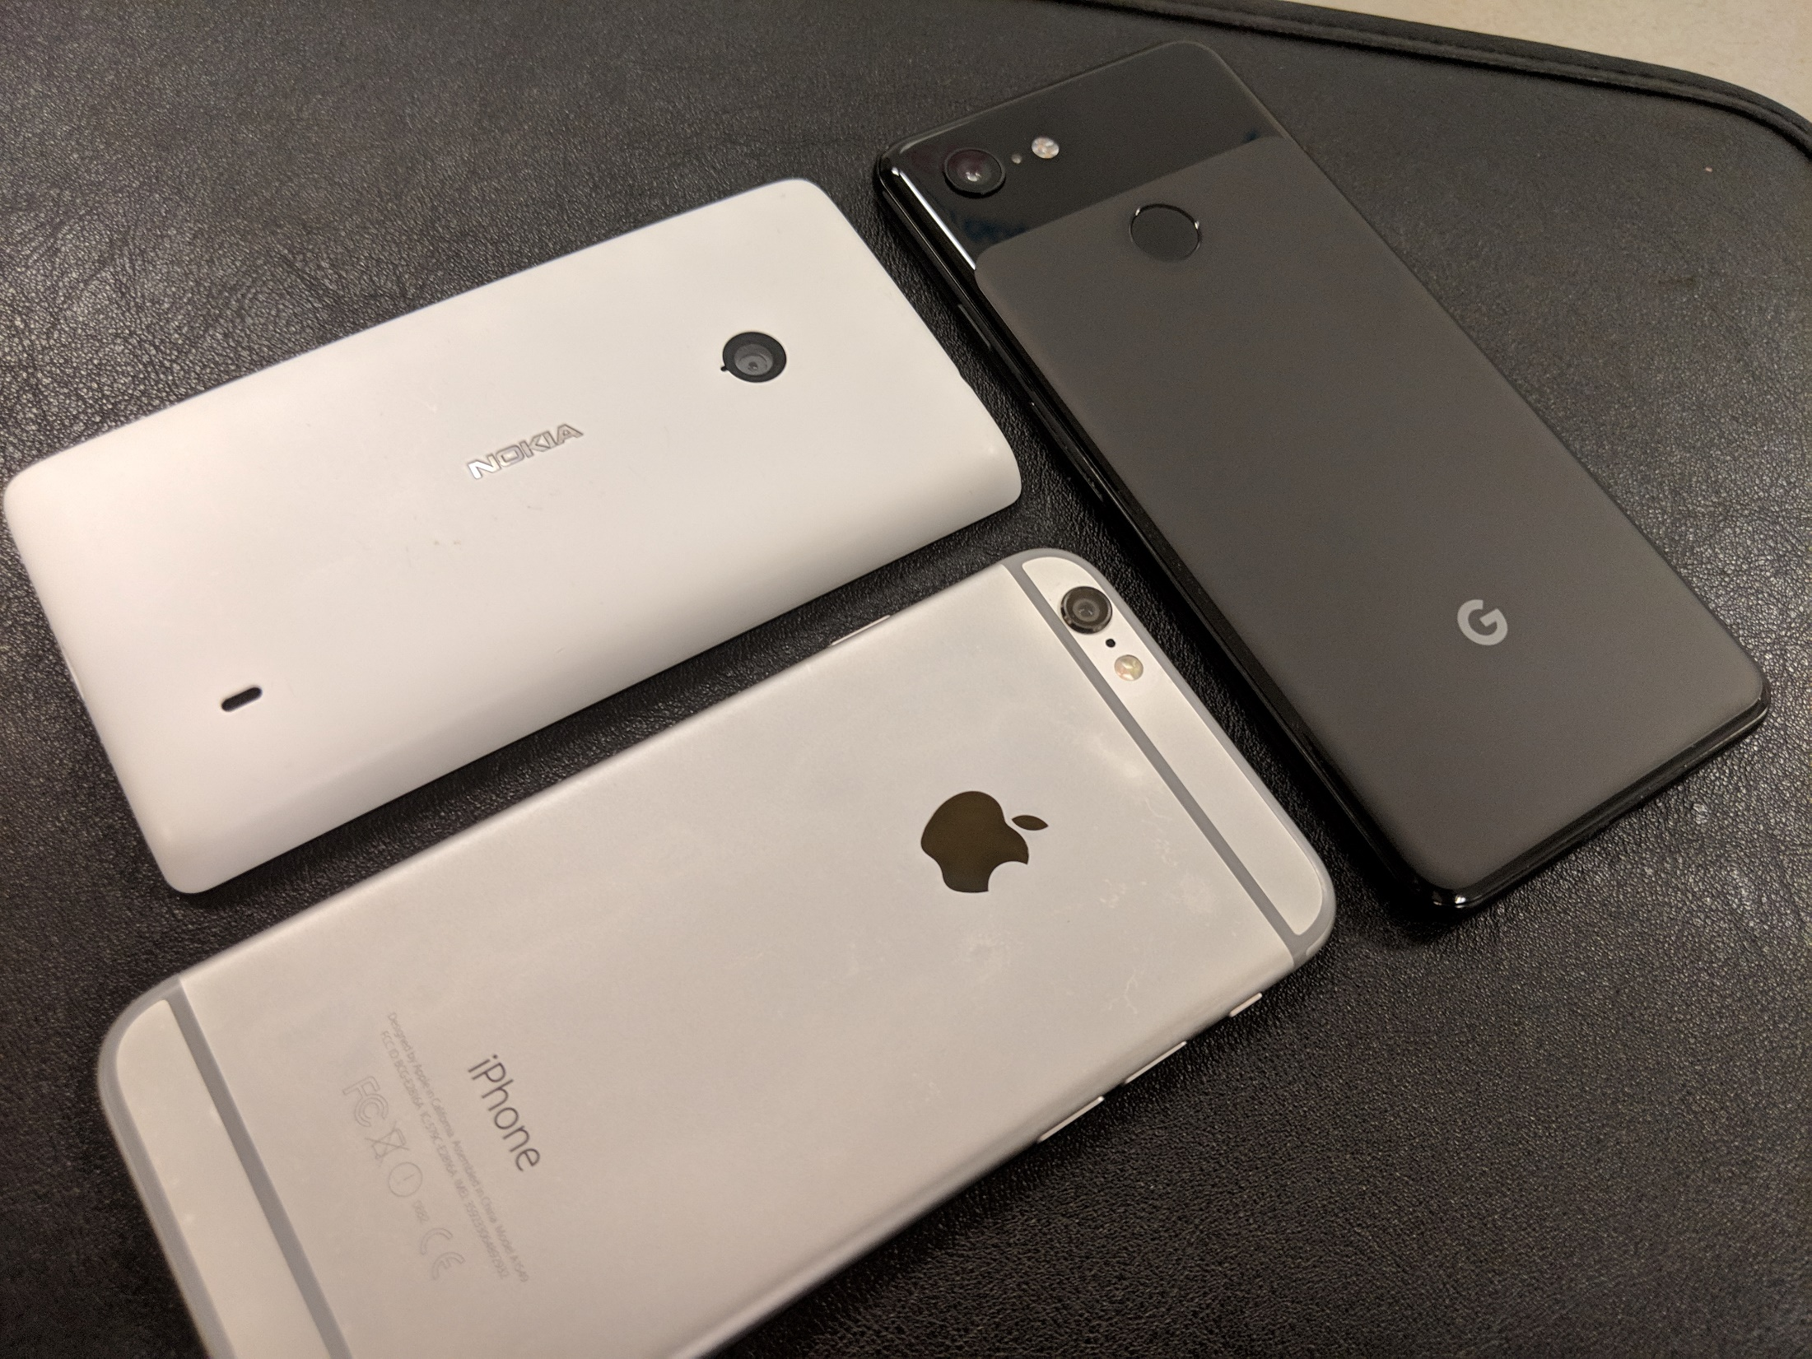





Securing your Smartphone
This project was supported by Cooperative Agreement Number 2013-CK-WX-K027 awarded by the Office of Community Oriented Policing Services, U.S. Department of Justice. The opinions contained herein are those of the author(s) and do not necessarily represent the official position or policies of the U.S. Department of Justice. Reference to specific agencies, companies, products, or services should not be considered an endorsement by the author(s) or the U.S. Department of Justice. Rather, the references are illustrations to supplement discussion of the issues.
Notes:
Over the next 15-20 minutes I am going to be addressing the topic of smartphone security and how to make sure your information is protected. Smartphone ownership is at an all-time high with new devices being released every month. As we rely more on our smartphones, they can collect large amounts of personal data on many aspects of our lives. In this presentation, I will help you understand the security features in your device and explain why it is important to utilize these features. I will also provide you with tips on how to recover a lost or stolen device.
I will briefly touch on how cloud storage services can reduce the impact in the event your device is damaged, lost, or stolen.

Slide 2
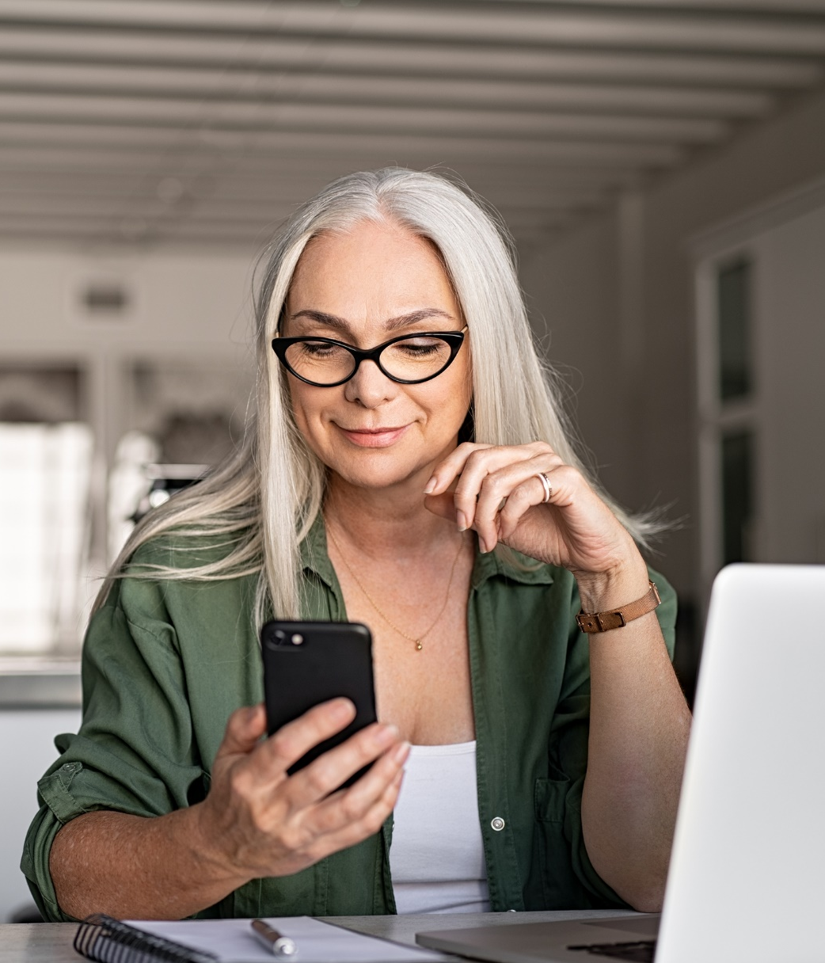
81%
of Americans
own a smartphone
What do you use your smartphone for?
Phone calls and texting
Streaming music and video
Social media
Photography
Online banking
Travel
Online shopping
Health management
Notes:
Poll the class: How many of you are carrying a smartphone right now?
According to the Pew Research Center – (on internet and technology) “Approximately 81% of Americans own smartphones.”
Additionally, nearly ¾ of U.S. adults now own desktop or laptop computers, and roughly ½ own tablets or e-reader devices.
Accessed on 9/25/2019: https://www.pewinternet.org/fact-sheet/mobile/
This slide highlights the high usage rate of smartphones among Americans.
What do we use smartphones for? (Allow the audience to chime in)
Phone calls and texting remain a primary use for phones, however, smartphones have quickly evolved into pocket computers that allow us to stay connected 24/7.
Netflix, Hulu, Cable Service Providers allow us to stream shows and movies
Facebook, Instagram, Reddit (Forums), Snapchat and other social media platforms allow us to stay connected and share content
Our smartphones feature cameras that capture high quality photos and videos that not only store information about our location, but use artificial intelligence to recognize who we are with.
Check your account balance, transfer funds, make payments with your bank’s mobile app on your smartphone. Even use a digital wallet to store your credit, debit and gift cards.
Make travel arrangements and board flights using mobile boarding passes displayed on your smartphone.
Access thousands of online marketplaces and retailers such as Amazon, Best Buy, Walmart, Target, Lowe’s, Macy’s, JCPenney’s, and more
Manage your health and fitness through a variety of apps and services offered by 3rd parties and health care providers.

Slide 3

Wyatt builds smart home
“I would be lost without my phone.”
“I don’t leave home without it.”
“It’s my lifeline!”
“I feel naked without it.”
Hi Jonathan! It sure does seem like we have a lot in common. I am a little busy over the next few days, but maybe I’ll message you Tuesday.
Sounds good! Looking forward to it!
Yeah me too! I’m free at 9pm.
Does that time work?
Perfect for me!
TTYL
Notes:
According to Hosting Facts: By 2019, 63.4 percent of all mobile phone users will access the Internet from their mobile phone.
https://hostingfacts.com/internet-facts-stats/#targetText=By%202019%2C%2063.4%20percent%20of,Internet%20from%20their%20mobile%20phone.&targetText=90%20percent%20of%20the%20time,to%2050.3%20percent%20from%202017.
How many of you feel this way about your smartphone? It’s not uncommon for people to rely on their smartphones to manage daily tasks and activities.
Image obtained from BIGSTOCKPHOTO.COM. Golubovy 302051089

Slide 4
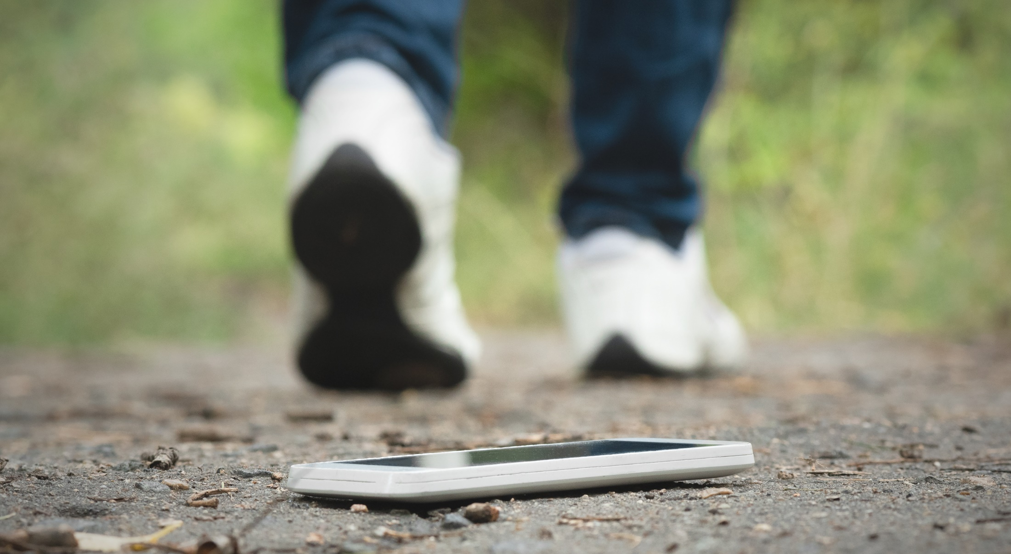
“I would be lost without my phone.”
“I don’t leave home without it.”
“It’s my lifeline!”
“I feel naked without it.”
Are you familiar with your smartphone’s security and privacy settings?
Hi Jonathan! It sure does seem like we have a lot in common. I am a little busy over the next few days, but maybe I’ll message you Tuesday.
Sounds good! Looking forward to it!
Yeah me too! I’m free at 9pm.
Does that time work?
Perfect for me!
OK!
TTYL
Notes:
Without a doubt, smartphones can store and access vast amounts of data about us. If your device is damaged, lost, or stolen, would you worry about someone accessing the data on it?
Have you done enough as a smartphone user to lower the risk of your data being compromised?
In this presentation, I will cover 5 features on your smartphone that will help you secure your data, and understand what data is being recorded and shared.

Slide 5


Identify your device and OS
There are 2 major operating systems
Manufactured by Apple
iPhone
Common models
  6, 7, 8, X (10), and 11
New OS annually
OS by Google
Various manufacturers
  Samsung, LG, Huawei, Moto, Google
New OS annually
Notes:
In understanding your security and privacy settings, you must first identify the type of device and OS (Operating System) you have. This baseline information is critical moving forward because you will see different options depending on the device they are using.
iOS and Android smartphones contain a number of security and privacy settings. However, these settings are often overlooked by new users. It is YOUR responsibility to know the security and privacy level of YOUR device.
Apple manufacturers the iPhone which runs iOS.
Samsung, Google, Huawei (pronounced wah way), LG, and Moto are all manufacturers of smartphones that run the Android operating system.
The operating systems are different, however both have security and privacy settings.
Your devices may be running different versions of their respective Operating System (OS’es). How to find this information using the steps below:
Helpful info:
Learn about your device by going to > Settings > About Phone or > Settings > General > About device.
You will find which particular model you are using and the software version.

Slide 6
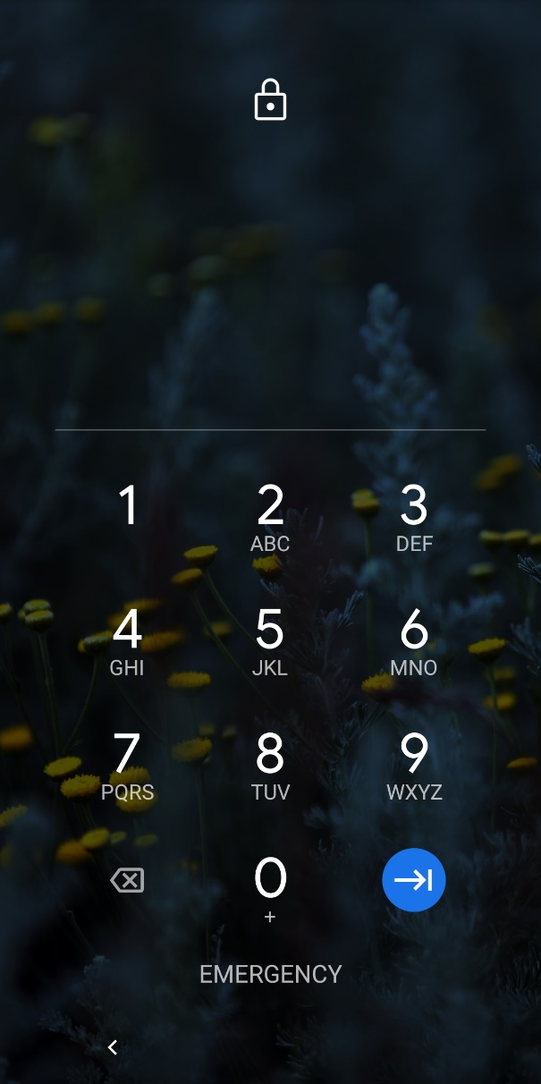
Security
Your password, pin, or fingerprint is your first line of defense in securing your device
If the device is restarted, the password or pin will need to be entered
User defined options for screen timeout and unsuccessful password attempts can be set
Hi Jonathan! It sure does seem like we have a lot in common. I am a little busy over the next few days, but maybe I’ll message you Tuesday.
Yeah me too! I’m free at 9pm.
Does that time work?
OK!
Notes:
Security
The security feature on your smartphone relates to the password, pin number, fingerprint, facial recognition used to unlock your device.
On both the iPhone and Android phones, it is suggested to create a fingerprint scan or image for facial recognition unlock. *Facial Recognition is improving, but it is possible for devices to be unlocked with a photograph. It is required to set a password or pin number to continue the setup process.
A smartphone’s features are limited and access to user data is restricted while a smartphone is locked. However, “Emergency calls to 911” may be placed from a locked device.
User Tips:
Set multiple layers of security with a pin/passcode AND fingerprint. You may add multiple fingerprints of the same finger or different fingers.
On iOS and Android phones, you can adjust the screen timeout options for locking the device. You can also set, “Pressing the Power button instantly locks the device.”
Unsuccessful attempts to access the device can trigger a screen lock, preventing further attempts and notify your Apple ID account or Google account.

Slide 7
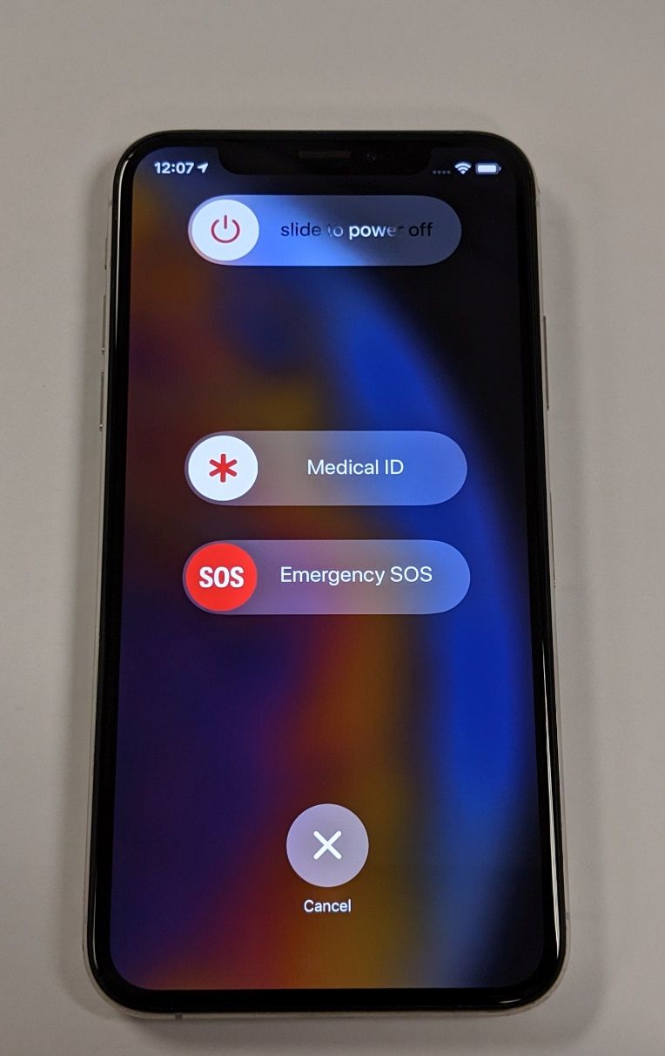
Emergency features
Pertinent life saving medical information regarding medications, allergies, etc.
Emergency SOS on iPhones can be configured to automatically call 911 when power button is pressed repeatedly 5 times
Emergency contacts can be set
Hi Jonathan! It sure does seem like we have a lot in common. I am a little busy over the next few days, but maybe I’ll message you Tuesday.
Yeah me too! I’m free at 9pm.
Does that time work?
OK!
Notes:
Security Continued.
Emergency features that are accessible from the security lock screen can be life saving in the event of an emergency. This feature allows the user or another person to quickly contact 911 or defined contacts. Important information about the smartphone user can also be entered under the emergency features.
User Tips:
Emergency information can be set by the user containing contact information, Blood type, or other special instructions.
What is Emergency SOS? Accessed on 9/25/2019
https://www.payetteforward.com/what-is-emergency-sos-on-an-iphone-heres-the-truth/#targetText=Emergency%20SOS%20on%20an%20iPhone,an%20emergency%20SOS%20slider%20appears.

Slide 8
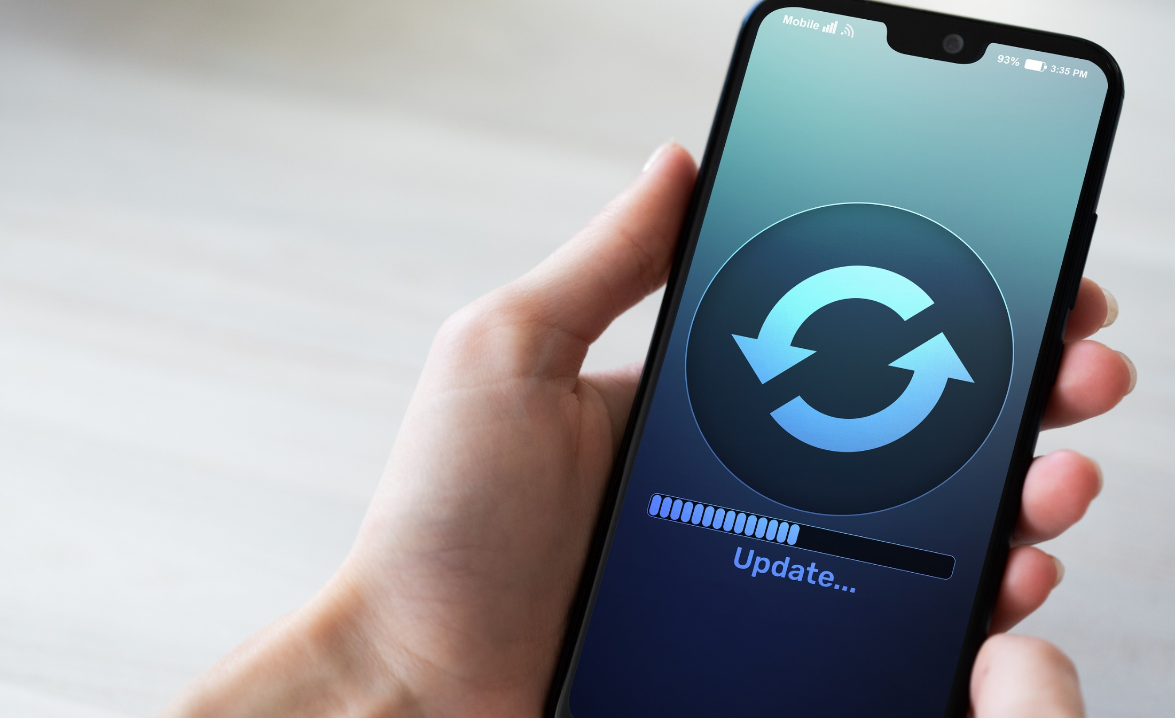
System updates
Users can set option to automatically update
Make sure the latest patches and fixes are installed
Check the manufacturer’s website
Update over wifi
Notes:
2. System Updates
By keeping your device updated, you are ensuring that the latest security patches and fixes are installed within your smartphone’s OS. Cyber criminals and fraudsters also recognize the amount of mobile traffic on the internet and thus target mobile users. Mobile user data can be targeted through malicious apps, websites, and links distributed through email or text messages.
User Tips:
Check your system updates screen in your settings to see if auto-updates are enabled or turned off.
On Android, go to Settings > System > Advanced > System update. You should see a message telling you your system is up to date. If you want to double-check, then hit the Check for update button.
Over in the land of iPhones and iPads, check for new updates in Settings > General > Software Update. If a new version of iOS is available, you can tap Download and Install; otherwise, you'll see a message saying everything is up to date.
PopularScience accessed on 9/25/2019. https://www.popsci.com/update-every-gadget/
In the latest iOS 12 or iOS13 update, Apple provided a new Automatic Updates option on the Software Update screen. If you enable it, the phone will automatically apply patches overnight, waiting until the device is idle, plugged into a power charger, and connected to a Wi-Fi network.
BIGSTOCKPHOTO.com Wrightstudio. 291322441.

Slide 9
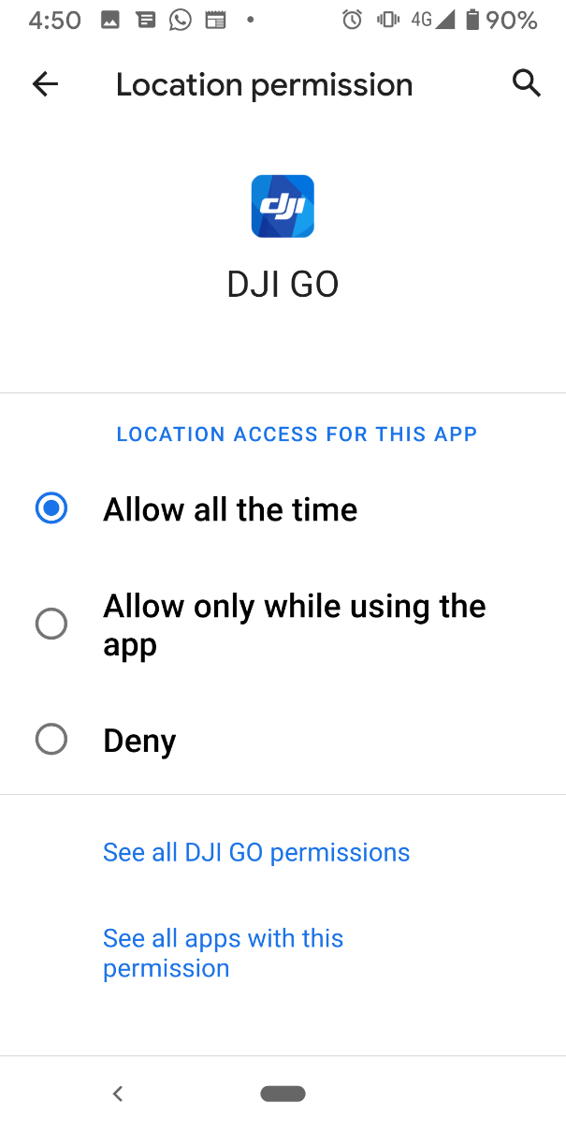
App Permissions
Know what apps are on your phone and what they do
App permissions govern what the app is allowed to do and access such as:
  Contact data
  Media files (images and videos)
  The camera (front and rear)
  Microphone
Permissions can be adjusted any time
Based on user comfort level
Hi Jonathan! It sure does seem like we have a lot in common. I am a little busy over the next few days, but maybe I’ll message you Tuesday.
Yeah me too! I’m free at 9pm.
Does that time work?
OK!
Notes:
3. APP Permissions (Applications – programs installed on your smartphone)
Depending on storage capacity, your smartphone has the capability to store and run hundreds of apps. It’s easy to install an app, breeze through the permissions, use the app several times, and forget it was installed.
It is strongly recommended that APPS be installed only from trusted sources, such as the Apple App Store or Google Play Store. Even in obtaining apps from those sources, malicious code or unnecessary permissions can be overlooked by quality control. On both the iPhone and Android phones, you can access a list of installed apps from the settings menu. By accessing apps in the settings menu, you’ll find more details than just the icon that is displayed in the APP tray or drawer.
PERMISSIONS relate to what you as the user allow the app to do.
As the name suggests, app permissions govern what your app is allowed to do and access. This ranges from access to data stored on your phone, like contacts and media files, through to pieces of hardware like your handset’s camera or microphone. Granting permission allows the app to use the feature. Denying access prevents it from doing so. Applications cannot automatically grant themselves permissions, they have to be confirmed by the user. Apps will ask you to accept each of their permissions the first time you launch them via a popup that asks you to “allow” or “deny” each request.
Well maintained modern apps will continue to function if you deny it a permission, although some features obviously won’t work. Often if you try to use a feature requiring a previously denied permission, you’ll see the permission popup appear again. There’s often no problems with denying app permissions you feel uncomfortable with, they always be changed later.
Android Authority. “What Android App Permissions Mean and How to Use Them. Accessed on 9/25/2019 https://www.androidauthority.com/app-permissions-886758/#targetText=As%20the%20name%20suggests%2C%20app,app%20to%20use%20the%20feature.
User Tips:
App permissions appear when you run an app for the first time. Before downloading an app, you should read user reviews and comments to find out more about their user experience. You may often find security conscious reviews regarding app permissions.
Also, consider the vendor of the app. Does the vendor have a good reputation with users? Does the vendor offer a suite of apps?

Slide 10


Location
Location services on both iOS and Android phones deal with more than GPS and Mapping Apps. With location services enabled, you are allowing Apple/Google to send you more information based on your physical location.
You are also allowing apps that utilize location services to track or report your location for app functionality or research.
Many apps have their own location settings which can be turned on or off.
Notes:
4. Location
On Android devices:
Manage your Android device’s location settings
When you have location turned on for your phone, you can get info based on its location, like commute predictions, nearby restaurants, and local search results.
When an app is using your phone’s location via GPS, the top of your screen shows Location.
Understand the location settings available on your phone: Google has a number of location-based services, including:
Location Accuracy for your Android device (a.k.a. Google Location Services): To get a more accurate location for your phone, learn how to turn on Location Accuracy.
Location History for your Google Account To see and manage the places your phone has been, learn how to turn on Location History.
Location Sharing for Google Maps: To let others see where your phone is, learn how to share your real-time location via Google Maps.
Note: Apps have their own settings. Learn how to manage app location settings.

Slide 11
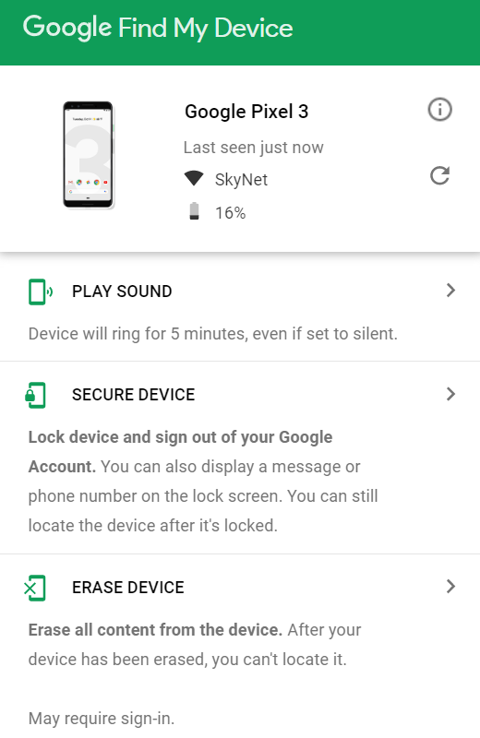
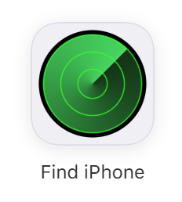
Tips to recover a lost smartphone
Familiarize yourself with iCloud’s find my iphone, Google’s find my phone, or Samsung’s find my mobile
Enable location services on your device
Turn on feature to lock, ring, or remotely wipe your device
Notes:
We all can imagine that it would be extremely stressful to lose our smartphone. It only takes a moment to leave it on the counter at a store and walk away or have it stolen from your pocket on a busy street, or from your car. Regardless of how you lose it, through theft or an honest mistake: follow these tips to recover your device.
USER Tip: Keep in mind that Apple (iCloud) and Google One, as well as a number of other 3rd party cloud services exist. At the very minimum, you want to make sure your contact list is backed up. You don’t want to be that person on social media posting, “I lost my phone, please send me your numbers.” Utilizing cloud storage ensures that your valuable files and data are stored in a remote location. This reduces the impact of a lost or stolen phone.
While smartphones cost hundreds of dollars, the most important thing is the data they contain. If you cannot recover a lost or stolen smartphone, you at least have access to your data.
Other Tips:
Keep your phone charged – The longer the battery lasts, the greater chance you have of finding it.
Customize a lock screen message with instructions on how to contact you. Email is recommended.
If you suspect theft, contact local law enforcement and provide them the information you have. (Do not confront thieves or agree to meet at a location other than a police station.)
Contact your carrier and file an insurance claim.
CNET. This is how you get your smartphone back fast. Accessed on 9/25/2019. https://www.cnet.com/how-to/this-is-how-you-get-your-lost-or-stolen-android-phone-back-fast/#comments

Slide 12

Resources
Apple iCloud
www.icloud.com
Google Android
www.android.com
Your smartphone is YOUR responsibility. Explore your devices features, options, menus, app permissions, location-based services, and security.
Notes:
There are a number of online resources to help you understand smartphone security and the capabilities of your smartphone.
Visit: www.imore.com for Apple iPhone related news and discussions
Visit: www.androidcentral for Android phone related news and discussions
Apple.com or visit an Apple Store to speak with a specialist.
You may also visit your cellular service provider – carrier store for more information on your device.

Slide 13

QUESTIONS
Notes:
**Instructor Note: Ask the participants if they have any questions about smartphone security, or how to learn more about the device they are using.
www.apple.com
www.android.com

Slide 14
Graphics Credit
291322441. Wrightstudio. Used under license from BigStockPhoto.com
322491415. Iskorka. Used under license from BigStockPhoto.com
302051089. Golubovy. Used under license from BigStockPhoto.com
312721969. Rido81. Used under license from BigStockPhoto.com

Slide 15
Bibliography
Pew Research Center. Accessed on 9/25/2019: https://www.pewinternet.org/fact-sheet/mobile/
CNET. This is how you get your smartphone back fast. Accessed on 9/25/2019. https://www.cnet.com/how-to/this-is-how-you-get-your-lost-or-stolen-android-phone-back-fast/#comments
Android Authority. “What Android App Permissions Mean and How to Use Them. Accessed on 9/25/2019. https://www.androidauthority.com/app-permissions-886758/#targetText=As%20the%20name%20suggests%2C%20app,app%20to%20use%20the%20feature.
Payette Forward. “What is Emergency SOS?” Accessed on 9/25/2019.
https://www.payetteforward.com/what-is-emergency-sos-on-an-iphone-heres-the-truth/#targetText=Emergency%20SOS%20on%20an%20iPhone,an%20emergency%20SOS%20slider%20appears.
Popular Science. “Update Your Smartphone.” Accessed on 9/25/2019. https://www.popsci.com/update-every-gadget/

