Slide 1






The Opioid Epidemic
This project was supported by Cooperative Agreement Number 2013-CK-WX-K027 awarded by the Office of Community Oriented Policing Services, U.S. Department of Justice. The opinions contained herein are those of the author(s) and do not necessarily represent the official position or policies of the U.S. Department of Justice. Reference to specific agencies, companies, products, or services should not be considered an endorsement by the author(s) or the U.S. Department of Justice. Rather, the references are illustrations to supplement discussion of the issues.
Notes:
Over the next 15-20 minutes I will be discussing the opioid epidemic . With the increase of opioid abuse, we should all be informed about the factors within this current epidemic. During this presentation I will cover what opioids are, what they used for, the common types of opioids, the indicators of opioid addiction, and national hotlines created for helping individuals who are effected by opioids.

Slide 2
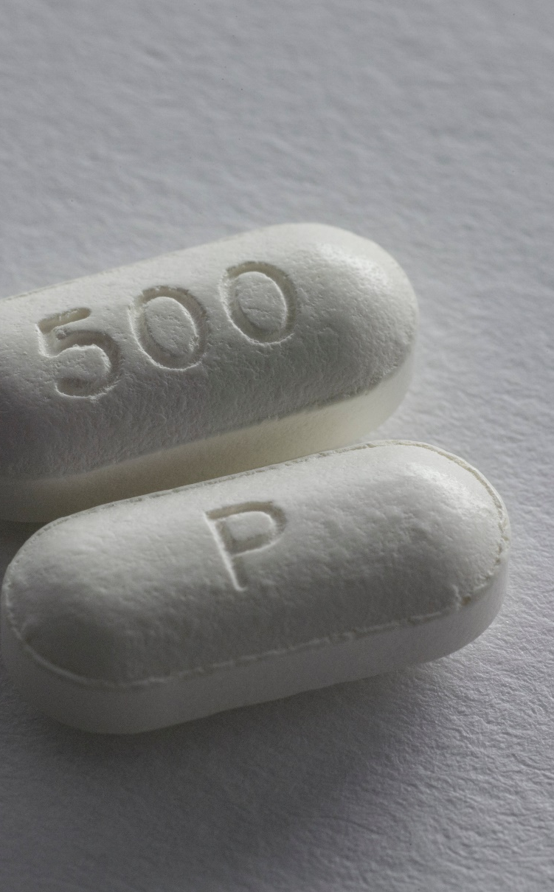
What are opioids?
A category of drugs that involve heroin and synthetic opioids
Synthetic opioids are prescribed by medical professionals to help relieve pain in patients
Medical professionals often prescribe opioids to individuals with acute or chronic pain due to a disease, surgery or injury
Notes:
To start this presentation, let’s begin discussing what opioids are and what their purpose is. Opioids are a category of drugs that involve heroin and synthetic opioids. Synthetic opioids are prescribed by medical professionals to help relieve pain. When they are taken as directed, they fulfill their purpose, but when taken recreationally they can be become addictive. Medical professionals often prescribe opioids to individuals with acute or chronic pain due to a disease, surgery or injury. They are also prescribed to individuals with moderate to severe coughs and diarrhea. Methadone and buprenorphine are commonly used when treating addiction to other opioids, such as heroin.
(Accessed on September 25, 2019.)
https://www.hhs.gov/opioids/prevention/index.html
https://choicesforchange.ca/client-resources/alcohol-and-drug-information/opioids/

Slide 3

Why is there an epidemic?
Based on the increase of deaths and hospitalizations due to the abuse of opioid prescriptions and illegal drugs
Pharmaceutical companies increased production and sales of opioids in the late 90s
The pharmaceutical companies believed that the opioids would not become addictive when being used for pain relief
Hi Jonathan! It sure does seem like we have a lot in common. I am a little busy over the next few days, but maybe I’ll message you Tuesday.
Yeah me too! I’m free at 9pm.
Does that time work?
OK!
Notes:
Now that we have an idea of what opioids are, let’s discuss why and when the epidemic began. The opioid epidemic is based on the increase of deaths and hospitalizations due to the use of opioid prescriptions and illegal drugs.
Increased distribution of opioids as a pain management drug by pharmaceutical companies in the late 90s is also believed to be a contributing factor. The pharmaceutical companies believed that the opioids would not become addictive when being used for pain relief. Due to the statements made by the pharmaceutical companies, medical professionals began to prescribe them in high volume. The high volume of prescriptions resulted in mass misuse of the opioids which created the conclusion that they are in fact addictive.
(Accessed on September 25, 2019)
https://www.addictioncenter.com/opiates/opioid-epidemic/
https://www.drugabuse.gov/drugs-abuse/opioids/opioid-overdose-crisis

Slide 4

Recent Statistics
47,000 lives lost
In 2017, the most recent year for which data is available, opioid overdoses killed more than forty-seven thousand people
A nearly 21 percent rise in deaths involving methamphetamine — to 12,987 in 2018, from 10,749 in 2017
Causes of death were abuse of prescription opioids, heroin, and illicitly manufactured fentanyl, a powerful synthetic opioid
Notes:
This slide discusses the most recent statistics regarding the effects of the national opioid epidemic.
Read through the statistics
“In 2017, the most recent year for which data is available, opioid overdoses killed more than forty-seven thousand people, or more than six times the number of U.S. military service members killed in the post-9/11 wars in Iraq and Afghanistan.” – Claire Felter, Council of Foreign Relations
“A nearly 21 percent rise in deaths involving methamphetamine — to 12,987 in 2018, from 10,749 in 2017 — has officials at every level of government concerned.”- New York Times
“In 2017, more than 47,000 Americans died as a result of an opioid overdose, including prescription opioids, heroin, and illicitly manufactured fentanyl, a powerful synthetic opioid.”- National Institute of Drug Abuse
(Accessed on September 25, 2019)
https://www.cfr.org/backgrounder/us-opioid-epidemic
https://www.nytimes.com/interactive/2019/07/17/upshot/drug-overdose-deaths-fall.html
https://www.drugabuse.gov/publications/drugfacts/prescription-opioids

Slide 5

Projections
Mental health and substance abuse treatment expenditures expected to reach $280.5 billion by 2020
The total number of opioid overdose deaths in the United States will increase from 33,100 in 2015 to 81,700 by 2025
Between 2016 and 2025, 700,400 individuals will die from opioid overdose, with 80% of the deaths attributable to illicit opioids
Notes:
This slide discusses the expected statistics regarding the effects of the national opioid epidemic.
Read through the statistics
“According to SAMHSA, mental health and substance abuse treatment expenditures totaled $171.7 billion in 2009. This is expected to reach $280.5 billion by 2020.” – Nursing 2019
“We projected that under the status quo, the total number of opioid overdose deaths in the United States will increase from 33,100 in 2015 to 81,700 by 2025.” – Jama Network Open
“We estimated that between 2016 and 2025, 700,400 individuals will die from opioid overdose, with 80% of the deaths attributable to illicit opioids. – Jama Network Open
(Accessed on September 25, 2019)
https://journals.lww.com/nursing/Fulltext/2019/05000/Evolution_of_the_national_opioid_crisis.14.aspx
https://jamanetwork.com/journals/jamanetworkopen/fullarticle/2723405

Slide 6

Where do opioids come from?
Morphine and Codeine come from the natural gummy substance produced from the seed pod of the opium poppy, grown in South Asia
Heroin is created by mixing morphine and other chemicals
Aside from the natural aspect to opioids, they are now mostly created synthetically from chemicals
Notes:
So far we have learned about why the opioid epidemic begin and what it is. Now, let’s dive into where the actual opioid drugs originate from. From a natural perspective, Morphine and Codeine come from the natural gummy substance produced from the seed pod of the opium poppy, grown in South Asia. Heroin is created by mixing morphine and chemicals. Aside from the natural aspect to opioids, they are now mostly created synthetically from chemicals.
(Accessed on September 25, 2019)
https://choicesforchange.ca/client-resources/alcohol-and-drug-information/opioids/

Slide 7

What are some commonly prescribed opioids?
Fentanyl
Oxycodone
aka OxyContin or Percocet
Hydrocodone
aka Vicodin
Codeine
Morphine
aka Kadian or Avinza
Oxymorphone
aka Opana
Notes:
There are various opioids in the medical field, but the following opioids are the ones commonly prescribed: Fentanyl, Oxycodone, also known as OxyContin or Percocet, Hydrocodone, also known as Vicodin, Codeine, Morphine, also known as Kadian or Avinza, and Oxymorphone, also known as Opana.
(Source Accessed on September 25, 2019)
https://www.drugabuse.gov/drugs-abuse/opioids/opioid-overdose-crisis

Slide 8
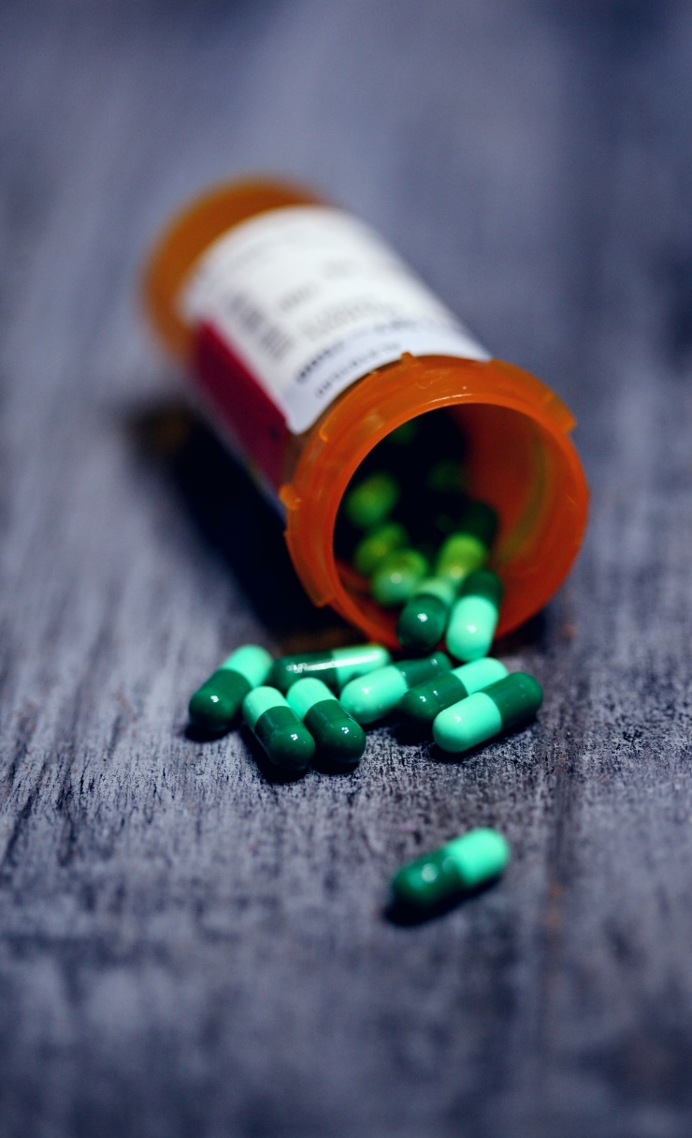
Safe opioid disposal
Return unused drugs to any local pharmacy
Check the FDA medication flush list to determine if the drugs are safe to flush
If discarding in the trash, remove labels and indicators from prescription bottle
Notes:
When individuals are prescribed an opioid, they do not always finish the prescribed amount. Therefore, the surplus, whether is be expired or unused, of opioids should by disposed of immediately. Here are a few possibilities to consider when disposing opioids. The best way to dispose of extra, unused, or expired opioid medication is to take it back to the pharmacy as soon as possible. If finding a pharmacy is not an option, then checking the FDA medication flush list is the course of action.
If the medication is listed on the FDA flush list, then flush the medication immediately. If the medication is not on the flush list, then the last resort to throw the medication in the trash.
(Accessed on September 25, 2019)
https://www.fda.gov/drugs/safe-disposal-medicines/disposal-unused-medicines-what-you-should-know

Slide 9

Indicators of drug addiction
Isolation from family, friends, and/or co-workers
Loss of interest in activities/social events
Decline in hygiene
Depression
Increased appetite
Highly energetic, talking quickly, and slurred speech
Irritable, anxious, quick to anger or change mood
Inconsistent sleep schedule
Neglect of priorities in life including school and work
Financial troubles
Here are some behavioral indicators that are commonly associated with drug abuse.
*These indicators alone cannot be used to determine the abuse or addiction of opioids or other drugs.
Notes:
When it comes to the topic of the opioid epidemic, the issue of opioid abuse is significant. Over the next few slides, we will go over the possible indicators of opioid addiction, opioid withdraw, and opioid overdose. Possible symptoms of addiction to opioids are spending more time alone and avoiding time with loved ones, loss of interest in activities, decline in hygiene, feeling more drained and unhappy, an increase in appetite, being highly energetic, talking quickly, and not making sense with words, being irritable, anxious, or moody, having an unorganized sleep schedule , having a lack of priorities in life including school and work, and experiencing financial troubles
(Accessed on September 25, 2019)
https://www.asahq.org/whensecondscount/pain-management/opioid-treatment/opioid-abuse/

Slide 10
Indicators of drug withdrawal
Craving the effects of the drug
Anxious or irritable behavior
Abdominal pain
Vomiting
Diarrhea
Shivering
Being cold
Here are some behavioral indicators that are commonly associated with drug withdrawal.
*These indicators alone cannot be used to determine the abuse or addiction of opioids or other drugs.
Notes:
The following symptoms are focused on opioid withdraw: Craving the effects of the drug, anxious or irritable behavior, abdominal pain, vomiting, diarrhea, shivering, and being constantly cold
(Accessed on September 25, 2019)
https://www.asahq.org/whensecondscount/pain-management/opioid-treatment/opioid-abuse/

Slide 11
Indicators of drug overdose
Here are some indicators that are commonly associated with drug overdoses cases.
*These indicators alone cannot be used to determine the abuse or addiction of opioids or other drugs.
Quick, low breathing
Powerful drowsiness
Unable to speak
A blue tint to skin and lips
Snoring related sounds
If you suspect that someone is experiencing a drug overdose, call 911 immediately.
Notes:
The following symptoms are focused on opioid overdose: quick, low breathing, powerful drowsiness, unable to speak, a blue tint to skin and lips, and snoring related sounds.
If you suspect that someone is experiencing a drug overdose, immediately call 911.
(Accessed on September 25, 2019)
https://www.asahq.org/whensecondscount/pain-management/opioid-treatment/opioid-abuse/

Slide 12

Finding help
Substance Abuse and Mental Health Services Administration National Helpline (SAMHSA)
For families or individuals having problems involving drugs and mental health.
National Alcoholism and Substance Abuse Center (NASAIC)
Provides a list of drug and alcohol treatment centers
You can call, live chat, or complete a contact form
National Intervention Referral
Used for getting information about drug and alcohol based interventions and treatment referrals
Notes:
Due to the national spread of opioid abuse in correlation with the widespread opioid epidemic, there are several national hotlines created to assist individuals dealing with opioid abuse. Over the next few slides, we will learn about them and their provided services.
(Accessed on September 25, 2019)
https://www.samhsa.gov/find-help/national-helpline
https://www.justthinktwice.gov/content/get-help

Slide 13

Finding help
Boys Town National Hotline
A referral hotline that has trained counselors to help with questions concerning school problems, pregnancy, suicide, chemical dependency, sexual and physical abuse
National Council on Alcoholism and Drug Dependence (NCADD)
Provides assistance in confronting and working through alcohol and drug problems
Notes:
Here are a few more national hotlines that help with opioid dependency
(Accessed on September 25, 2019)
https://www.justthinktwice.gov/content/get-help

Slide 14

QUESTIONS
Notes:
**Instructor Note: Ask the participants if they have any questions about the general overview the opioid epidemic, types of opioids, opioid abuse, or help hotlines **

Slide 15
Graphics Credit
2019. Photo by Simon Migaj on Unsplash.
2019. Photo by Lauren York on Unsplash.
2019. Photo by Noah Buscher on Unsplash.
2019. Photo by Thought Catalog on Unsplash.
2019. Photo by JC Gellidon on Unsplash.
2019. Photo by Matilda Vistbacka on Unsplash.
2019. Photo by Adeolu Eletu on Unsplash.
2019. Photo by Milos Tonchevski on Unsplash.
2019. Photo by Haley Lawrence on Unsplash.
2019. Photo by Sharon McCutcheon on Unsplash.

Slide 16
Bibliography
Chhatwal, Jagpreet. “Prevention of Prescription Opioid Misuse and Projected Overdose Deaths in the United States.” JAMA Network Open, 1 February, 2019. Accessed on September 26, 2019. https://jamanetwork.com/journals/jamanetworkopen/fullarticle/2723405
“Disposal of Unused Medicines: What You Should Know.” U.S. Food & Drug Administration. 1 February, 2019. Accessed on September 25, 2019. https://www.fda.gov/drugs/safe-disposal-medicines/disposal-unused-medicines-what-you-should-know
Felter, Claire. “The U.S. Opioid Epidemic.” Council on Foreign Relations, 17 September, 2019. Accessed on September 25, 2019. https://www.cfr.org/backgrounder/us-opioid-epidemic
“Get Help.” Just Think Twice. Drug Enforcement Administration. Accessed on September 25, 2019. https://www.justthinktwice.gov/content/get-help
Goodnough, Abby., Katz, Josh., Sanger-Katz, Margot. “Drug Overdose Deaths Drop in U.S for the First Time Since 1990.” The New York Times. The New York Times Company, 17 July, 2019. Accessed on September 25, 2019. https://www.nytimes.com/interactive/2019/07/17/upshot/drug-overdose-deaths-fall.html
Morland, Rebecca. “Evolution of the national opioid crisis.” Nursing 2019. Wolters Kluwer Health, Inc., May 2019. Accessed on September 25, 2019. https://journals.lww.com/nursing/Fulltext/2019/05000/Evolution_of_the_national_opioid_crisis.14.aspx

Slide 17
Bibliography
“National Helpline.” Substance Abuse and Mental Health Services Administration. Accessed on September 25, 2019. https://www.samhsa.gov/find-help/national-helpline
“Opioids.” Choices for Change. Choices for Change, 2016. Accessed on September 25, 2019. https://choicesforchange.ca/client-resources/alcohol-and-drug-information/opioids/
“Opioid Abuse.” When Seconds Count American Society of Anesthesiologists. Accessed on September 25, 2019. https://www.asahq.org/whensecondscount/pain-management/opioid-treatment/opioid-abuse/
“Opioid Overdose Crisis.” National Institute of Drug Abuse. Turning Discovery into Health, January 2019. Accessed on September 25, 2019. https://www.drugabuse.gov/drugs-abuse/opioids/opioid-overdose-crisis
“Prescription Opioids.” National Institute of Drug Abuse. Turning Discovery into Health, June 2019. Accessed on September 25, 2019. https://www.drugabuse.gov/publications/drugfacts/prescription-opioids
“Submit a Tip to the DEA.” U.S Department of Justice, Drug Enforcement Administration, Diversion Control Division. Accessed on September 25, 2019. https://www.deadiversion.usdoj.gov/tips_online.htm
“The Opioid Epidemic.” Addiction Center. Addiction Center, 12 September, 2019. Accessed on September 25, 2019. https://www.addictioncenter.com/opiates/opioid-epidemic/
“What are Opioids?” U.S Department of Health and Human Services. Department of Health and Human Services, 15 May, 2018. Accessed on September 25, 2019. https://www.hhs.gov/opioids/prevention/index.html

