Slide 1
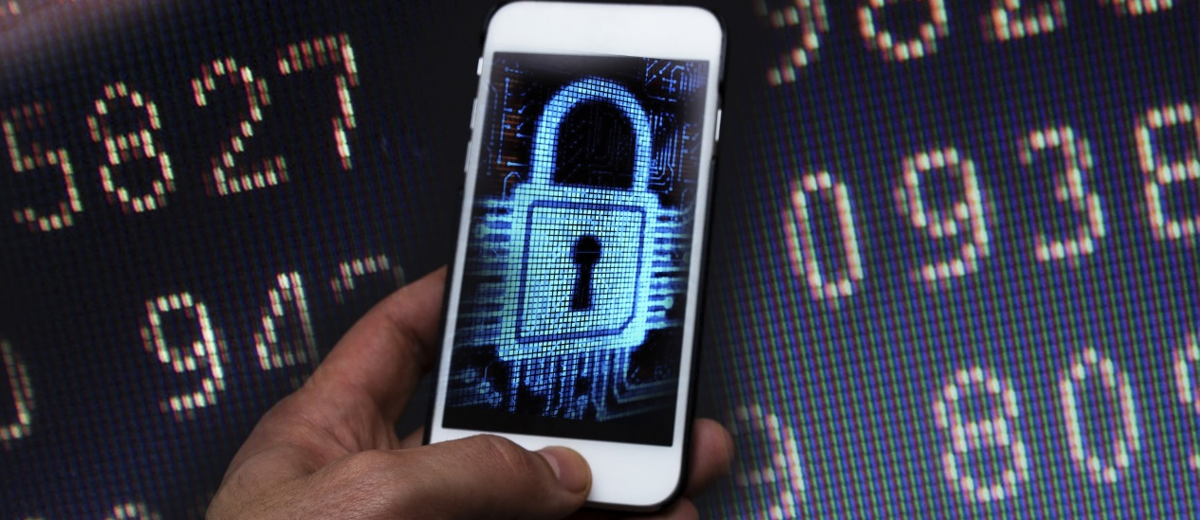
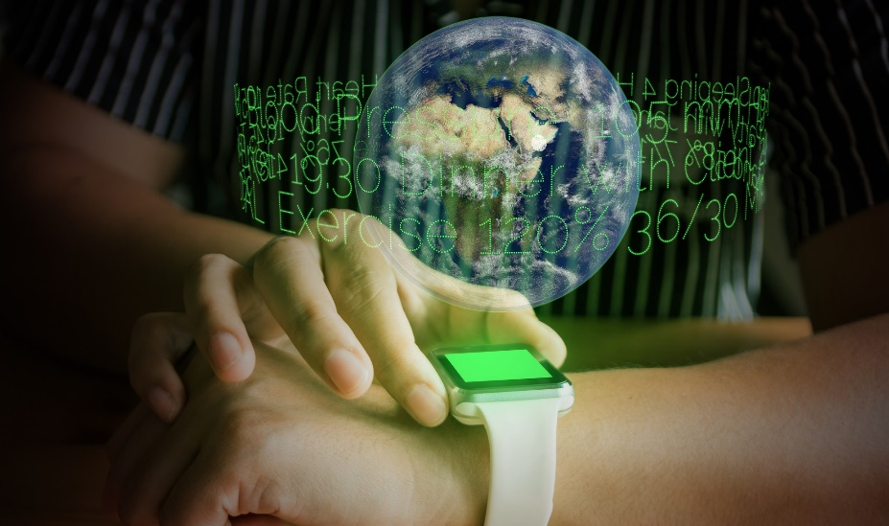





Wearable Technology
This project was supported by Cooperative Agreement Number 2013-CK-WX-K027 awarded by the Office of Community Oriented Policing Services, U.S. Department of Justice. The opinions contained herein are those of the author(s) and do not necessarily represent the official position or policies of the U.S. Department of Justice. Reference to specific agencies, companies, products, or services should not be considered an endorsement by the author(s) or the U.S. Department of Justice. Rather, the references are illustrations to supplement discussion of the issues.
Notes:
Over the next 15-20 minutes I will be discussing wearable technology. With the increase of wearable technology use involving social media, communication, and connection to various personal devices, there is information that we should all be aware of when using our wearable technology. During this presentation I will cover what wearable technology is, what it is used for, types of wearable technology, the risks of using wearable technology, prevention and security tips to avoid being a victim of online crime, and who to contact if you or someone you known has fallen victim to online crime through their wearable technology.

Slide 2

Meet Tina
Lead Programmer at a Printing Company
  27 years old
  Busy work schedule
  Lost her Michael Kors Smartwatch
Master’s degree in Communications
Hobbies
  Painting
  Cooking
  Yoga
Notes:
First let’s start the presentation by meeting Tina Johnson. Tina is one of the lead programmers at a printing company called Primary Prints. She graduated from college with a master’s degree in communications about 4 years ago and has worked her way to gain her current position. Tina recently returned from a week long business trip and quickly realized that she lost her Michael Kors Smartwatch (This smartwatch runs Wear OS and is commonly used with Android smartphones.) She used her smartwatch for work related connections, social media connections, and schedule reminders. Her smartwatch helped stay organized with her busy lifestyle. After struggling for a few days without her smartwatch, she was excited to get a new one.
Sarah enjoys yoga, painting, and cooking because these activities help her stay relaxed during her chaotic schedule.

Slide 3
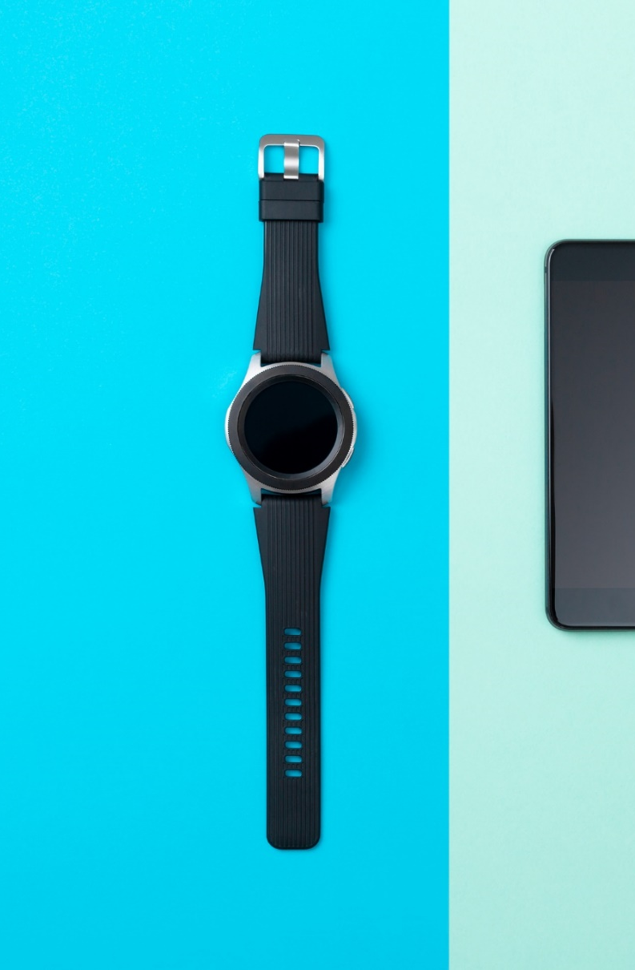
Facebook Marketplace
Tina purchased the smartwatch on the Facebook Marketplace
Smartwatch was advertised as being in “like new” condition for 50% below retail price
After buying the watch, she received a few days later and inspected the condition of the watch
Hi Jonathan! It sure does seem like we have a lot in common. I am a little busy over the next few days, but maybe I’ll message you Tuesday.
Yeah me too! I’m free at 9pm.
Does that time work?
OK!
Notes:
Tina does not have the money to buy another brand new watch, so she decided to search for a similar smartwatch on the Facebook Marketplace. Quickly, she found an identical Michael Kors Wear OS smartwatch that was advertised as being in “like new” condition for only half of the price she paid for her previous watch. She believed she found a great deal and she paid $150.00 for the smartwatch, and after a few days of waiting Tina receives the package. After receiving the package, she begins to inspect it. The condition of the watch appears to match the advertised condition. The watch looked new and she was happy with her purchase. As she looked though the warranty papers, she noticed that they were in a foreign language. She ignored that red flag and continued to set up her watch exactly how she did with her previous smartwatch
Class participation
With a show of hands, how many of you have purchased technology off of the internet?
If you are willing to share, was it a good experience or bad experience?

Slide 4
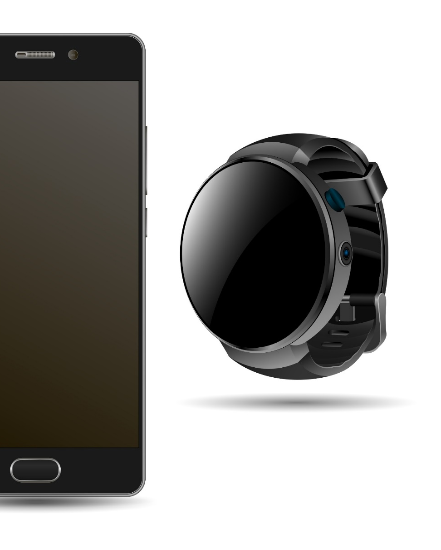
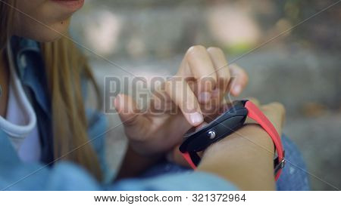
The smartwatch setup
Tina begins to setup her watch by following the instructions to download the app for her watch from the Google Play Store
She syncs her other apps and quickly accepts all permissions to access her data
Once the smartwatch is synced, notifications and other app related data can be displayed
Notes:
Tina downloaded and installed the smartwatch app, which requested her to create an account. After creating an account, app began to request permission to link to her contacts, media files, and location.
She wanted to get her smartwatch set up as fast as she could and she accepted all permissions for her apps to have access to her data. (As consumers, we should be aware of the fine print and understand what accepting permissions and granting access means. Just because a device is compatible and can be synced with multiple services and apps, does not always mean it is the best course of action to allow unrestricted access.)
Once all of her apps were synced to her smartwatch, she began organizing it like her previous smartwatch. She updated her calendar and made sure she was logged into her social media accounts.

Slide 5
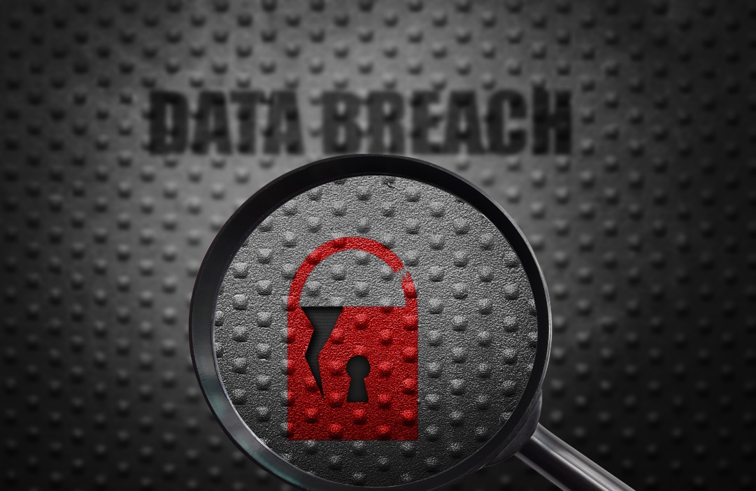
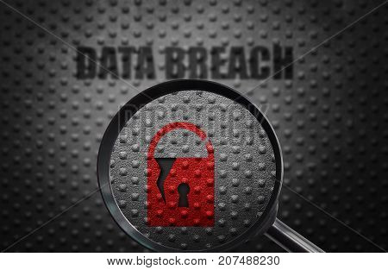
Tina’s identity is compromised
Several days after Tina synced her information to her watch, she noticed suspicious activity on her social media accounts
The hackers exploited her social connections and communication in an attempt to scam others for money
Notes:
After Tina downloaded the app for the watch from the Play Store, it was likely that the app contained malware or she had granted the app permission to access data on her phone.
By syncing her phone to the watch, and using the downloaded app, the data on Tina’s phone was at risk. Her social media login credentials, contact information, calendar, and media files accessed by the downloaded app.
This data was used by unknown hackers to contact various people though her email and social media accounts posing as her.
Class participation
Have any of you or someone you know, had their emails or social media accounts hacked?
Q: What is the first thing you should do if you notice suspicious activity on an account? A: Change your password.

Slide 6
What is wearable technology?
Wearable technology is a device that can be worn as an accessory that has the ability to sync collected data to smartphones or computers through Bluetooth technology
Wearable technology uses motion, temperature, and other digital sensors to record our activity and biometrics
The main benefits of wearable technology are the convenience factors such as hands-free tracking of data, fitness activities, and healthy habits
“43% of wearables users say that they believe smartphones will one day be replaced with technologies offered by the industry. 40% of those who own a smartwatch say that they already spend less time on their phones, treating it as more of a secondary screen.”
- Ericsson Consumer Lab
Notes:
Wearable technology is a device that can be worn as an accessory that has the ability to sync collected data to smartphones or computers with the use of Bluetooth. Wearable technology uses motions sensors to record our activity and biometrics. The main benefits of wearable technology are the convenience factors such as hands-free tracking of data, fitness activities, and healthy habits.
“43% of wearables users say that they believe smartphones will one day be replaced with technologies offered by the industry. 40% of those who own a smartwatch say that they already spend less time on their phones, treating it as more of a secondary screen.”
(Source Accessed on 9/4/19)
https://www.ericsson.com/en/trends-and-insights/consumerlab/consumer-insights/reports/wearable-technology-and-the-internet-of-thing
https://www.wareable.com/wearable-tech/what-is-wearable-tech-753
http://www.humavox.com/blog/exploring-advantages-disadvantages-wearable-tech/

Slide 7
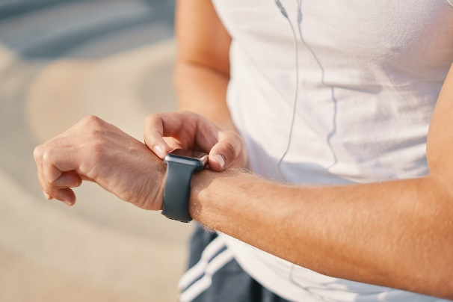

What are the most common types of wearable technology?
The most highlighted wearable technology industries are Apple, Fitbit, and Android
Popular brand of wearable technology are Apple, Fitbit, Fossil, and Xiaomi
There are smartwatches, fitness trackers, head mounted displays (VR), sports watches, smart jewelry, smart clothing, and implantable devices
Notes:
These are some of the most popular brand and manufacturers of fitness trackers and smartwatches. The most highlighted wearable technology industries are Apple, Fitbit, and Android. Popular brand of wearable technology are Apple, Fitbit, Fossil, and Xiaomi( Chinese company, creator of MI Band fitness tracker). There are smartwatches, fitness trackers, head mounted displays (virtual reality), sports watches, smart jewelry, smart clothing, and implantables.
(Source accessed on 9/4/19)
https://www.happiestminds.com/Insights/wearable-technology/
https://www.statista.com/topics/1556/wearable-technology/

Slide 8
What devices can be linked to which smartphones?
Apple watches can be linked to iPhones and iPads
Fitbit activity trackers can be synced to operating systems such as Apple iOS 11 or higher, Android OS or higher, and Windows 10 version 1607.0 or higher
Fossil products are compatible with Android and iOS Apple
Notes:
There are several different brands of wearable technology in the world. Here is some compatibility information on the popular wearable technology manufacturers and products.
Apple watches can be linked to iOS Apple products
Fitbits can be synced to operating systems such as Apple iOS 11 or higher, Android OS or higher, and Windows 10 version 1607.0 or higher
Fossil products are compatible with Android and iOS Apple
(Source Accessed on 9/4/19)
https://www.techradar.com/news/best-smartwatch-for-iphone-what-great-watches-work-with-your-iphone
https://help.fitbit.com/articles/en_US/Help_article/2315

Slide 9
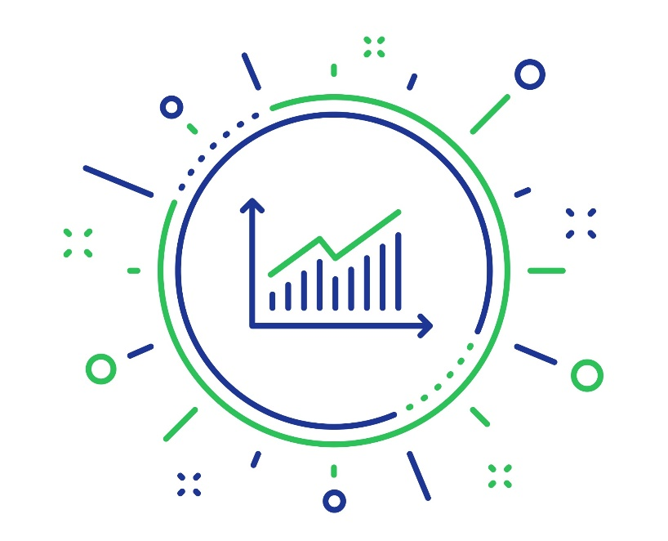
Risks of wearable technology
Most wearable technology has low security which can leave an individual’s data unprotected
Unprotected data that is collected by wearable technology can be used by the company or the government
The data on wearable technology has no encryption on it therefore, the data could be defenseless to cybercriminals
Notes:
The overwhelming use of wearable technology has its convenient benefits, but it also has some risk that everyone should be aware of when syncing their data. Most wearable technology has low security which can leave an individual’s data unprotected and that unprotected data that is collected by wearable technology can be used by the company or the government. With saying that, an individual’s data could be misrepresented or it could have positive results that could be used for marketing/ health purposes. An individual’s data on their wearable technology has no encryption on it therefore, the data could be defenseless to cybercriminals .
(Source accessed on 9/4/19)
https://edu.gcfglobal.org/en/wearables/how-can-wearables-affect-our-lives/1/
https://www.eidebailly.com/insights/articles/2018/3/you-are-what-you-wear

Slide 10
Risks of wearable technology
Wearable technology is not always viewed as a valuable target to cybercriminals, but as wearable technology advances the value level could change.
  “53 percent of existing users of wearables, and an equal proportion of non-wearables owners, also acknowledge that it is very likely that wearables will be vulnerable to viruses, hacking and data breaches in the next 5 years.” -Ericsson Consumer lab
Notes:
The use of wearable technology is used as a motivational or convenience tool, and because of this most people connect their wearable technology to all ways of communication in order to stay up to date. The cycle of synced devices creates a single door to an individual’s data. All wearable technology is synced to other devices, if the information on the wearable technology is targeted then the other connected devices can be breached. As of now, wearable technology is not a prime target for cybercriminals but as the years progress and the technology advances that could change.
“However, 53 percent of existing users of wearables, and an equal proportion of non-wearables owners, also acknowledge that it is very likely that wearables will be vulnerable to viruses, hacking and data breaches in the next 5 years.” -Ericsson Consumer lab
https://www.ericsson.com/en/trends-and-insights/consumerlab/consumer-insights/reports/wearable-technology-and-the-internet-of-things
https://edu.gcfglobal.org/en/wearables/how-can-wearables-affect-our-lives/1/
https://www.eidebailly.com/insights/articles/2018/3/you-are-what-you-wear

Slide 11
Prevention and security tips
In order to protect your information from being compromised you should:
  Give the minimum information requested by the wearable technology app
  Exercise healthy password usage, try not to use the same password for several things, and occasionally change your password
  Avoid phishing attempts by being cautious when opening informational emails or messages from the manufactures, make sure the message came from a secure source
  Stay consistent with software updates when they become available because software updates support exposed patches within the software
Notes:
Now that we have discussed what wearable technology is and what the risk are, we should discuss some prevention and security tips to help everyone protect their information.
Read off the bullet points
(Source accessed on 9/4/19)
https://www.experian.com/blogs/ask-experian/how-to-protect-your-privacy-on-wearable-devices/
https://securitytoday.com/Articles/2018/07/30/Wearables-Open-Door-to-Many-Security-Vulnerabilities.aspx?Page=4

Slide 12
Prevention and security tips
Be aware of the security, app, and lock settings on your smartphone
Secure your wearable technology by protecting your smartphone
  Creating a secure pin
  Keeping your Bluetooth turned off until you need to use it
  Keeping your smartphone with you at times, do not leave it unattended.
  Be cautious of connecting to public wireless internet
  Add two- factor authentication for the apps that are connected to your wearable device
PRIVACY
LOCATION
ACCESSIBILITY
Notes:
Here are some more prevention and security tips that involve keeping your wearable technology safe by protecting your connected devices such as your smartphone.
Read bullet points
Familiarize yourself with the Privacy, Location, and Accessibility options and permissions when connecting your wearable device.
(Source accessed on 9/4/19)
https://hypersecu.com/blog/119-how-secure-are-your-wearables

Slide 13
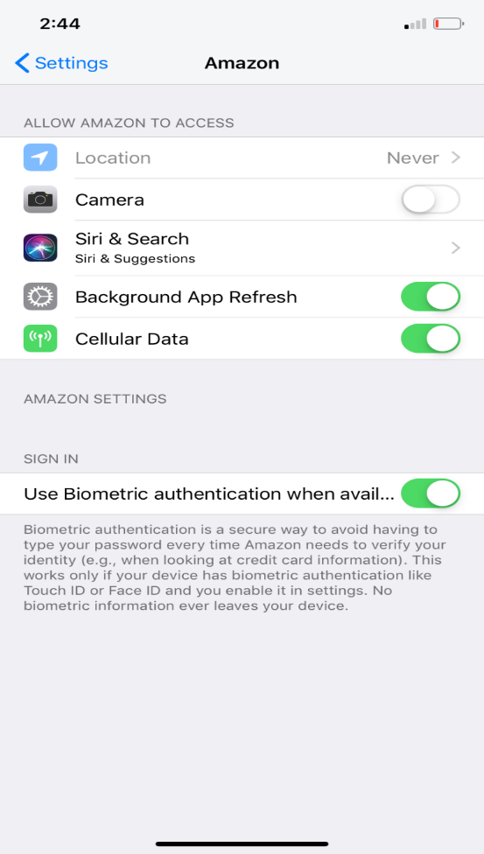
How to check app permissions
iPhone X and new models
Go to your home screen
Find the gear icon and it will take you to your settings page
Once you are on the settings page, scroll towards the bottom of the screen to find your apps
When you choose an app, the following screen will display the permission settings
Notes:
Most of you probably know how to access your settings, but over the next few slides we show you how to look at you app permissions and accessibility settings.
Note: Talk through each of these steps with participants.

Slide 14
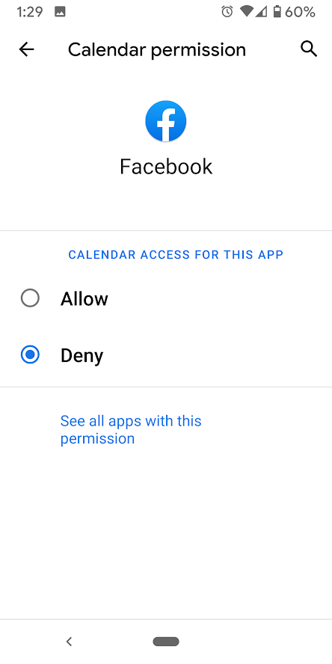
How to check app permissions
Android Phones
Swipe down notification shade and look for a gear icon
The gear icon will take you into your settings
Once your in the settings, select the apps and notification section
From there, it shows you all of our apps
When you select an app, it shows the permissions which is the information that app is allowed to access
Notes:
The steps listed on this slide are specifically for Android phones and how to find your app permissions
Note: Talk through each of these steps with participants.

Slide 15

If you suspect you are a victim of internet facilitated crime
Contact the Internet Crime Complaint Center (IC3) which is operated by the Federal Bureau of Investigation
  www.ic3.gov
Report as much information about the incident as possible – WHO, WHAT, WHERE, WHEN, and HOW
Notes:
If any one has suspicion that they are being targeted by internet facilitated crime please contact “IC3.gov.” If you or someone you know is suspected to be in immediate danger, but is anyone is in immediate danger dial 911 or contact your local police department.
Document as much information as possible regarding the incident. Complainant provided screenshots, emails, website links, text messages, and individual names will assist law enforcement in the complaint review process.
(Source accessed 9/11/19)
https://www.ic3.gov/default.aspx

Slide 16

QUESTIONS
Notes:
**Instructor Note: Ask the participants if they have any questions about wearable technology, prevention and security tips, or how to report this type of crime.**

Slide 17
Graphics Credit
187851316 Copyright karn684, 2019 Used under license from bigstockphoto.com
321372964 Copyright ArtZone, 2019 Used under license from bigstockphoto.com
289196485 Copyright timofeev, 2019 Used under license from bigstockphoto.com
207488230 Copyright zimmytws, 2019 Used under license from bigstockphoto.com
169639358 Copyright Tonygers, 2019 Used under license from bigstockphoto.com
208582549 Copyright oleggawriloff, 2019 Used under license from bigstockphoto.com
306968932 Copyright Blan-k, 2019 Used under license from bigstockphoto.com
288465361 Copyright Dontree, 2019 Used under license from bigstockphoto.com
238982413 Copyright Verona-winner, 2019 Used under license from bigstockphoto.com
293263408 Copyright Blan-k, 2019 Used under license from bigstockphoto.com
273044632 Copyright rstavila, 2019 Used under license from bigstockphoto.com
196674739 Copyright Siriporn2525, 2019 Used under license from bigstockphoto.com
250897696 Copyright New Design Illustrations, 2019 Used under license from bigstockphoto.com
224491957 Copyright Olegkalina, 2019 Used under license from bigstockphoto.com

Slide 18
Bibliography
Blair, Alita. “How Secure are Your Wearables?” Hypersecu, Hypersecu Information Systems Inc., 18 June 2015, 2018. https://hypersecu.com/blog/119-how-secure-are-your-wearables
“Exploring the advantages and disadvantages of wearable tech.” Humavox, Humavox, 11 August, 2016. http://www.humavox.com/blog/exploring-advantages-disadvantages-wearable-tech/
Federal Bureau of Investigation. The Internet Crime Complaint Center (IC3). Accessed on September 18, 2019. www.ic3.gov
GCF Global. “Can wearables affect our lives?” GCF Learn Free, Goodwill Community Foundation, 2019. https://edu.gcfglobal.org/en/wearables/how-can-wearables-affect-our-lives/1/
Mangla, Ismat. “How to protect your privacy on wearable devices.” Experian. Experian Information Solutions Inc., 1 February, 2018. https://www.experian.com/blogs/ask-experian/how-to-protect-your-privacy-on-wearable-devices/
Peckham, James. “Best smartwatches for iPhone: Apple Watch, Wear OS, Tizen and more.” Techradar, Future U.S Inc., 19 June, 2019. https://www.techradar.com/news/best-smartwatch-for-iphone-what-great-watches-work-with-your-iphone
Shepard, Sydny. “Wearables open doors to many security vulnerabilities.” Security Today. 1105Media Inc., 30 July, 2018. https://securitytoday.com/Articles/2018/07/30/Wearables-Open-Door-to-Many-Security-Vulnerabilities.aspx?Page=4

Slide 19
Bibliography
Smith, Chris. “What is wearable tech? Everything we need to know explained.” Wareable, Wareable LTD, 17 August, 2019. https://www.wareable.com/wearable-tech/what-is-wearable-tech-753
Statista Research - Shanhong Liu. "Wearable technology - Statistics & Facts." Accessed on September 11, 2019. https://www.statista.com/topics/1556/wearable-technology/
Telefonaktiebolaget LM Ericsson. "Wearable technology and the IoT." Accessed on September 11, 2019. https://www.ericsson.com/en/trends-and-insights/consumerlab/consumer-insights/reports/wearable-technology-and-the-internet-of-things
Tode, Chantal. “Wearables to account for 20pc of mobile proximity payments by 2020: report.” Retail Dive, Industry Dive, 2019. https://www.retaildive.com/ex/mobilecommercedaily/wearables-payments-to-reach-501b-by-2020-report
Urrutia, Amanda. “You are what you wear.” Eide Bailly, Eide Bailly LLP, March 2018. https://www.eidebailly.com/insights/articles/2018/3/you-are-what-“Wearable technology.” Happiest Minds: The Mindful IT Company, Happiest Minds, 2019. https://www.happiestminds.com/Insights/wearable-technology/you-wear
“Wearable technology.” Happiest Minds: The Mindful IT Company, Happiest Minds, 2019. https://www.happiestminds.com/Insights/wearable-technology/
“Which phones and tablets can I use with my fitbit watch or tracker?” Fitbit, Fitbit, 2019. https://help.fitbit.com/articles/en_US/Help_article/2315

