Slide 1







Work-at-Home Scams
This project was supported by Cooperative Agreement Number 2013-CK-WX-K027 awarded by the Office of Community Oriented Policing Services, U.S. Department of Justice. The opinions contained herein are those of the author(s) and do not necessarily represent the official position or policies of the U.S. Department of Justice. Reference to specific agencies, companies, products, or services should not be considered an endorsement by the author(s) or the U.S. Department of Justice. Rather, the references are illustrations to supplement discussion of the issues.
Notes:
Notes

Slide 2

Meet Bill
Bill recently lost his job of 17 years
He has applied for a number of jobs but hasn’t had any success
He decides to post his resume online on various job search sites
Notes:
Bill recently lost his long-time factory job of 17 years. He has a family to take care of and is looking for a new job. But times are tough and Bill hasn’t had much success. Worried that he may not find a job, Bill decides to post his resume online on various job search sites.

Slide 3
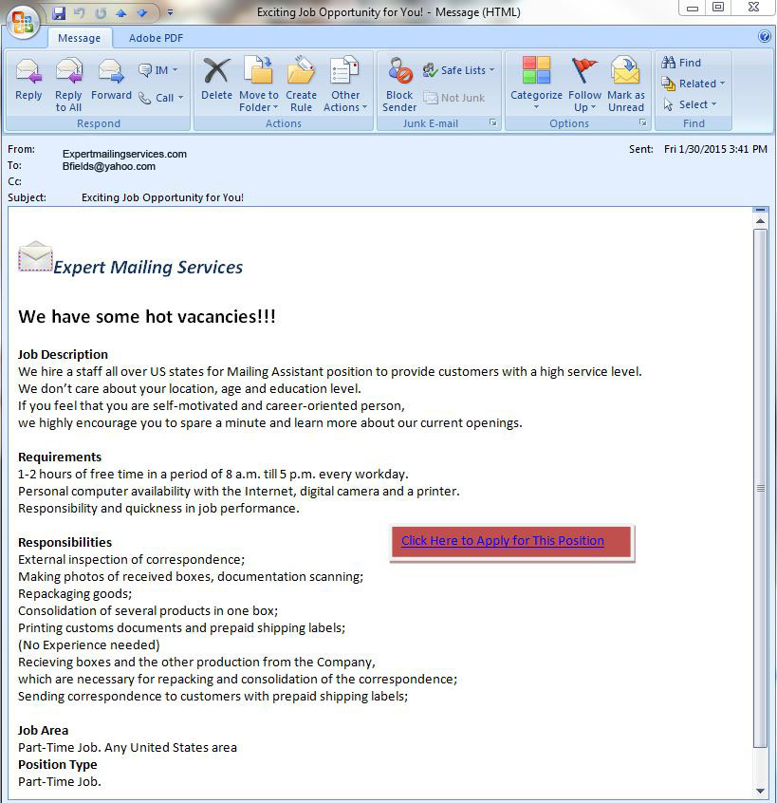
Bill receives an email
Mailing assistant
1-2 hours a day
Repackaging goods and printing labels
Need computer, internet, digital camera and printer
No experience needed
Notes:
Within a couple of days of posting his resume online, Bill receives an email from a company called Expert Mailing Services. The company is looking for someone to be a mailing assistant. The job is described as work-from-home position in which Bill would need to work 1-2 hours a day repackaging goods and printing labels. No experience is needed but the candidate would need to have a working computer, internet access, and a printer.

Slide 4

Things are looking up for Bill
Bill applies for the position and gets a call saying he is hired and can make up to $1,500 a week!
He fills out a W-4 with his DOB, address, SS# and banking info for direct deposit.
Notes:
After reading through the email, Bill decides to apply for the position. Shortly after applying he gets a call that provides him with some additional information about the job and is told that he can make up to $1,500 a week. Excited about the great news, Bill fills out the attached W-4 and provides the required personal identifiable information (DOB, SS#, address) along with his bank information so they can direct deposit his earnings.

Slide 5

Bill’s new job is going great
Bill receives several packages in the mail which he forwards to addresses in Europe, Russia, and former Soviet republics.

Slide 6
Until…
Bill receives a notice from the Postal Inspection Service that he may have participated in a scam!
Bill checks his credit report and learns that several credit cards were taken out in his name.
Not only did Bill reship stolen merchandise but he also reshipped merchandise that was purchased with credit cards taken out in his own name.
Bill is the victim of a reshipping scam and identity theft.
Notes:
Bill has participated in a scam and has been scammed himself. Bill found out that he reshipped stolen merchandise and merchandise that was purchased by false credit cards created with his personal information.

Slide 7
What is a work-at-home scam?
Work-at-home scams usually involve an offer to
be employed at home, doing some simple task in
a minimal amount of time for a large amount of
income. The true purpose is to extort money
from the victim through check fraud or advance
payment fee fraud or to perpetrate other crimes
against the victim.
Notes:
A work-at-home scam involves offered employment that involves minimal work in exchange for a large payment. The malicious intent behind the scam results in extortion of money from the victim.
(Accessed on September 18, 2019)
https://www.ic3.gov/crimeschemes.aspx#item-7

Slide 8

Work-at-Home Scams
Check Fraud
Money Laundering
Reshipping
Mystery Shopper
Medical Billing
Business Opportunities
Advance-Fee
Identity Theft
Notes:
The next few slides will cover some of the more prevalent work-at-home scams: check fraud, money laundering, reshipping, mystery shopper, medical billing, and business opportunities that can include advance-fee fraud and identity theft.
https://www.forbes.com/sites/groupthink/2011/12/13/16-work-at-home-scams-to-avoid/#5ecf3bcf6f65
https://www.consumer.ftc.gov/articles/0175-work-home-businesses

Slide 9

Check Fraud
Victim receives a check or money order for work performed
Victim is overpaid and instructed to keep a small amount and wire back the difference
Check/money order is counterfeit and victim is now responsible for entire amount of bad check
Notes:
You are sent a hefty check and asked to deposit it into your bank account, then withdraw funds to shop and check out the service of local stores and wire transfer companies. You keep a small amount of the money for your “work,” but then, as instructed, mail or wire the rest to your “employer.” Sound good? One problem: the initial check was phony, and by the time your bank notifies you, your money is long gone and you’re on the hook for the counterfeit check.
(Accessed on October 2, 2019)
https://www.consumer.ftc.gov/blog/2017/03/dont-bank-check

Slide 10
Money Laundering
The scammer will request account and financial information to send check/money order to the victim
The check or money order is real, but it is usually stolen money.
The scammer uses the victim’s bank account to facilitate illegal money.
Victim is playing a role in laundering of “dirty” money
Notes:
While the financial benefit to the victim in this scam is real and the effort needed to make the money is minimal, the legal risk is still quite high and the penalties are very real. The victim at this point is taking part in money laundering. When the victim answers a fraudulent ad, the scammer with immediately grant them the position and move the continue the employment process by requesting bank account information and personal information for payment. The scammer will use the victim’s account to facilitate illegal money.
(Accessed on October 2, 2019)
https://www.monster.com/career-advice/article/money-laundering-reshipping-scams

Slide 11
Reshipping
Victim is getting paid to receive merchandise ad reship merchandise outside of the United States.
They are given some reason why the “employer” cannot receive the merchandise
Laws of their country do not allow
Substantial taxes if shipped direct
Victim is actually receiving stolen merchandise that was purchased with a stolen credit card and shipping it to the scammer
Notes:
In this scam the victim is getting paid to receive merchandise such as electronics, jewelry, or some other valuable and easily disposable merchandise. The victim is given some reason why the “employer” cannot have the merchandise directly shipped to their address, usually claiming that due to the laws of the country in which they are residing, they cannot accept or would be substantially taxed if the product were shipped direct. What is actually happening is that the scammer is using stolen credit card information to purchase valuables, having them shipped to the victim’s address and having the victim reship them to the scammer. When the authorities investigate the credit card fraud, it leads them to the victim’s address who has now participated in a conspiracy, is guilty of receiving and concealing stolen goods and is quite likely to face criminal charges.
(Accessed on October 2, 2019)
https://www.monster.com/career-advice/article/money-laundering-reshipping-scams

Slide 12

Mystery Shopper
The job assigned to a mystery shopper is to write a review based on their shopping experience.
Victim given check/money order to deposit in their account
Victims are told to deposit check into their account, keep a percent of the money for their work, and wire the remaining amount back the scammer.
Check/money order is counterfeit and victim is out the money and merchandise purchased and shipped
Notes:
The mystery shopping scam occurs when an individual receives a check/money order. They are instructed to use this money to go shopping at a store and write a review based on their shopping experience. You might be told to use the money to buy reloadable gift cards and send pictures of card numbers as proof of purchase. to The scammer is usually counting on the time delay it generally takes the bank to discover that the check or money order is fraudulent. If the victim takes the check/money order, deposits it into their account, writes a review of their shopping experience, wires the remaining amount of money back, and the victim will eventually find that they are responsible for the total cost of the items they just bought but no longer have in their possession.
(Accessed on October 2, 2019)
https://www.bbb.org/article/news-releases/18367-dont-cash-that-check-bbb-study-shows-how-fake-check-scams-bait-consumers
https://www.consumer.ftc.gov/blog/2018/05/scam-story-secret-shopping-and-fake-checks

Slide 13

Medical Billing
Victim promised substantial amount of money for full-time or part-time work.
Expected to pay for software/equipment
No accredited certifications or experience necessary
Notes:
Medical Billing scams usually show up as ads promising earnings of substantial weekly processing insurance claims from you home computer. Scammers will advise that you need to purchase special software and training and will charge you applicable fees or software fees. Be aware, there are valid work from home jobs doing medical billing, but the real ones don’t change fees for software or application—they usually provide you with the software/resources to do the job.
Medical billing certifications usually take 1-2 years to complete. Shortcuts in training is usually a red flag.
(Accessed on October 2, 2019)
https://www.consumer.ftc.gov/articles/0175-work-home-businesses

Slide 14

In the news
Tresea Judson was looking for a job when she saw a local ad for mystery shoppers.
She applied and received a letter and a check for $3,990!
She was instructed to find a MoneyGram branch and wire $3,500 back to the company and keep $400 for herself (w/$90 fee).
All she had to do was send an evaluation of how she was treated by MoneyGram employees.
A week later, check bounces and she’s on the hook for entire amount plus fees.
“When I saw that letter I thought it was a godsend,” said Judson. “I thought it was an unanswered prayer that I had gotten a good job, and I was
happy.”
Notes:
What do you think happens to Judson? Judson was instructed to deposit the check into her bank account. Then, within two days, she was told to find a Moneygram branch and wire $3,500 back to the company. There was a $90 fee to wire the money which left her with $400. All she had to do was send in a written evaluation of how she was treated by Moneygram employees.
A week later, the check bounces and now Judson is on the hook for the entire amount plus fees.
https://abcnews.go.com/Business/Economy/print?id=7014111.

Slide 15
Business Opportunities
Victim is promised that they will be set up with their own work-at-home business
This may include equipment, software, training and/or a client list
There are several common frauds associated with this such as:
Advance fee
Unknowing involvement in criminal activity
Identity theft
Notes:
In this type of scam, the victim is promised that they will be set up with their own personal home business which often includes the promise of equipment, software, training and client lists. There are several other types of common frauds that are often associated with this type of scam.
Advance-fee: there is always a fee for advice, equipment, list of potential customers and training needed to engage in this home based business venture.
Unknowing involvement in criminal activity: Criminals, often located overseas, sometimes use unwitting victims to advance their operations, steal and launder money, and maintain anonymity. For example, they may “hire” the victim as a U.S. based agent to receive and re-ship checks, merchandise and solicitations to other potential victims without you even realizing that you are participating in criminal activity.
Identity theft: During the application process, you’re often asked to provide personal information that can be used to steal from your bank account or establish new credit cards in your name.
(Accessed on October 2, 2019)
https://www.consumer.ftc.gov/articles/0175-work-home-businesses

Slide 16
In the news
Laura O’Neal wanted to stay at home with her child when she saw an online ad that promised she’d make $12 for every envelope she stuffed.
O’Neal sent $37.94 for a starter kit.
The starter kit never came and O’Neal complained to the Better Business Bureau.
The investigation led to the arrest of 27-year-old Matthew Whitley.
The scam netted him $120,000 in just nine months.
Taking $37.94 from multiple victims really adds up.
“It seemed like it would work out great,” said O’Neal. “I could just sit here and stuff envelopes and pay attention to my daughter and be able to make a legitimate paycheck.”
Notes:
But the starter kit never came. O’Neal complained to the Better Business Bureau, which forwarded her complaint to the police who had already received 50 similar complaints. The investigation led let to 27-year-old Matthew Whitley. It was determined that Whitley’s scam had brought him in $120,000 in just nine months. Police arrested Whitley at his high-rent condominium filled with a 7-foot poker table, large flat-screen TV and seven computers. Taking $37.94 from multiple victims really adds up.
https://abcnews.go.com/Business/Economy/print?id=7014111.

Slide 17
Work-at-home scam prevention
Could Bob’s situation have been
prevented?
YES
Researched the company (Better Business Bureau) www.us.bbb.org
Asked lots of questions
Asked for references
Not provided personal information up front
Notes:
Let’s go back and take a look at Bob’s situation. Is there anything he could have done to prevent himself from being victimized? YES. As you can see on the screen there are a few specific things he could have done that may have prevented this from occurring.
He could have:
Researched the company - contact the Better Business Bureau (BBB.) Research legal requirements, licenses and certifications for particular job duties
Asked lots of questions
Asked for references
Not provided personal information up front

Slide 18
TIPS to avoid victimization
Contact Better Business Bureau (www.us.bbb.org), to find out about the company
Do not pay for anything such as products, certifications, or background checks.
Do not provide personal information up front
Do your research on legal requirements, licenses, and certifications for particular job duties
Do your research on potential scams and reviews of the company
Trust your instincts, if you feel uncomfortable, then walk away from the situation
Be wary of offers of advance payment for services
If it sounds too good to be true, it probably is
Notes:
Contact BBB to find out if company is legit.
Do a background check to see if the company has a good track record or not. You can do this by simply doing a search on the internet or by going to your local library and referencing the “The Work-at-Home Sourcebook” by Lynie Arden.
Always be suspicious if a company wants money up front for instructions or products.
(Accessed on October 2, 2019)
https://www.thebalancecareers.com/protect-yourself-work-at-home-scams-4049387
https://www.flexjobs.com/blog/post/how-to-find-a-real-online-job-and-avoid-the-scams/

Slide 19
What to do if you are a victim
Immediately cease all contact with scammer
Report the incident to the local police
File a complaint with the United States Postal Inspection Service
Immediately flag your credit with the three credit bureaus
Call your bank and cancel your account
File a complaint with the Internet Crime Complaint Center (IC3) www.ic3.gov
Report a complaint to the FTC, at www.ftccomplaintassistant.gov
Notes:
If you are the victim of a work-at-home scam, you should:
Immediately cease all contact with scammer
Report the incident to the local police
File a complaint with the United States Postal Inspection Service
Immediately flag your credit with the three credit bureaus
Call your bank and cancel your account
File a complaint with the Internet Crime Complaint Center (IC3) www.ic3.gov
Report a complaint to the FTC, at www.ftccomplaintassistant.gov
(Accessed on October 2, 2019)
https://www.ftccomplaintassistant.gov/#crnt&panel1-1
www.ic3.gov

Slide 20

QUESTIONS
Notes:
**Instructor Note: Ask the participants if they have any questions about work-at-home scams, prevention tips, or how to report this type of fraud.**

Slide 21
QUESTIONS
Photo Credits
“94686637 Copyright fotographic 1980, 2015 Used under license from Shutterstock.com“, “214296676 Copyright master art, 2015 Used under license from Shutterstock.com“,“77417080 Copyright bajinda, 2015 Used under license from Shutterstock.com“, “83920210 Copyright Benjamin Haas, 2015 Used under license from Shutterstock.com“, “85839025 Copyright Kzenon, 2015 Used under license from Shutterstock.com“, “104193053 Copyright Curioso, 2015 Used under license from Shutterstock.com“, “133104098 Copyright Mega Pixel, 2015 Used under license from Shutterstock.com“, “151164671 Copyright Andry Popov, 2015 Used under license from Shutterstock.com“, “171790418 Copyright Sean Locke Photography, 2015 Used under license from Shutterstock.com“, “189274157Copyright Oleg Golonev, 2015 Used under license from Shutterstock.com“, “222984970 Copyright racorn, 2015 Used under license from Shutterstock.com“,“153213146 Copyright garriphoto, 2015 Used under license from Shutterstock.com“

Slide 22
QUESTIONS
Bibliography
Avila, Jim, and Ann Varney. “Victims of Employment Scams Speak Out.” ABC News. March 6, 2009. https://abcnews.go.com/Business/Economy/print?id=7014111.
Brunelli, M. Laureen. The balance careers. Dotdash, 11 September, 2019. Accessed on October 2, 2019. https://www.thebalancecareers.com/protect-yourself-work-at-home-scams-4049387
“Don’t Cash That Check :BBB Study Shows How Fake Check Scams Bait Consumer.” Better Business Bureau. International Association of Better Business Bureaus, Inc., 4 October, 2018. Accessed on October 2, 2019. https://www.bbb.org/article/news-releases/18367-dont-cash-that-check-bbb-study-shows-how-fake-check-scams-bait-consumers
Federal Bureau of Investigation Internet Crime Complaint Center (IC3). “Internet Crime Schemes.” Accessed December 26, 2018. https://www.ic3.gov/crimeschemes.aspx#item-7.
Federal Trade Commission Consumer Information. “Work-at-home Businesses.” Accessed December 26, 2018. https://www.consumer.ftc.gov/articles/0175-work-home-businesses.
Fletcher, Emma. “A Scam Story: Secret shopping and fake checks.” Federal Trade Commission Consumer Information. Federal Trade Commission, 16 May, 2018. Accessed on October 2, 2019. https://www.consumer.ftc.gov/blog/2018/05/scam-story-secret-shopping-and-fake-checks

Slide 23
Bibliography
Lake, Lisa. “Don’t bank on that check.” Federal Trade Commission Consumer Information. Federal Trade Commission, 17 March, 2017. Accessed on October 2, 2019. https://www.consumer.ftc.gov/blog/2017/03/dont-bank-check
Mallet, Max, and Terry Stanley. “16 Work-at-home Scams to Avoid.” Forbes. December 13, 2011. https://www.forbes.com/sites/groupthink/2011/12/13/16-work-at-home-scams-to-avoid/#5ecf3bcf6f65
Reynolds, W. Brie. “How to Avoid Work-from-Home Job Scams: 6 Tips.” Flexjobs. Flexjobs, 2007-2019. Accessed on October 2, 2019. https://www.flexjobs.com/blog/post/how-to-find-a-real-online-job-and-avoid-the-scams/
Rossheim, Josh. “Hot to Spot Money-Laundering and Reshipping Scams.” Monster. Monster Worldwide, 2019. Accessed on October 2, 2019. https://www.monster.com/career-advice/article/money-laundering-reshipping-scams
“Welcome to Complaint Assistant.” Federal Trade Commission Protecting America’s Consumers. Federal Trade Commission. Accessed on October 2, 2019. https://www.ftccomplaintassistant.gov/#crnt&panel1-1
“Work-at-Home Businesses.” Federal Trade Commission Consumer Information. Federal Trade Commission, April 2015. Accessed on October 2, 2019. https://www.consumer.ftc.gov/articles/0175-work-home-businesses

