Slide 1







Romance Scams
This project was supported by Cooperative Agreement Number 2013-CK-WX-K027 awarded by the Office of Community Oriented Policing Services, U.S. Department of Justice. The opinions contained herein are those of the author(s) and do not necessarily represent the official position or policies of the U.S. Department of Justice. Reference to specific agencies, companies, products, or services should not be considered an endorsement by the author(s) or the U.S. Department of Justice. Rather, the references are illustrations to supplement discussion of the issues.
Notes:
Romance scams reporting in the US and Canada have exceeded $1 billion dollars in total losses. In addition to the embarrassment, victims often suffer emotional and even physical trauma as a result of these cruel scams.
Source (accessed 12/10/18):
https://www.bbb.org/globalassets/article-library/romance-scam-study/bbb-study-online-romance-scams-study.pdf

Slide 2

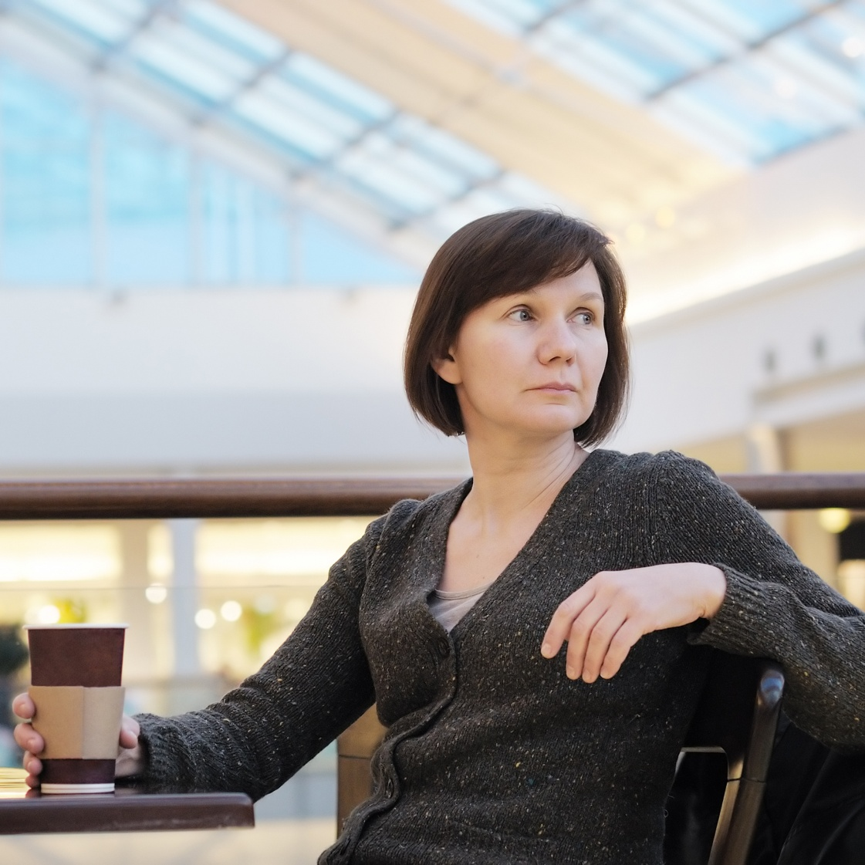
Meet Katherine
She recently lost her husband
Her daughter just moved to attend an out of state college
She is lonely and ready to start dating
Her daughter has encouraged her try online dating
Notes:
Meet Katherine. Katherine lost her husband about a year ago in a car accident. She’s lonely and thinking of dating again. Her daughter, who is away at college, encourages her to try online dating.

Slide 3
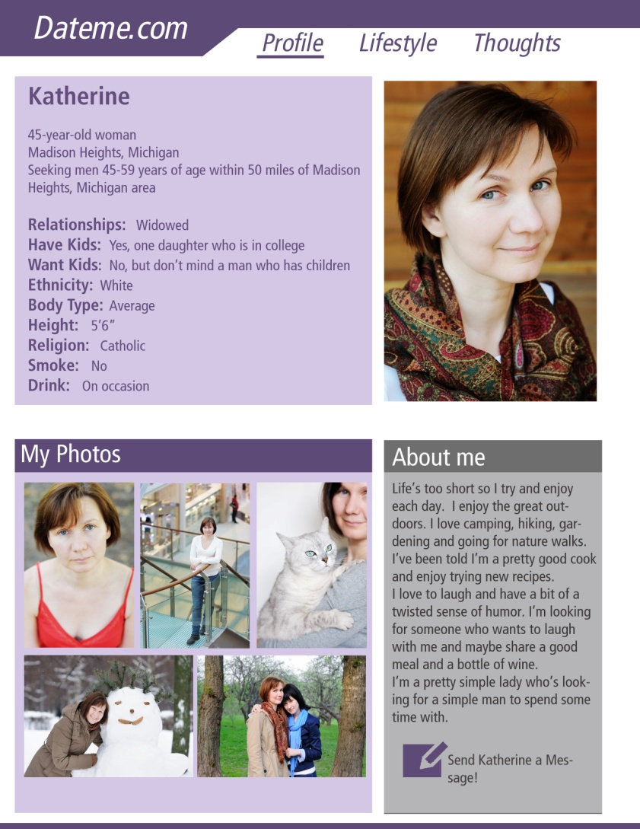
Online Dating Profile
Katherine takes her daughter’s advice and creates an online dating profile
After reviewing some available sites she decides to try out Dateme.com
Notes:
As you can see Katherine has taken her daughter’s advice and created an online dating profile on Dateme.com. Over the next few slides we are going to take a closer look at Katherine’s profile.

Slide 4
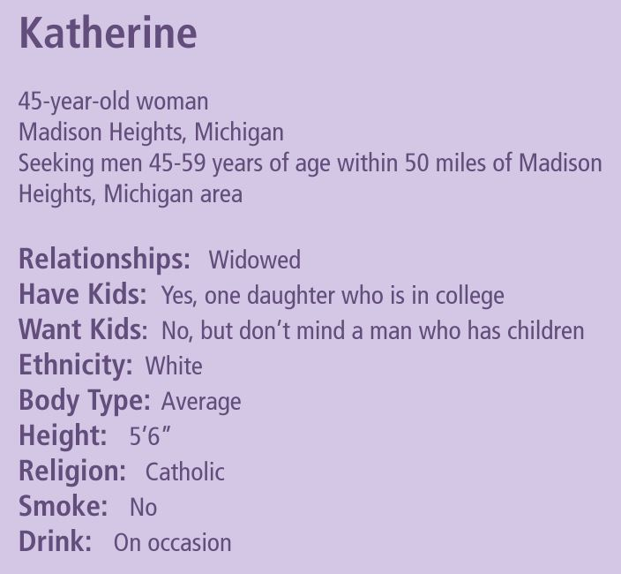
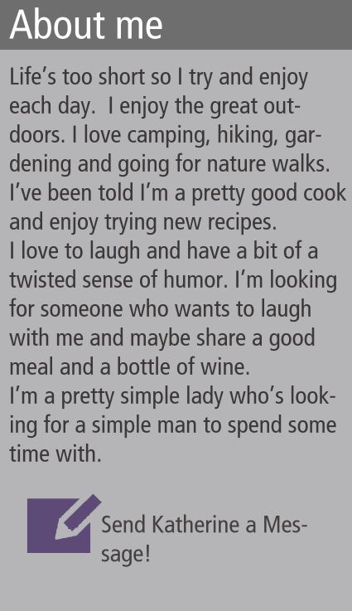

Slide 5
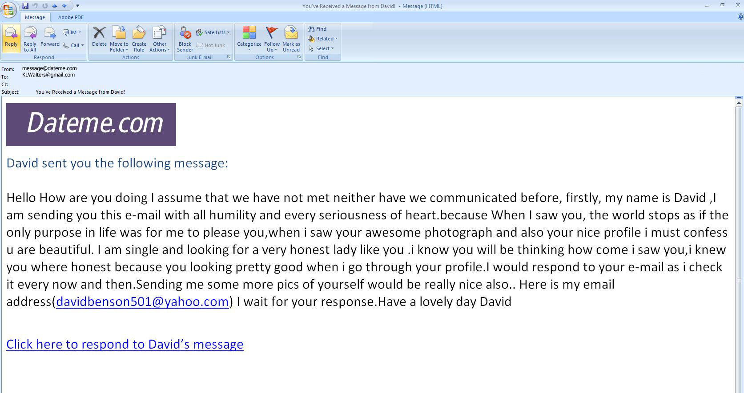


Katherine receives an email
Unauthorized transactions detected
  Out of state grocery stores
  Out of state restaurants
  One online purchase
Dave contacts the bank to put a hold on their account and disable their debit cards
Bank advised Dave to run a credit report
Notes:
So what do you think of David’s message? Should Katherine contact him? What should she do next? Email him? Check out his dating profile? Ignore him? Katherine decides to take a look at David’s profile.

Slide 6
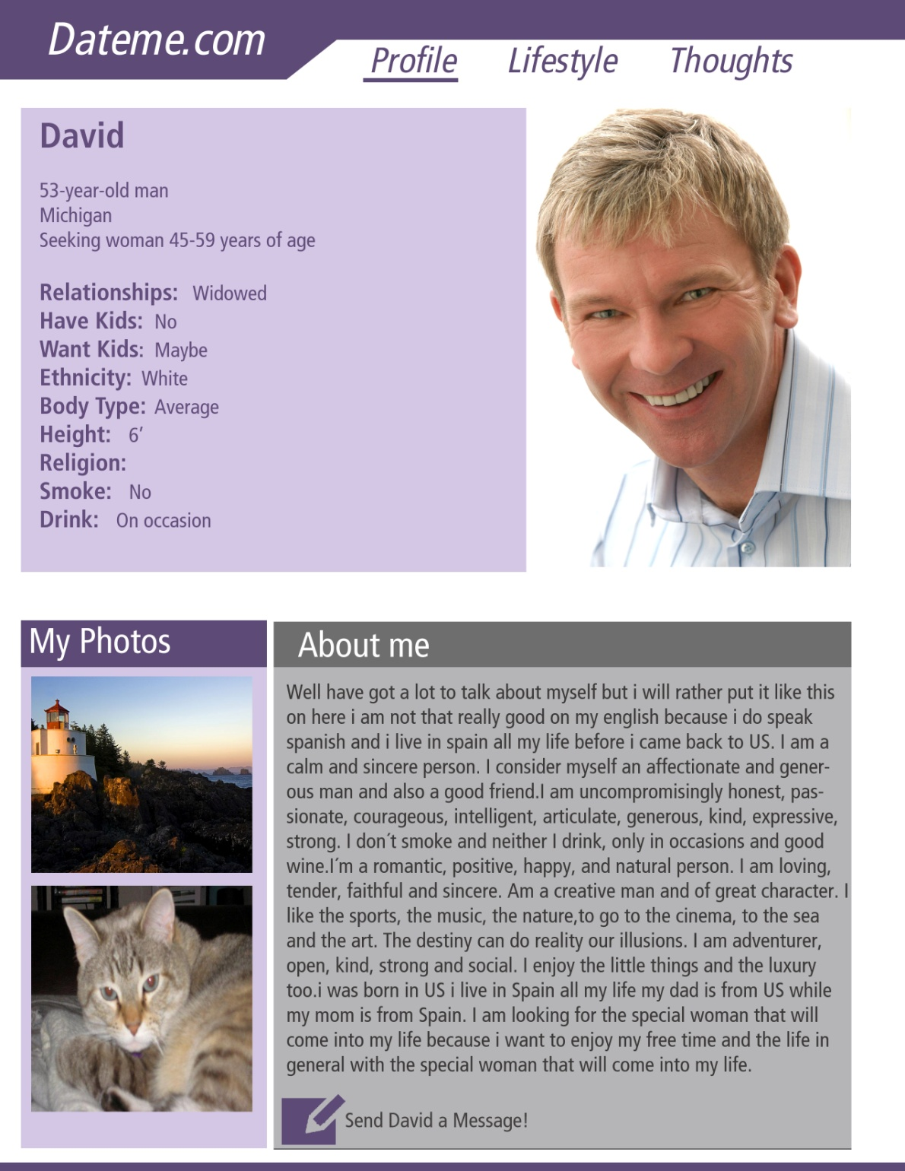
Meet David
53-year-old from Michigan
Seeking woman 45-59 years of age
Widowed with no kids
White man with average build
Non-smoker
Occasionally has a drink
Notes:
David’s profile says that he is a 53-year-old white male from Michigan and seeking a woman between 45 and 59 years of age. He is a widower with no kids and has an average build. Let’s take a closer at David’s profile.

Slide 7
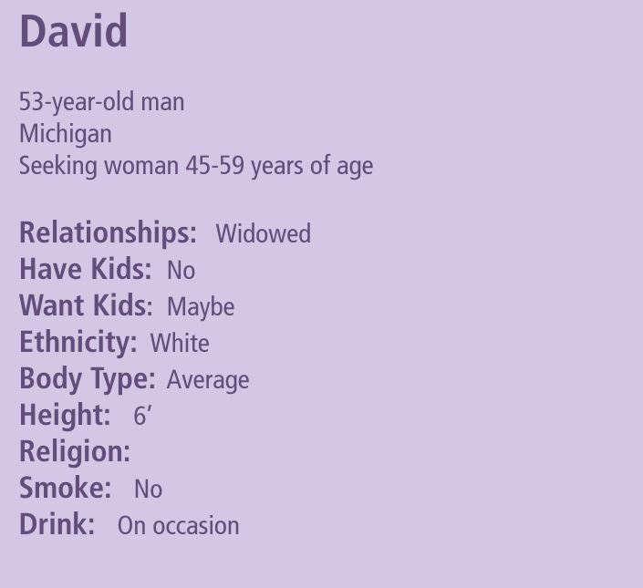
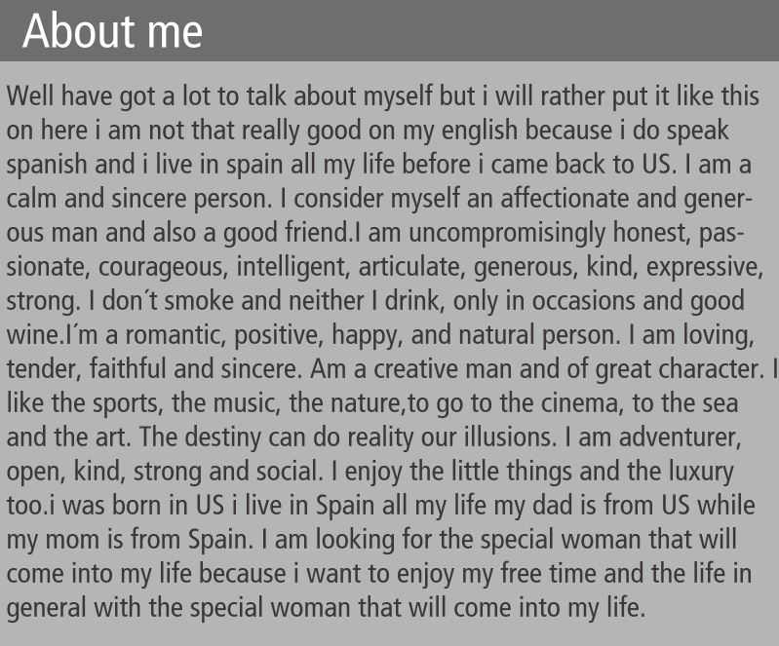
Notes:
There is not a whole lot of information on here.
** Instructor Note: Take a closer look at David’s info. Go over these sections. Give the audience a chance to give their opinion of David.** In his profile he says that he doesn’t speak English well because he is originally from Spain. Do you think this is why the profile is written in broken English? We will learn more about David in a minute.

Slide 8
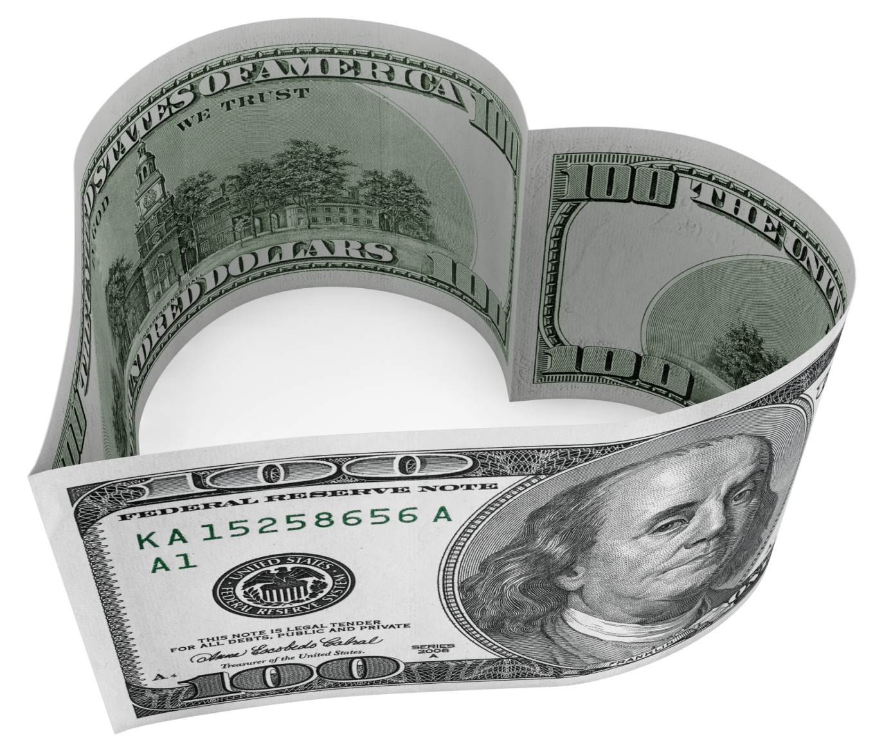
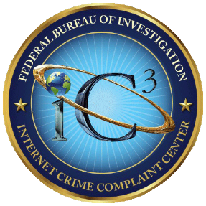

What is a romance scam?
IC3 – Individuals who use the promise of love and romance to entice and manipulate online victims.
FTC – An online love interest who asks for money is almost certainly a scam artist.
Notes:
There are a number of agencies and entities that have defined romance scams, but we chose to present you with the definitions used by the Federal Trade Commission and the Internet Crime Complaint Center. It is important to note with advancements in technology, the romance scam has evolved from being an in-person scam to an online scam. However, it does still occur in-person. This presentation focuses on the online scam.
https://www.ic3.gov/default.aspx
https://www.ftc.gov/

Slide 9
How the scam works
Oftentimes, scammers contact a victim via social media as well.
Victim is usually looking for a relationship (i.e. registered on dating site, social media).
Victim is contacted by someone who is their “ideal” match.
Scammer will quickly try to communicate privately with victim.
Notes:
Recent studies show more and more often, scammers are using online dating sites or apps to lure victims into romance scams. Oftentimes, scammers contact a victim via social media as well.
Scammers are good at reading a potential target’s profile and constructing a profile of their own that is attractive to their target, which often includes a stolen photograph from the internet. More recently, scammers have been using identities of military personnel in an attempt to lure the target into thinking they are communicating with someone currently serving oversees.
Education, interests and hobbies are often listed in a profile which further enables a skilled con artist to seem like the ideal soul mate. The ultimate goal is for the scammer to make the victim believe they are communicating with a good honest person looking for the same kind of relationship, sharing the same values and interests.
One of the main reasons the scammer wants to steer the conversation away from the dating site is so that they can carry on a more intimate conversation and have a record of this intimate conversation. They may try to obtain particularly embarrassing information (like inappropriate photos or financial information) and use that to extort the victim. By moving the conversation away from the dating site, if/when the site realizes the account is fake, the scammer can maintain contact with the person and continue to “groom” the victim into trusting them.
A large portion of these scams originate in Nigeria, where organized groups participate in other scam-related crimes as well. Victims can also be lured into becoming unknowing accomplices in money laundering, or even ‘mules’ in business email compromise schemes.
Sources (accessed 12/10/18):
https://www.bbb.org/globalassets/article-library/romance-scam-study/bbb-study-online-romance-scams-study.pdf

Slide 10
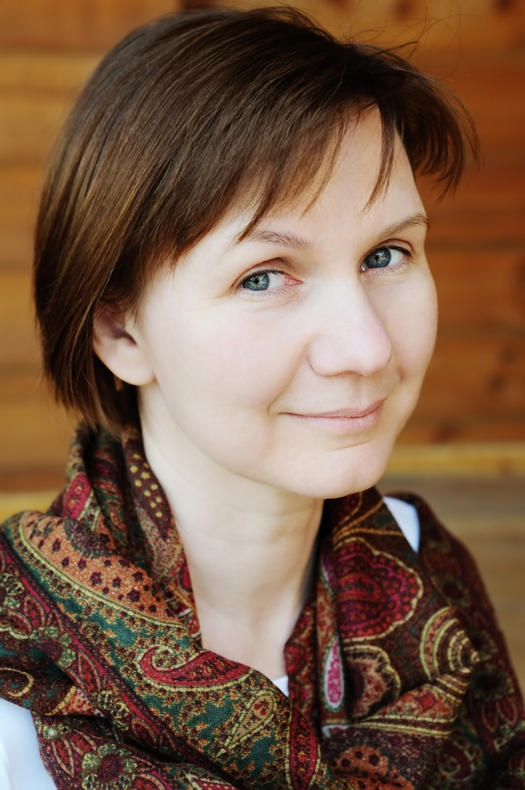

Notes:
Knowing this information, let’s take another look at the profiles of Katherine and David. **Instructor Note: Click to view and compare profiles.**
David is in Katherine’s age range. He also lives in Michigan, though we don’t know where. He is widowed as well. He is the same ethnicity. He doesn’t smoke and only drinks on occasion. Based on this profile, he is a pretty good match for Katherine.

Slide 11
Katherine receives an email
Unauthorized transactions detected
  Out of state grocery stores
  Out of state restaurants
  One online purchase
Dave contacts the bank to put a hold on their account and disable their debit cards
Bank advised Dave to run a credit report
Notes:
Let’s look at the message that David sent to Katherine again. David doesn’t want Katherine to communicate with him through the dating site. He gives her his personal email address and even requests more pictures.

Slide 12
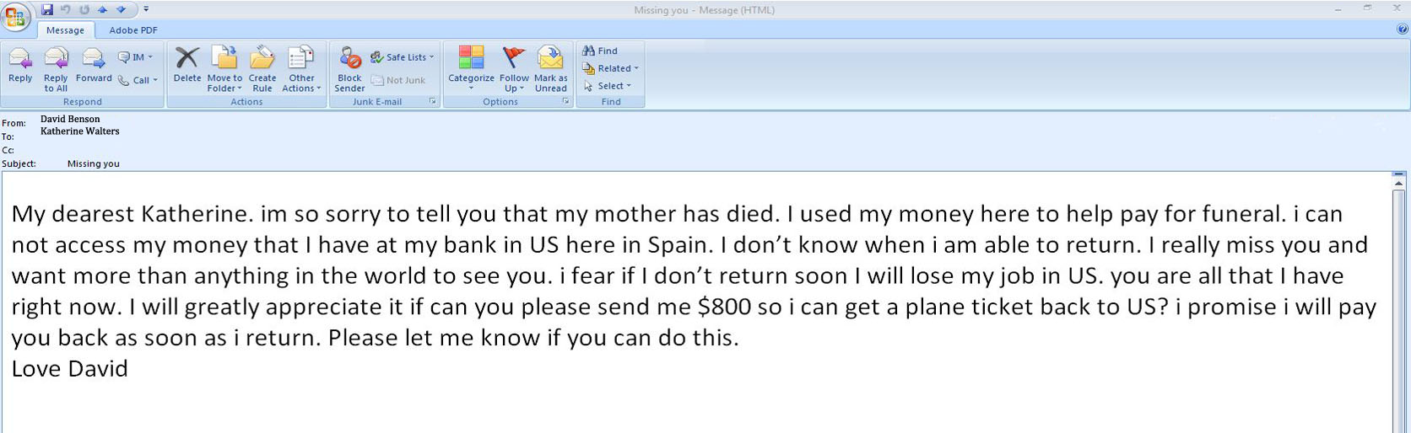
They agree to meet each other
Katherine and David have been communicating regularly
After a couple weeks of talking they have finally decided to meet
Then there is a tragedy……
Notes:
Katherine and David begin exchanging emails regularly. Just when they are about to meet, Katherine gets an email from David saying his mother is sick and he must travel back to Spain to care for her. Soon after she receives this email from David. **Instructor Note: Click to show email.**
**Instructor Note: Ask the audience what they think Katherine should do?** Katherine decides to send David the $800 and then never hears from him again!

Slide 13
As the scam evolves
Scammer may have a continuing set of problems and in need of financial assistance in order for the couple to meet in person.
Scammer may try and obtain as much personal information about victim as possible to steal their identity or access financial accounts.
Victim may be enticed to travel and meet scammer and then possibly be robbed or even murdered.
Notes:
Sources (accessed 12/10/18):
https://www.fbi.gov/contact-us/field-offices/washingtondc/news/press-releases/fbi-cautions-public-to-be-wary-of-online-romance-scams
https://www.bbb.org/article/news-releases/17012-bbb-tip-romance-scams

Slide 14



Other scam tactics
Send you gifts, poems, quick to confess “undying love” for you.
Ask you to cash a check or money order for them.
Ask you to reship packages.
Notes:
Scammers use tragic stories to entice victims to send them money. Also scammers may ask victims to cash checks for them or receive funds in the form of cashier’s check, money order, or wire transfer, claiming they are out of the country and unable to cash the instruments or receive the funds directly. The scammers ask victims to redirect the funds to them or to an associate to whom they purportedly owe money. They may even tell you to keep a little money for yourself for your trouble and send them the rest. These checks are fake and if you cash them at your bank, YOU are responsible for the total amount of the check and any associated fees. The bank may not be able to verify that a check or money order is fake for several weeks.
The “Reshipping” scheme continues to change and evolve with time but the underlying components remain the same. The scheme requires individuals in the U.S., who sometimes are co-conspirators and other times unwitting accomplices, to receive packages at their residence and repackage the merchandise for shipment usually abroad. The truth is the scammer bought something with a stolen credit card and in order to not arouse suspicion by having it shipped to Africa or somewhere abroad they have it shipped to your U.S. address. Then you reship the merchandise to them.
Source (accessed 12/10/18): https://www.ic3.gov/crimeschemes.aspx

Slide 15

Who is David?
Profile and original message taken from Romancescams.org.
Picture is of a model named Richie Jones.
  Scammers often use pictures from modeling sites and sometimes depict someone in the military.
Computer used was tracked to Nigeria.
Notes:
This profile and first message was taken directly from Romancescam.org. It is a fake profile that was created using a stolen picture of a model named Richie Jones. The IP address it was sent from is located in Nigeria. It is not known who created it only that it is a fake.
Romancescams.org features a forum with over 45,000 registered users and more than 200,000 posts. You can go to it to see what the likelihood is that the person you’re talking to is a scammer, research your contact on different social media networks, etc.
IC3 complainants most often report the countries of Nigeria, Ghana, England and Canada as the location of the scammers.

Slide 16

Who is Katherine?
She can be anyone, anywhere.
Scammers typically target people over 40, recently divorced, widowed, elderly or disabled.
Notes:
Anyone, any age, any gender can be a victim. However, people who are recently divorced, widowed, elderly, or disabled are often targeted and may be particularly vulnerable.

Slide 17
Romance scam prevention
Could Katherine’s situation have been prevented?
YES
She should have never sent money to someone she’s never even met in person
She could have looked for red flags
  Emails written in broken English
  Wanted to talk to her privately via personal email
  David’s photo looks a little “too good to be true”
Notes:
Looking back at Katherine’s situation could this romance scam have been prevented? Absolutely.
She should have never sent money to someone she’s never even met
She could have looked for red flags
Emails written in broken English
Wanted to talk to her privately via personal email
David’s photo looks a little too good to be true

Slide 18
TIPS to avoid victimization
Watch for scammer grammar.
Be aware of ZIP code 23401.
Too good to be true – probably is.
Avoid mailing address requests.
Don’t agree to deposit a check and wire money back.
Don’t reply to messages asking for personal or financial information.
Notes:
On this slide are some ways to avoid falling victim to a romance scam.
Scammer Grammar: Scammers often portray themselves as educated American or British businessmen, but English is usually their second language and their messages contain frequent misspellings and poor grammar. **For example, David’s messages and profile information was written in broken English and he blamed it on the fact that he was originally from Spain.
ZIP Code 23401: Sometimes this zip code is given as part of the scammer’s home address in Nigeria, to receive wired funds. It’s actually the zip code for Keller, VA but scammers provide it believing American victims expect a zip code. Coincidentally or not, 234 is the international telephone code for Nigeria. Mailing Address Requests: Victims are told their lover would like to send gifts or to visit and therefore need the victim’s mailing address, but the true purpose may be to set up a reshipping scam or some other variety of the con.
Too Good to Be True: Some scammers appear to be incredibly good looking, usually because the photo on their profile was stolen from an online modeling site. Recently scammers have been stealing more average looking photos in order to disguise themselves further. ** David’s picture is actually stolen from a model.
Don’t agree to deposit a check and wire money back: By law, banks have to make funds from deposited checks available within days, but uncovering a fake check can take weeks. You’re responsible for the checks you deposit: If a check turns out to be fake, you’re responsible for paying back the bank. No matter how convincing the story, someone who overpays with a check is almost certainly a scam artist. It is very difficult to recover any money. Do not send money to people you’ve never met.
Don’t reply to messages asking for personal or financial information: Often the romance con artist will invest considerable time winning over the victim and gaining their confidence and trust before developing a problem that requires the victim to provide them with funds. When the request eventually comes, it’s time to terminate the relationship. **David claimed his mother passed away and he needed funds to return to the U.S.
Sources (accessed 12/10/18):
https://www.fbi.gov/contact-us/field-offices/washingtondc/news/press-releases/fbi-cautions-public-to-be-wary-of-online-romance-scams
https://www.bbb.org/avoidscams
https://www.bbb.org/article/news-releases/17012-bbb-tip-romance-scams

Slide 19
What to do if you are a victim
Immediately cease all contact with the scammer! Block their email, ignore messages, phone calls, etc.
Report the incident to your bank(s) and ask them to flag your account for any unusual activity. Ask your bank to stop payment on any checks you sent to the scammer.
If you sent a payment through another financial institution such as money transfer service, check to see if payment has been picked up yet.
Notes:
Contact your email provider for instructions on how to block the scammers emails.
Report the incident to your bank(s) and ask them to flag your account and contact you regarding unusual activity.
Sources:
https://www.bbb.org/article/news-releases/17012-bbb-tip-romance-scams

Slide 20
What to do if you are a victim
Make copies of your communications and keep all receipts and envelopes, anything that can be used as evidence.
Report scammer to dating site or social media site you were contacted on, the Internet Crime Complaint Center (IC3) www.ic3.gov., local police, and Romancescams.org.
Contact your postal carrier/office and ask that no packages be delivered at your home/work. Also bring checks and money orders that you received to the post office to make a report and turn them over.
Notes:
Sources:
https://www.bbb.org/article/news-releases/17012-bbb-tip-romance-scams
www.ic3.gov

Slide 21

QUESTIONS
Notes:
**Instructor Note: Ask the participants if they have any questions about romance scams, prevention tips, or how to report this type of fraud.**

Slide 22
QUESTIONS
Photo Credits
“94686637 Copyright fotographic 1980, 2015 Used under license from Shutterstock.com“, “214296676 Copyright master_art, 2015 Used under license from Shutterstock.com“,“73405111 Copyright librakv, 2015 Used under license from Shutterstock.com“, “82328794 Copyright sita ram, 2015 Used under license from Shutterstock.com“, “107863904 Copyright xavier gallego morell, 2015 Used under license from Shutterstock.com“, “118023301 Copyright KYTan, 2015 Used under license from Shutterstock.com“, “143530636 Copyright Karen Roach, 2015 Used under license from Shutterstock.com“, “77092990 Copyright Maria Sbytova, 2015 Used under license from Shutterstock.com“, “88084333 Copyright Maria Sbytova, 2015 Used under license from Shutterstock.com“, “90727972 Copyright Maria Sbytova, 2015 Used under license from Shutterstock.com“, “96044669 Copyright Maria Sbytova, 2015 Used under license from Shutterstock.com“, “98440487 Copyright Maria Sbytova, 2015 Used under license from Shutterstock.com“, “100480945 Copyright Maria Sbytova, 2015 Used under license from Shutterstock.com“, “105364754 Copyright Africa Studio, 2015 Used under license from Shutterstock.com“, “106401467 Copyright sattva78, 2015 Used under license from Shutterstock.com“, “113697166 Copyright Maria Sbytova, 2015 Used under license from Shutterstock.com“, “122214280 Copyright Maria Sbytova, 2015 Used under license from Shutterstock.com“, “125546585 Copyright doomu, 2015 Used under license from Shutterstock.com“, “126600755 Copyright Maria Sbytova, 2015 Used under license from Shutterstock.com“, “127894817 Copyright kpathyhka, 2015 Used under license from Shutterstock.com“, “141798031 Copyright Maria Sbytova, 2015 Used under license from Shutterstock.com“, “151745162 Copyright Burlingham, 2015 Used under license from Shutterstock.com“, “161317589 Copyright Eduard Derule, 2015 Used under license from Shutterstock.com“, “192462875 Copyright Syda Productions, 2015 Used under license from Shutterstock.com“, “218030563 Copyright Maria Sbytova, 2015 Used under license from Shutterstock.com“, “153213146 Copyright garriphoto, 2015 Used under license from Shutterstock.com“

Slide 23
QUESTIONS
Bibliography
Baker, C. Stephen. “Online Romance Scams.” www.bbb.org. Accessed December 14, 2018. https://www.bbb.org/globalassets/article-library/romance-scam-study/bbb-study-online-romance-scams-study.pdf.
Better Business Bureau. “BBB Tip: Romance Scams.” October 2, 2018. https://www.bbb.org/article/news-releases/17012-bbb-tip-romance-scams.
Better Business Bureau. “10 Steps to Avoid Scams.” Accessed December 14, 2018. https://www.bbb.org/avoidscams.
Federal Bureau of Investigation. “FBI Cautions Public to Be Wary of Online Romance Scams.” February 7, 2018. https://www.fbi.gov/contact-us/field-offices/washingtondc/news/press-releases/fbi-cautions-public-to-be-wary-of-online-romance-scams.
Federal Bureau of Investigation. The Internet Crime Complaint Center (IC3). Accessed on October 2, 2019. www.ic3.gov
Federal Trade Commission Consumer Information. Federal Trade Commission, Accessed on October 2, 2019. www.ftc.gov
“Internet Crime Schemes.” Federal Bureau of Investigation Internet Crime Complaint Center (IC3). Accessed on October 2, 2019. https://www.ic3.gov/crimeschemes.aspx#item-16

