Slide 1







Health-Related Fraud
This project was supported by Cooperative Agreement Number 2013-CK-WX-K027 awarded by the Office of Community Oriented Policing Services, U.S. Department of Justice. The opinions contained herein are those of the author(s) and do not necessarily represent the official position or policies of the U.S. Department of Justice. Reference to specific agencies, companies, products, or services should not be considered an endorsement by the author(s) or the U.S. Department of Justice. Rather, the references are illustrations to supplement discussion of the issues.
Notes:
Notes

Slide 2

Meet Megan
Megan is a second grade teacher.
Last year, Megan repeatedly caught various illnesses from her students.
She decides to prepare for flu season ahead of time.
Notes:
As a busy teacher of second-graders, Megan can’t afford to call off sick from work. Last year she repeatedly caught various illnesses from her students, so she decides to be proactive this year.

Slide 3

Megan conducts an online search
Megan starts looking online for the prescription flu remedy, Kikaflu.
She finds an online pharmacy that sells it for $39.99 and no prescription is needed.
What a bargain! Megan orders it.
Notes:
Megan knows that many doctors prescribe Kikaflu to help lessen the symptoms of the flu. She doesn’t have time to go to the doctor and even with her insurance covering part of the cost, the Kikaflu is still quite expensive. She finds an online pharmacy that offers it for $39.99 without a prescription. So she orders it.
**Instructor Note: Kikaflu is a fictional prescription flu remedy being used for illustrative purposes.**

Slide 4

Megan wakes up feeling sick
There have been a lot of cases of flu going around the school. So Megan decides now is the time to take that Kikaflu she purchased online.
Notes:
Megan wakes up feeling a little under the weather and some of her students have been out with the flu. She decides that now is a good time to take that Kikaflu she purchased online.

Slide 5
Megan begins to feel worse
She experiences tightness in her chest, hives and dizziness.
Megan is rushed to the emergency room
Analysis of the product reveals that the active ingredient is not oseltamivir but cloxacillin instead, an ingredient in the same class of antibiotics as penicillin.
Megan is allergic to penicillin
Notes:
Megan is having a severe allergic reaction to the Kikaflu that she ordered from the online pharmacy. Instead of the correct active ingredient, this fraudulent version of Kikaflu has an ingredient in the same class of antibiotics as penicillin. Megan and many people are allergic to penicillin. Megan has ordered medication from a fraudulent online pharmacy.

Slide 6
What is health-related fraud?
Any kind of health-related or health insurance-related fraud that someone can fall victim to online.
It can involve a variety of activities including:
Fraudulent online pharmacies selling harmful and/or ineffective medications
Harmful and/or ineffective health-related products such as supplements for weight loss or health equipment
Health insurance and medical discount card scams
Notes:
It can involve a variety of activities including:
Fraudulent online pharmacies selling harmful and/or ineffective medications
Harmful and/or ineffective health-related products such as supplements for weight loss or health equipment
Health insurance and medical discount card scams
(Accessed on January 2, 2019)
https://www.fda.gov/forconsumers/protectyourself/healthfraud/default.htm

Slide 7


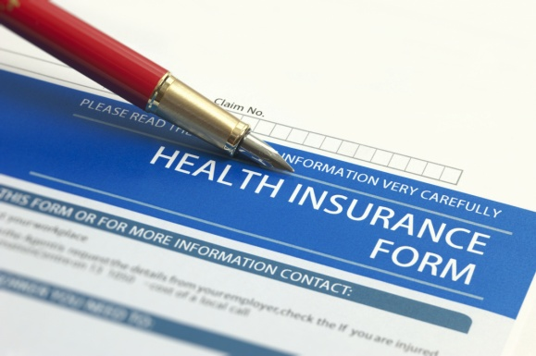

Health-Related Fraud
Fraudulent online pharmacies
Fraudulent health-related products
Health insurance scams
Medical discount card scams
Notes:
We will explore all of these topics further in the upcoming slides.

Slide 8
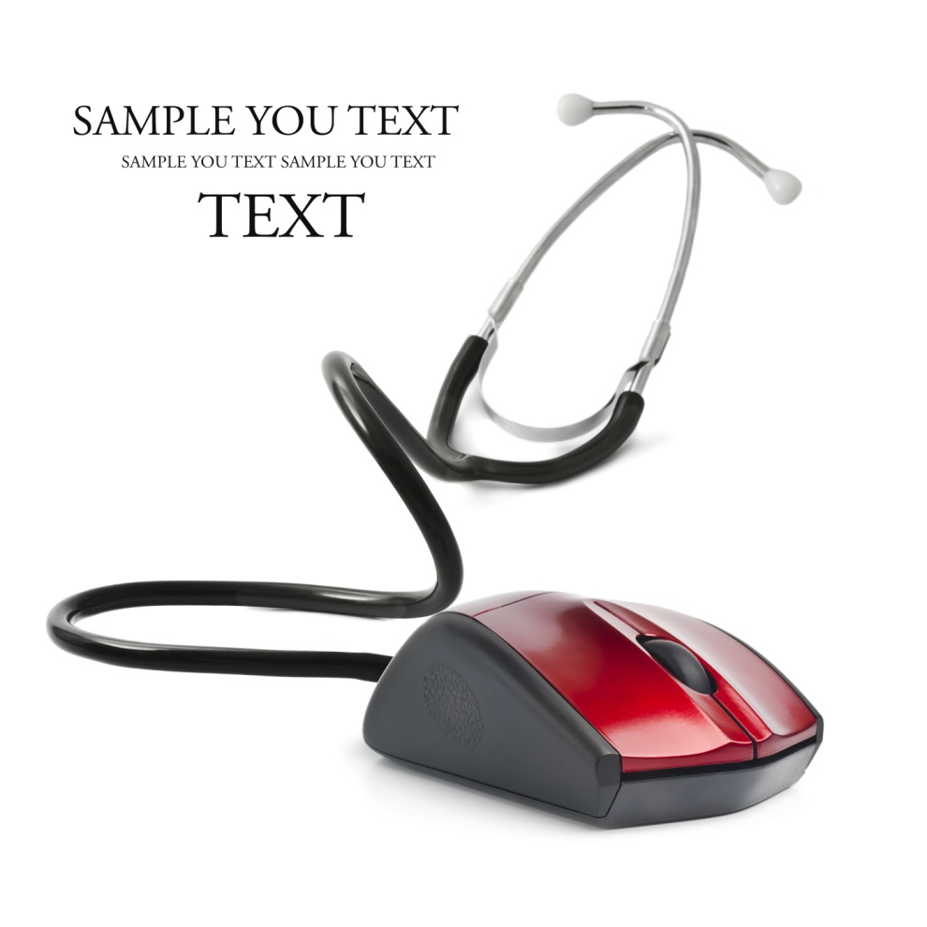
Fraudulent Online Pharmacies
Medications can be:
Expired
Counterfeit
Mislabeled
Contaminated
Adulterated
Contain no active ingredient, too much active ingredient, or too little active ingredient
Notes:
While there are legitimate online pharmacies and we will explore how to detect the ones that are in later slides, there are many fraudulent ones online. These pharmacies can carry harmful medications that are expired, counterfeit, mislabeled, contaminated, adulterated or contain no active ingredient or too much or too little active ingredient.
(Accessed on January 2, 2019)
https://www.nclnet.org/unregulated_online_pharmacies

Slide 9
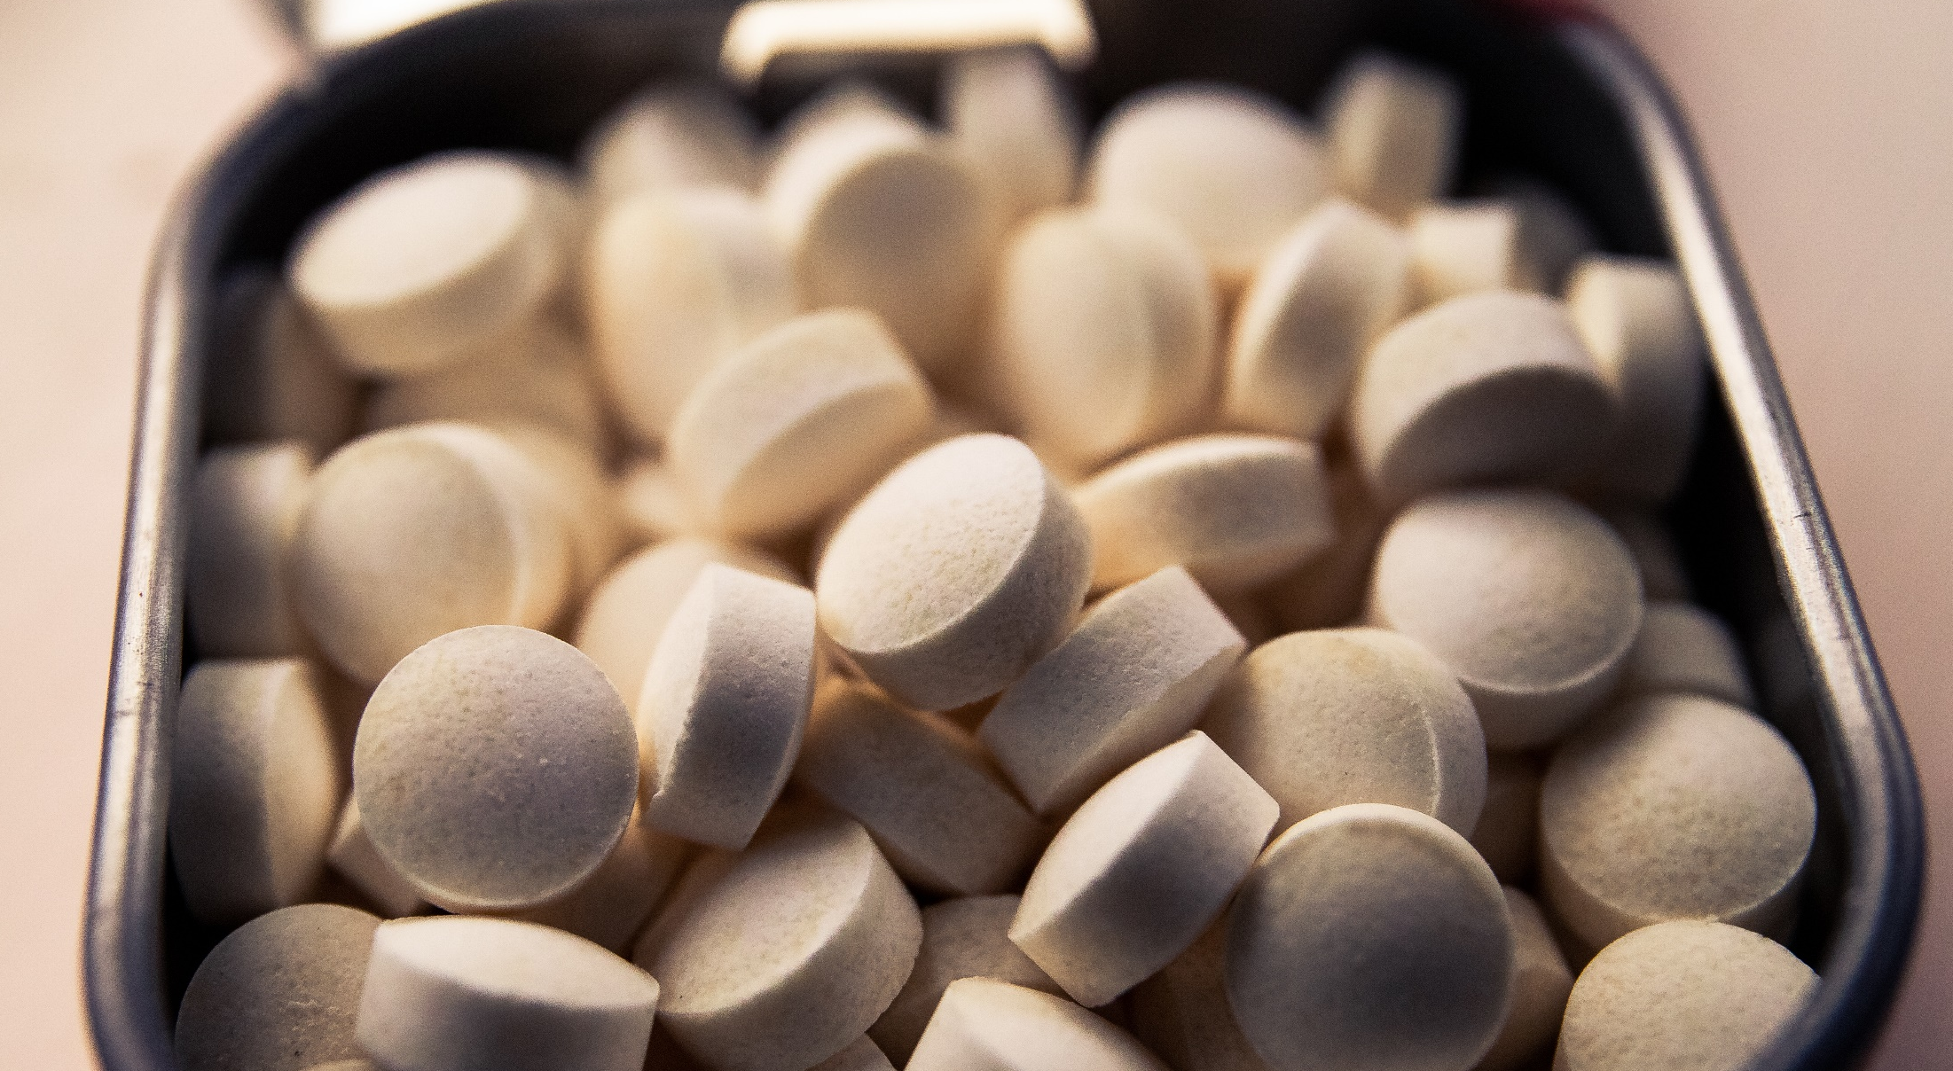

Counterfeit Medication
https://youtu.be/3FljxI4tl_8?t=1071
Notes:
**Instructor Note: Internet Connection Required.** This clip comes from a National Geographic video called Illicit: The Dark Trade. National Geographic explores the dark side of globalization and the underground economy. Based on the book, Illicit, by Dr. Moises Naim, highly acclaimed editor of Foreign Policy Magazine, this TV special explores the onslaught of illicit activities exploding worldwide and the consequences of globalization spurring arms trafficking and human smuggling to money laundering and music bootlegging.
The video can be found on YouTube here: https://youtu.be/3FljxI4tl_8?t=1071
Illicit – Counterfeit Medicines and Other Products. Counterfeit medicines clip begins at 17:51

Slide 10
Health-related fraud prevention
Could Megan have prevented this health-related fraud ?
YES
Gotten a prescription from a licensed physician.
Not ordered from a pharmacy outside the U.S.
Made sure it was a legitimate licensed pharmacy.
Noticed that the bargain price is too good to be true!
Notes:
Let’s go back and take a look at Megan’s situation. Is there anything she could have done to prevent herself from being victimized? YES. As you can see on the screen there are a few specific things she could have done that might have prevented this from occurring.
She could have:
Gotten a prescription from a licensed physician
Not ordered from a pharmacy outside the U.S.
Made sure it was a legitimate licensed pharmacy
Noticed that the bargain price is too good to be true!

Slide 11
Signs of Fraudulent Online Pharmacy
Located outside the U.S.
Not licensed in the U.S. by any state agency
Does not require a prescription
Very low prices
Sends spam or unsolicited email offering big discounts
Ships prescriptions worldwide
Ships drugs from foreign country
Notes:
Here are some signs of that an online pharmacy is probably fraudulent:
Located outside the U.S.
Not licensed in the U.S. by any state agency
Does not require a prescription
Very low prices
Sends spam or unsolicited email offering big discounts
Ships prescriptions worldwide
Ships drugs from foreign country
(Accessed on January 2, 2019)
https://www.fda.gov/Drugs/ResourcesForYou/Consumers/BuyingUsingMedicineSafely/BuyingMedicinesOvertheInternet/BeSafeRxKnowYourOnlinePharmacy/ucm294170.htm#safely_purchase
https://www.fda.gov/ForConsumers/ConsumerUpdates/ucm048396.htm

Slide 12
Signs of Legitimate Online Pharmacy
Requires a valid prescription from a doctor
Requires a detailed medical history from you
Clearly states their payment, privacy and shipping fees on their sites
Uses secure or encrypted website
Licensed by state board of pharmacy (or equivalent state agency) where the patient is located
Located in the U.S. and provides a physical street address
Has a licensed pharmacist available for consultation
Notes:
Here are some signs that an online pharmacy is probably legitimate:
Requires a valid prescription from a doctor
Requires a detailed medical history from you
Clearly states their payment, privacy and shipping fees on their sites
Uses secure or encrypted website
Licensed by state board of pharmacy (or equivalent state agency) where the patient is located
Located in the U.S. and provides a physical street address
Has a licensed pharmacist available for consultation
(Accessed on January 2, 2019)
https://www.fda.gov/Drugs/ResourcesForYou/Consumers/BuyingUsingMedicineSafely/BuyingMedicinesOvertheInternet/BeSafeRxKnowYourOnlinePharmacy/ucm294170.htm#safely_purchase
https://www.fda.gov/ForConsumers/ConsumerUpdates/ucm048396.htm

Slide 13

Questionable Health Products
Miracle Cure
Revolutionary Scientific Breakthrough
Alternative to Drugs or Surgery
Notes:
Up to this point we have been discussing online pharmacies that CLAIM to sell FDA approved medications but what about the other drugs out there? Have you ever seen products with these promises attached to them? Pay attention to the wording of the product descriptions if they make these huge claims, they are probably bogus and may do more than just waste your money. They can cause serious injury or even death.
(Accessed on January 2, 2019)
https://www.fda.gov/ForConsumers/ConsumerUpdates/ucm341344.htm

Slide 14

Food and Drug Administration (FDA)
“A health product is fraudulent if it is deceptively promoted as being effective against a disease or health condition but has not been scientifically proven safe and effective for that purpose.”
Source: U.S. Food & Drug Administration
Notes:
The FDA says a health product is fraudulent if it is deceptively promoted as being effective against a disease or health condition but has not been scientifically proven safe and effective for that purpose.
(Accessed on January 2, 2019)
https://www.fda.gov/ForConsumers/ConsumerUpdates/ucm341344.htm

Slide 15

Many fraudulent products make make make claims related to:
Weight loss
Sexual performance
Memory loss
Serious diseases such as cancer, diabetes, heart disease, arthritis and Alzheimer’s
Notes:
Fraudulent health care products not only waste your money but can cause serious injury or death. Using unproven treatments can delay getting a potentially life-saving diagnosis and medication that actually works. Also fraudulent products sometimes contain hidden drug ingredients that can be harmful when unknowingly taken by consumers.
(Accessed on January 2, 2019)
https://www.fda.gov/ForConsumers/ConsumerUpdates/ucm341344.htm

Slide 16

Zi Xiu Tang Bee Pollen
Product marketed for weight loss
FDA found it contained dangerous drug ingredients known as sibutramine and/or phenolphthalein.
Sibutramine and phenolphthalein was removed from the market in October 2010.
Sibutramine increases risk of heart attack and stroke
Phenolphthalein has cancer causing risks
Notes:
Manufacturers and distributors of Zi Xui Tang even created an anti-counterfeiting system to persuade consumers that their product is “authentic” and that not all bee pollen products are the same. The ruse includes a 16-digit code on the package that consumers can use to go online and “validate” whether the product is “genuine” or counterfeit.
(Accessed on October 2, 2019)
http://www.safebee.com/health/some-bee-pollen-weight-loss-products-are-dangerous-scam

Slide 17

Cancer Cures
Treats all forms of cancer
Shrinks or kills cancer cells and tumors
More effective than chemotherapy
Leaves healthy cells intact
Cures cancer
Notes:
Possibly one of the most cruel attempts to defraud are the erroneous claims of having found the “miracle cure” for cancer. Many of these products come in the form of pills, capsules, powders, creams, teas, oils, and treatment kits and are advertised as “natural” treatments or dietary supplements. Fraudsters often promote these products as dietary supplements or natural products when in fact, they may cause harm, interfere with, or delay the beneficial treatments patients may be receiving under their physician’s care, using FDA-regulated treatments.
(Accessed on January 2, 2019)
https://www.fda.gov/ForConsumers/ConsumerUpdates/ucm048383.htm

Slide 18
Signs that a product is fraudulent
One product does it all
Personal testimonials
Quick fixes
All natural
Miracle cure
Conspiracy theories
Notes:
One product does it all: Be suspicious of products that claim to cure a wide range of diseases. A New York firm claimed its products marketed as dietary supplements could treat or cure senile dementia, brain atrophy, atherosclerosis, kidney dysfunction, gangrene, depression, osteoarthritis, dysuria, and lung, cervical and prostate cancer. In October 2012, at FDA’s request, U.S. marshals seized these products.
Personal testimonials: Success stories, such as “It cured my diabetes” or “My tumors are gone,” are easy to make up and are not a substitute for scientific evidence.
Quick fixes: Few diseases or conditions can be treated quickly, even with legitimate products. Beware of language such as “Lose 30 pounds in 30 days” or “eliminates skin cancer in days.”
All natural: Some plants found in nature (such as poisonous mushrooms) can kill when consumed. Moreover, FDA has found numerous products promoted as “all natural” but that contain hidden and dangerously high doses of prescription drug ingredients or even untested active artificial ingredients.
Miracle Cure: Alarms should go off when you see this claim or others like it such as “new discovery,” “scientific breakthrough” or “secret ingredient.” If a real cure for a serious disease were discovered, it would be widely reported through the media and prescribed by health professionals—not buried in print ads, TV infomercials or on websites.
Conspiracy theories: Claims like “The pharmaceutical industry and the government are working together to hide information about a miracle cure” are always untrue and unfounded. These statements are used to distract consumers from the obvious, common-sense questions about the so-called miracle cure.
(Accessed on January 2, 2019)
https://www.fda.gov/ForConsumers/ConsumerUpdates/ucm341344.htm

Slide 19

Health Insurance Scams
Scammers selling false health insurance to gain personal information for financial gain
  Affordable premiums
  No medical exams
  Guaranteed acceptance
Notes:
Often these scammers target small businesses, unions and associations. These policies are fake. It’s only when a policyholder needs the insurance that the game’s up. They can sell these false insurance plans through email, phone calls, or face-to-face.
(Accessed on October 2, 2019)
https://scambusters.org/healthinsurancescam.html

Slide 20
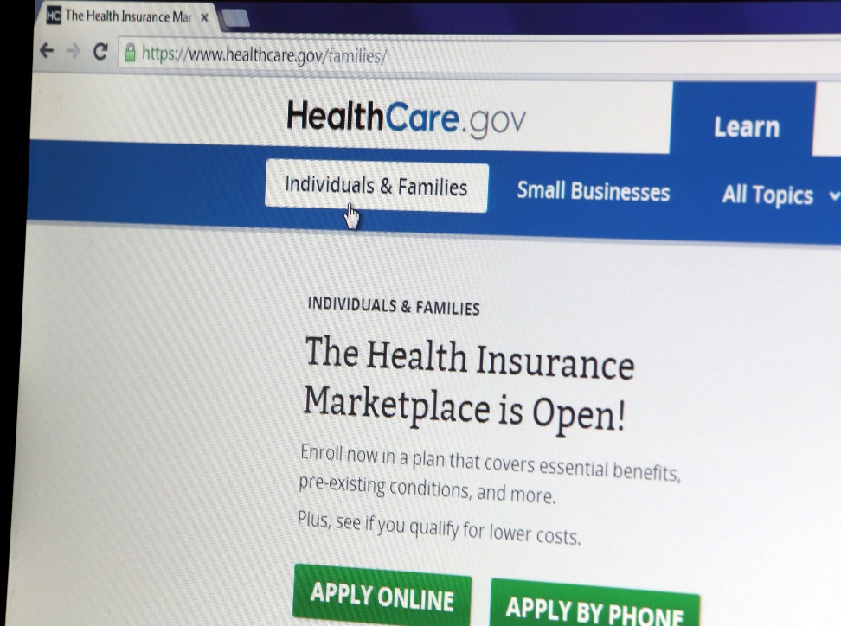
Health Care Marketplace Scams
Scammers try to con victims out of their personal information by telling them they are going to be issued a national health card.
Notes:
Any effort to solicit information from you for national health care should be regarded as suspicious. The government does not solicit information over the phone or through emails. Hang up on callers, and don’t respond to emails. Also those working for the government would never refer to the insurance obtained on the federal or state exchanges as “Obamacare.”
(Accessed October 2, 2019)
https://scambusters.org/healthinsurancescam.html

Slide 21
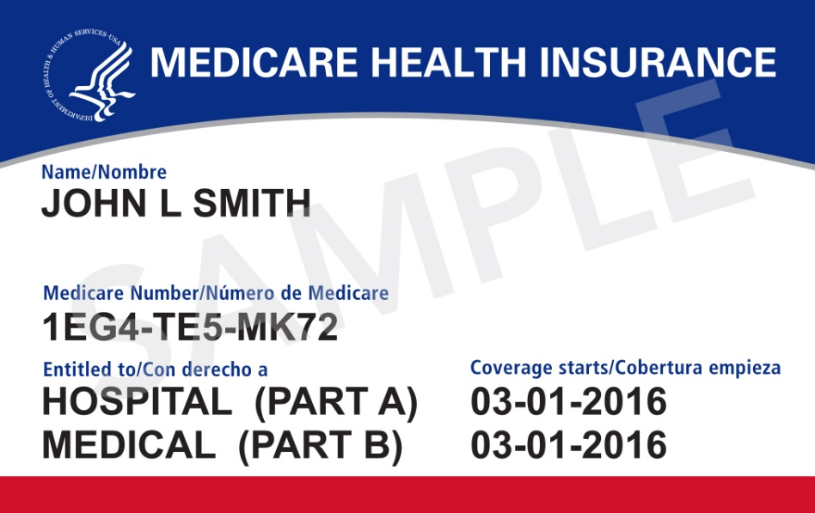
Medicare Card Scams
Scammers try and con victims out of their personal information by telling them they are going to be issued a “replacement card.”
Notes:
In April 2018, Medicare issued new cards consisting of randomly assigned combination of numbers and letters in order to help protect cardholders against theft—previous cards contained social security numbers. Unfortunately, scammers were prepared, rolling out multiple versions of the new card scam. In some cases, scammers will call unsuspecting seniors impersonating Medicare employees and for personal identifiable information so they can issue a new “replacement card.” This is bogus—the government would not call and ask for your personal identifiable information over the phone.
(Accessed on December 3, 2018)
https://www.aarp.org/money/scams-fraud/info-2019/new-medicare-card.html

Slide 22
Medical Discount Card Scams
Presented as substitute for medical insurance
Discounts on everything from eye exams to dental work
Ads for them can be found all over internet, in print and televised media
Scammers try and get victim to divulge personal information
Notes:
This scam is based on another version of medical insurance that provides a discount for all medical exams. These ads are painted all over the internet and their goal is to gain personal information from their victims
(Accesses on January 7, 2019)
https://www.consumer.ftc.gov/articles/0165-discount-plan-or-health-insurance#medicaldiscountscams

Slide 23
TIPS to avoid victimization
Check with your state’s department of insurance to see if the company is properly licensed
Research it, if you discover complaints, hidden fees, false promises, avoid the offer
Don’t divulge any personal information
Report your complaint to the Federal Trade Commission www.ftc.gov/complaint
Notes:
(Accessed on October 2, 2019)
www.ftc.gov/complaint
https://www.nerdwallet.com/blog/insurance/how-state-department-insurance-can-help/
https://www.insurancefraud.org/scam-alerts-fake-health.htm

Slide 24

QUESTIONS
Notes:
**Instructor Note: Ask the participants if they have any questions about health-related fraud, prevention tips, or how to report this type of fraud.**

Slide 25
Graphics Credit
“94686637 Copyright fotographic 1980, 2015 Used under license from Shutterstock.com“, “214296676 Copyright master_art, 2015 Used under license from Shutterstock.com“,
“191298941 Copyright JENG_NIAMWHAN, 2015 Used under license from Shutterstock.com“, “224800615 Copyright JMiks, 2015 Used under license from Shutterstock.com“, “54522421 Copyright Alexander Raths, 2015 Used under license from Shutterstock.com“, " 214833409 Copyright jannoon028, 2015 Used under license from Shutterstock.com“, " 83947003 Copyright T33kid, 2015 Used under license from Shutterstock.com“, “108587627 Copyright chuckstock, 2015 Used under license from Shutterstock.com“, “110402225 Copyright Stokkete, 2015 Used under license from Shutterstock.com“, “186368387 Copyright bochimsang12, 2015 Used under license from Shutterstock.com“, “93881164 Copyright ULKASTUDIO, 2015 Used under license from Shutterstock.com“, “179022608 Copyright Steve Cukrov, 2015 Used under license from Shutterstock.com“, “180412982Copyright Hurst Photo, 2015 Used under license from Shutterstock.com“, “100466146 Copyright Kzenon 2015 Used under license from shutterstock.com“, “163888526 Copyright Peter Waters, 2015 Used under license from shutterstock.com“, “226628770 Copyright Rawpixel, 2015 Used under license from shutterstock.com“, “153213146 Copyright garriphoto, 2015 Used under license from Shutterstock.com“”4474129 Copyright Amy Dunn, 2018 Used under license from Bigstock.com”

Slide 26
Bibliography
AARP. “New Medicare Card Scam.” December 3, 2018. https://www.aarp.org/money/scams-fraud/info-2019/new-medicare-card.html.
“Fake Health Plans.” Coalition Against Insurance Fraud. Accessed on October 2, 2019. https://www.insurancefraud.org/scam-alerts-fake-health.htm
Federal Trade Commission Consumer Information. “Discount Plan or Health Insurance?.” Accessed January 7, 2019. https://www.consumer.ftc.gov/articles/0165-discount-plan-or-health-insurance#medicaldiscountscams
National Consumer League. “Imposters, Information Theft, and Internet Scams: The Dangers of Unregulated Online Pharmacies.” Accessed January 2, 2019. https://www.nclnet.org/unregulated_online_pharmacies.
Renter, Elizabeth. “How Your State Department of Insurance Can Help You.” Nerdwallet. Nerdwallet, Inc., 2019. Accessed on October 2, 2019. https://www.nerdwallet.com/blog/insurance/how-state-department-insurance-can-help/
“Some Bee Pollen Weight Loss Products are a Dangerous Scam.” Safe Bee. Safe Bee, 12 March, 2015. Accessed on October 2, 2019. http://www.safebee.com/health/some-bee-pollen-weight-loss-products-are-dangerous-scam

Slide 27
Bibliography
U.S. Food and Drug Administration. “Be Safe Rx: Know Your Online Pharmacy.” Last modified February 13, 2018. https://www.fda.gov/Drugs/ResourcesForYou/Consumers/BuyingUsingMedicineSafely/BuyingMedicinesOvertheInternet/BeSafeRxKnowYourOnlinePharmacy/ucm294170.htm#safely_purchase
U.S. Food and Drug Administration. “How to Buy Medicines Safely from an Online Pharmacy.” Last modified January 25, 2018. https://www.fda.gov/ForConsumers/ConsumerUpdates/ucm048396.htm.
U.S. Food and Drug Administration. “Products Claiming to 'Cure' Cancer Are a Cruel Deception.” Last modified January 8, 2018. https://www.fda.gov/ForConsumers/ConsumerUpdates/ucm048383.htm.
U.S. Food and Drug Administration. “6 Tip-Offs to Rip-offs: Don't Fall for Health Fraud Scams.” Last modified December 13, 2017. https://www.fda.gov/ForConsumers/ConsumerUpdates/ucm341344.htm.
“10 Warning Signs of A Health Insurance Scam.” Scambusters. Jim Audri Lanford, 2019. Accessed on October 2, 2019. https://scambusters.org/healthinsurancescam.html
“Welcome to Complaint Assistant.” Federal Trade Commission Protecting America’s Consumers. Accessed on October 2, 2019. https://www.ftccomplaintassistant.gov/#crnt&panel1-1

