Slide 1






Advance Fee Fraud
This project was supported by Cooperative Agreement Number 2013-CK-WX-K027 awarded by the Office of Community Oriented Policing Services, U.S. Department of Justice. The opinions contained herein are those of the author(s) and do not necessarily represent the official position or policies of the U.S. Department of Justice. Reference to specific agencies, companies, products, or services should not be considered an endorsement by the author(s) or the U.S. Department of Justice. Rather, the references are illustrations to supplement discussion of the issues.
Notes:
Today, we are going to spend some time discussing the concept of Advance Fee Fraud. We will discuss what advance fee fraud is, the different types, and how to prevent advance fee fraud victimization.

Slide 2



Meet Joe and Gloria
Retired couple who recently decided to downsize from their family home and move to Florida
Since it’s just the two of them they decided to purchase a small town home in a retirement community
Notes:
Meet Joe and Gloria. The couple are recently retired, and after years of saving, they were able to purchase a new home in a Florida retirement community, fulfilling a lifelong dream.

Slide 3


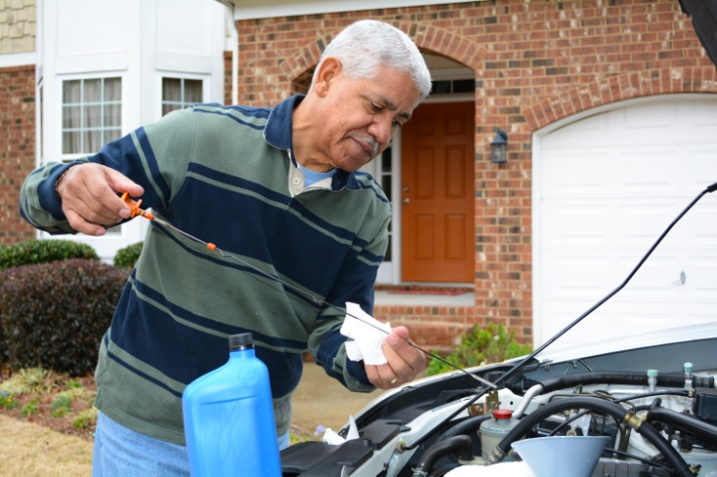
Enjoying Retired Life
Spending time with family
Enjoying hobby projects
Playing bingo at the local senior center
Notes:
Since retiring, Joe and Gloria have embraced their simpler, less hectic lives. They spend as much time with family as possible (although this is more difficult since they moved to Florida), devoting time to hobby projects, and playing bingo at the local senior center.

Slide 4

Spending More Time Online
Keeping up with family
Managing accounts
Reading news
Playing games/contests
Staying in touch with friends and family
Managing their retirement accounts online
Playing online games and reading the news
Entering an occasional contest
Notes:
Since retiring and moving to Florida, Joe and Gloria spend a lot more time on the internet than they used to. It is important to keep in touch with family and old friends since they are so far away now. And, since retiring, they aren’t bringing in as much money as they used to, and it helps that they can monitor their accounts online. They also enjoy other online leisure activities, playing games and entering the occasional contest. You never know, they might get lucky!

Slide 5

Email from the Caribbean
Lottery Commission
Dear Sir/Madam, This is to inform you of the release of your winnings in the CARRIBBEAN LOTTERY COMMISION OF ARUBA SWEEPSTAKES on the 12th of November 2014. Your name is attached to ticket number 986-11-345-983-936 with serial number 2014-91 which consequently won the lottery in the 2nd category.
You have approved therefore for a lump sum payout of USD 615, 810 (UNITED STATES DOLLARS ONLY) in cash credited to file with REF TQ/2987654818/02 and BATCH NO. 000348729. This is from total cash prize of USD 10,468,770 (US DOLLARS ONLY) shared among 17 (seventeen) international winners in this category, CONGRATULATIONS!!!! ACT NOW BEFORE YOUR CLAIM GOES TO SOMEONE ELSE!!!!
To begin your claim, please contact your claims agent, DR, Rose Perez Harris the foreign service Manager of ARUBA SECURITY Company on TEL: 011 297 982 5573 FAX: 011 297 982 9015 for the processing and remittance of your winning prize money to a designation of your choice.
Notes:
Joe cannot believe his luck! He knew that they entered some contests online but never dreamed that they would actually win! This money could not come at a better time in their lives. Now they can fully enjoy their retirement and not have to worry about their diminished income. With this money, they can afford to help their children and grandchildren with things that they need, like money for emergencies and school tuition.

Slide 6

Joe Contacts Rose Perez Harris
Joe decides to give Rose Perez Harris a call.
She confirms that he is a winner and will receive the money promised.
She just needs to confirm some information.
Joe confirms his name and address.
Notes:
Even if it is a scam, Joe decides that it can’t hurt to check it out and gave Rose Perez Harris a phone call. She confirms to Joe that he is indeed a winner and will be receiving the money promised in the email. She just needs him to confirm some information for her first.

Slide 7

Just One More Thing…
Ms. Harris tells Joe that everything is set, except for one thing: she needs $500 via Western Union for taxes and processing fees.
Joe wants to discuss this with his wife first,
but Ms. Harris assures him that he needs
to act soon or the money will go to
someone else.
$500 is a small price to pay for over $600,000.
Joe wires the money to Ms. Harris.
Notes:
Ms. Harris tells Joe that everything is set, except for one thing: He needs to Western Union $500 for taxes and processing fees. $500 is a lot of money, and Joe wants to discuss this with his wife first, but Ms. Harris assures him that he needs to act soon or the prize will go to someone else. After all, what is $500 when you are going to get over $600,000 in payout. So, Joe withdraws the money from his account and wires the money to Ms. Harris.

Slide 8
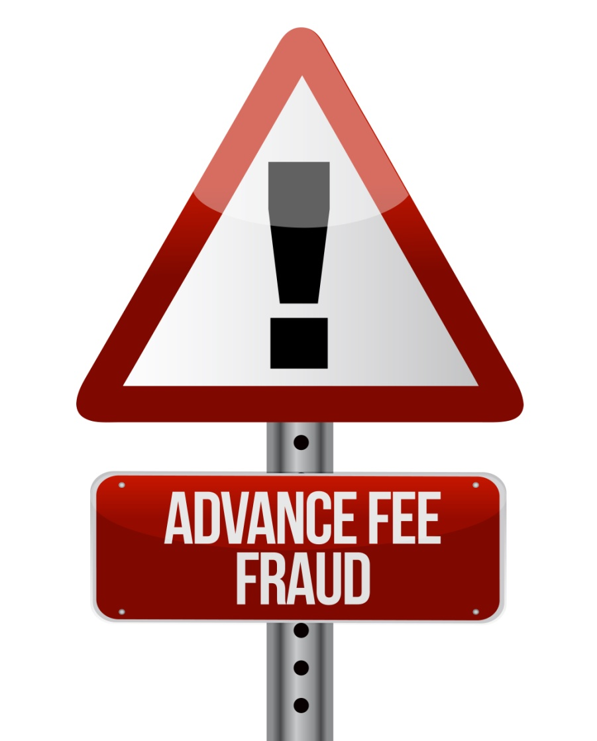
One Month Later and……
Joe hasn’t heard anything from Ms. Harris, and there is no sign of his lottery winnings.
He tries to call her many times but gets no answer, and his emails are returned.
Joe has fallen victim to advance fee fraud.
Notes:
Joe received notification that the $500 was picked up by someone at the Western Union office, but he hasn’t heard from Ms. Harris. He has tried to call her number but gets no answer, and there is no way to leave a message. There is no sign of the check that he was supposed to receive from the lottery. Ms. Harris said that it might take a few weeks to arrive, but it should have been here by now.
Joe is the victim of an advance fee fraud.

Slide 9

What is Advance Fee Fraud?
A scam in which criminals convince victims to pay a fee to receive something of value (money, goods, services, etc.) , but do not deliver anything of value to the victim.
Notes:
Advance fee fraud is a scam in which criminals convince victims to pay a fee to receive something of value, but do not deliver anything of value to the victim.
(Accessed on September 25, 2019)
https://www.fbi.gov/scams-and-safety/common-fraud-schemes/advance-fee-schemes
https://www.investor.gov/protect-your-investments/fraud/types-fraud/advance-fee-fraudhttps://www.fbi.gov/scams-and-safety/common-fraud-schemes/advance-fee-schemes

Slide 10
Types of Advance Fee Fraud
Lotteries
Victims are notified that they have won some sort of contest. The only thing required is that they provide a fee to collect their prize.
Nigerian Letters
Victim receives an email stating they have been identified as a trusted person to work with the letter writer (usually a government official) to gain access to riches. Victims are required to pay a fee to help free up access to the money.
FBI/Government Agency Scams
An email appearing to be from an official government agency, claiming the victim as committed a crime. Legal action can be avoided by paying a fee.
Notes:
There are many types of advance fee frauds. The following types are examples of popular ways in which this type of fraud is perpetrated:
Lotteries: Victim is notified that they have won some form of contest involving a valuable prize, whether it is money, merchandise, travel or some other type of valuable commodity. The only thing required from the “winner” is that they provide a fee of some sort, usually characterized as a processing or administrative fee, to facilitate delivery of the winnings.
419 Letters A.K.A. Nigerian Letters: This scam involves emails originating from a foreign country, usually Nigeria. The victim is notified that he or she has been identified as a reputable individual who can be trusted to work with the letter writer—a “high-ranking Nigerian government employee” who has come into an opportunity to collect several million dollars. The victim’s assistance is required to gain access to these funds; in return the victim is promised a substantial portion of the funds.
FBI Scams: Also known as impersonation scams, FBI scams usually involve an official-looking email with authentic-looking logos from a government agency—the FBI, IRS, Homeland Security, or other agencies—claiming that the recipient has committed an offense and will face legal action. The legal action can be avoided by payment of some form of bond or fine. The victim may be instructed to perform a wire transfer to a designated Green Dot money card, which is difficult if not impossible to trace.
(Accessed on September 25, 2019)
https://www.westernunion.com/us/en/fraudawareness/fraud-types.html
https://www.fbi.gov/scams-and-safety/common-fraud-schemes/nigerian-letter-or-419-fraud

Slide 11
Types of Advance Fee Fraud (contd.)
Credit Services/Payday Loans
The promise of a loan or credit card that requires you to pay a fee upfront or demands repayment of a loan that you did not take out.
Debt Rescue or Loan Modification
Offers to assist those suffering from bad credit or high levels of debt making the rescue effort sound simple, promising significant reductions in monthly payments. The victim is required to pay an upfront fee to use the services.
Classified Ads
Victims answer classified ads for merchandise or services and are asked to provide a down payment or partial payment, but never receive the product.
Notes:
Advance Payments for Credit Services : The promise of a loan or credit card that requires you to pay a fee first; worthless credit card loss protection and insurance programs; the promise that inaccurate negative information can be removed from your credit file for a fee; or services offering to recover government refunds or unclaimed funds.
Debt Rescue or Loan Modification Scams: This scheme typically involves offers to assist those suffering from bad credit or high levels of debt making the rescue effort sound simple, quick and promising significant reductions in monthly payments. The victim is required to pay an upfront fee to take advantage of the services of the scammer, who, if they perform any service at all, are simply doing what the victim could have done on their own for free.
Classified Ads: Victims answer a classified ad for merchandise or services and are asked to provide a down or partial payment. Victims pay but never receive the merchandise or services.
(Accessed on September 25, 2019)
https://www.investopedia.com/articles/pf/08/credit-scams-online.asp
https://www.scamwatch.gov.au/types-of-scams/buying-or-selling/classified-scams

Slide 12
Advance Fee Fraud Prevention
Could Joe’s situation have been prevented?
YES
He could have looked for red flags.
  The email wasn’t addressed to Joe
  He didn’t enter the Caribbean lottery
  There were misspellings and grammatical errors in the email.
    This will depend on the sophistication of the scammer.
  He could have researched the Caribbean Lottery Commission to see if they were a legitimate lottery retailer.
Notes:
Let’s go back and take a look at Joe’s situation. Is there anything he could have done to prevent being victimized? YES. As you can see on the screen there are a few specific things he could have done that could have prevented this from occurring.
He could have looked for red flags:
The email was not addressed directly to Joe.
He did not enter that specific lottery. You cannot win a lottery that you do not enter.
He could have looked a little closer at the email. There were a couple of grammatical errors and misspellings.

Slide 13
Indicators Within the Email
Dear Sir/Madam, This is to inform you of the release of your winnings in the CARRIBBEAN LOTTERY COMMISION OF ARUBA SWEEPSTAKES on the 12th of November 2014. Your name is attached to ticket number 986-11-345-983-936 with serial number 2014-91 which consequently won the lottery in the 2nd category.
You cannot win a lottery that you did not enter.
The email was not directed specifically to Joe.
Logos, “official” seals, and ticket numbers are used to try and add authenticity.
Misspellings.
Notes:
Let’s look at Joe’s original email more closely. There were clues that pointed to a scam.
You cannot win a lottery that you did not enter. If you do play a foreign lottery, you may be violating federal law.
Scammers often use logos and official looking seals to trick victims into thinking that the email is official.
The email was not directed specifically to Joe. Scammers will often put what appear to be specific details regarding your entry (such as the ticket number and reference numbers) into an email to trick you into believing that the letter is unique when, in fact, identical letters have been sent to thousands of other people. This letter has specific ticket numbers but is not addressed to a single person.

Slide 14
Indicators Within the Email
You have approved therefore for a lump sum payout of USD 615, 810 (UNITED STATES DOLLARS ONLY) in cash credited to file with REF TQ/2987654818/02 and BATCH NO. 000348729. This is from total cash prize of USD 10,468,770 (US DOLLARS ONLY) shared among 17 (seventeen) international winners in this category, CONGRATULATIONS!!!! ACT NOW BEFORE YOUR CLAIM GOES TO SOMEONE ELSE!!!!
To begin your claim, please contact your claims agent, DR, Rose Perez Harris the foreign service Manager of ARUBA SECURITY Company on TEL: 011 297 982 5573 FAX: 011 297 982 9015 for the processing and remittance of your winning prize money to a designation of your choice.
The lure of large amounts of money.
Scammers often ask you to “act soon” or “do not tell anyone” to encourage you to respond sooner.
Scammers request further contact. Telephone numbers and/or email listed may not belong to the country or area where the prize is supposed to be from.
Notes:
Let’s look at Joe’s original email more closely. There were clues that pointed to a scam.
The lure of hundreds of thousands of dollars in winnings is designed to grab the readers’ interest.
Scammers often ask you to “act soon” or “not tell anyone” to encourage you to respond to the email before you can do your research.
Scammers often provide telephone or fax contact information in the hopes that you will contact them for further information. If you do some research regarding the numbers listed, you will often find that they have been associated with scams in the past or are not connected to the country where the lottery is reporting to be from.

Slide 15
TIPS to avoid victimization
If you receive an email (especially from another country) asking you to send money, personal or identifying information in order to receive something else in exchange such as a monetary settlement, do not reply in any manner.
DO NOT wire money to someone you do not know personally.
Protect yourself through your email by deleting financial request emails, turning on your spam filters, and denying all requests for financial assistance.
Notes:
Here are some tips to avoid victimization.
(Accessed on September 25, 2019)
https://www.fbi.gov/scams-and-safety/common-fraud-schemes/nigerian-letter-or-419-fraud
https://www.webroot.com/us/en/resources/tips-articles/what-is-social-engineering

Slide 16
TIPS to avoid victimization (cont.)
Do not click on any links, open any files, or download any content contained within an email unless you personally know the sender.
Be skeptical of any individuals representing themselves as officials asking for help in placing large sums of money.
Be wary of business deals that require you to sign nondisclosure or non-circumvention agreements that are designed to prevent you from independently verifying the bona fides of the people with whom you intend to do business.
Notes:
Here are some tips to avoid victimization.
(Accessed on September 25, 2019)
https://www.fbi.gov/scams-and-safety/common-fraud-schemes/nigerian-letter-or-419-fraud
https://www.veridiancu.org/faq/12912/tips-for-avoiding-advanced-fee-fraud

Slide 17


What to Do If You Are a Victim
Report the incident to your local law enforcement agency.
Notify your banking institutions.
Contact your State Attorney General.
File a complaint with Internet Crime Complaint center @ www.ic3.gov.
Submit a consumer complaint with the Federal Trade Commission @ www.ftc.gov/complaint.
www.ic3.gov
www.ftc.gov
Notes:
Here is a list of ways to report your victimization.
(Accessed on September 25, 2019)
www.ic3.gov
www.ftc.gov

Slide 18

QUESTIONS
Photo Credits: “94686637 Copyright fotographic 1980, 2015 Used under license from Shutterstock.com“, “214296676 Copyright master_art, 2015 Used under license from Shutterstock.com“, “181104998 Copyright Sam72, 2015,Used under license from Shutterstock.com“, “150954545 Copyright evka119, 2015,Used under license from Shutterstock.com“, "11558632 Copyright Rob Marmion, 2015,Used under license from Shutterstock.com“, “11336398 Copyright Rob Marmion, 2015 Used under license from Shutterstock.com“, “11434561 Copyright Rob Marmion, 2015 Used under license from Shutterstock.com“, “11454436 Copyright Rob Marmion, 2015 Used under license from Shutterstock.com“, “11483422 Copyright Rob Marmion, 2015 Used under license from Shutterstock.com“, “12550048 Copyright Rob Marmion, 2015 Used under license from Shutterstock.com“, “129735743 Copyright Rob Marmion, 2015 Used under license from Shutterstock.com“, “258951164 Copyright cigdem, 2015 Used under license from Shutterstock.com“, “125572220 Copyright alexmillos, 2015 Used under license from Shutterstock.com“, “159397175 Copyright alexmillos, 2015 Used under license from Shutterstock.com“, “161005310 Copyright Imagentle, 2015 Used under license from Shutterstock.com“, “153213146 Copyright garriphoto, 2015 Used under license from Shutterstock.com“
Notes:
**Instructor Note: Ask the participants if they have any questions about Advance Fee Fraud, prevention tips, or how to report this type of fraud.**

Slide 19
Bibliography
“Advance Fee Fraud.” Investor.gov U.S Securities and Exchange Commission. U.S Securities and Exchange Commission. Accessed on September 25, 2019. https://www.investor.gov/protect-your-investments/fraud/types-fraud/advance-fee-fraud
“Advance Fee Schemes.” Federal Bureau of Investigation. Accessed on September 25, 2019. https://www.fbi.gov/scams-and-safety/common-fraud-schemes/advance-fee-scheme
“Classified scams.” Scam watch. Australian Competition & Consumer Commission. Accessed on September 25, 2019. https://www.scamwatch.gov.au/types-of-scams/buying-or-selling/classified-scams
“Common types of fraud.” Western Union. Western Union Holdings Inc., 2019. Accessed on September 25, 2019. https://www.westernunion.com/us/en/fraudawareness/fraud-types.html
Federal Bureau of Investigation. The Internet Crime Complaint Center (IC3). Accessed on September 19, 2019. www.ic3.gov

Slide 20
Bibliography
Federal Trade Commission Consumer Information. Federal Trade Commission, Accessed on September 19, 2019. www.ftc.gov
Morah, Chizoba. “Credit Scams to Watch Out For.” Investopedia, 25 June, 2019. Accessed on September 25, 2019. https://www.investopedia.com/articles/pf/08/credit-scams-online.asp
“Nigerian Letter or “419” Fraud.” Federal Bureau of Investigation. Accessed on September 25, 2019. https://www.fbi.gov/scams-and-safety/common-fraud-schemes/nigerian-letter-or-419-fraud
“Refund and Recovery Scams.” Federal Trade Commission Consumer Information. Federal Trade Commission, August 2016. Accessed on September 25, 2019. https://www.consumer.ftc.gov/articles/0102-refund-and-recovery-scams
“Tips for Avoiding Advanced Fee Fraud.” Veridian Credit Union. 2019. Accessed on September 25, 2019. https://www.veridiancu.org/faq/12912/tips-for-avoiding-advanced-fee-fraud
“What is Social Engineering? Examples and Prevention Tips.” Webroot Smarter Cybersecurity. Webroot Inc., 2004-2019. Accessed on September 25, 2019. https://www.webroot.com/us/en/resources/tips-articles/what-is-social-engineering

