Slide 1
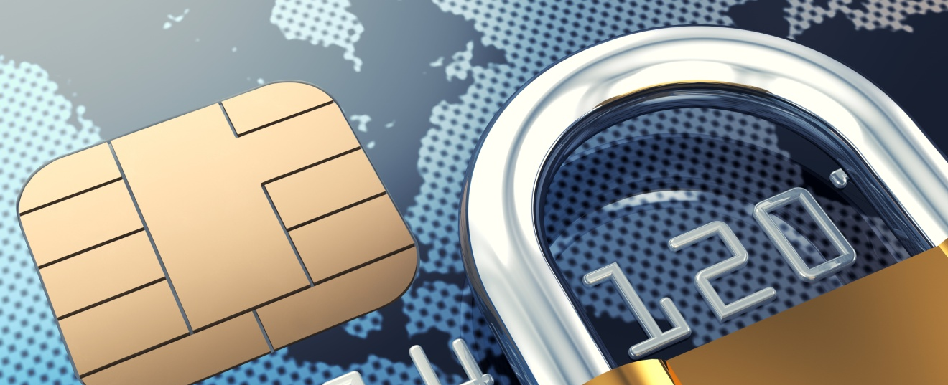
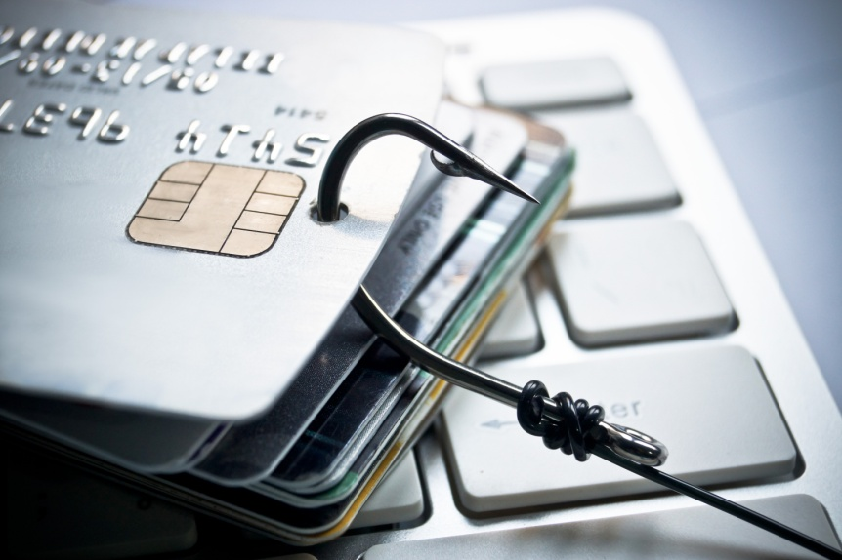






Credit/Debit Card Fraud
This project was supported by Cooperative Agreement Number 2013-CK-WX-K027 awarded by the Office of Community Oriented Policing Services, U.S. Department of Justice. The opinions contained herein are those of the author(s) and do not necessarily represent the official position or policies of the U.S. Department of Justice. Reference to specific agencies, companies, products, or services should not be considered an endorsement by the author(s) or the U.S. Department of Justice. Rather, the references are illustrations to supplement discussion of the issues.
Notes:
Notes

Slide 2

Meet Dave and Linda
Middle-aged couple
Family of four
Financially stable
Have recently taken on the responsibility of Dave’s parent’s finances
Notes:
Meet Dave and Linda Sampson. Dave and Linda are a middle-aged couple with two children and have been married for 20 years. Dave has recently took on the responsibility of being power of attorney for his elderly parents. While his parents are still able to live on their own, they asked Dave to help keep track of their finances and help them make financial decisions.

Slide 3

Missing mail
Dave picks up his parent’s mail every other day
He has been expecting a piece of mail from the courthouse
He contacts the courthouse and they assure him it was sent last week
Notes:
In addition to looking over his parent’s finances, Dave stops by every other day to get the mail for his parents. With their age it has been too much for them to get down to the bottom of the driveway. He has been expecting a piece of mail from the courthouse to be delivered to his parent’s address. After a week he began to question whether it had been sent. He contacts the courthouse and they assure him they sent the document out last week. During his conversation with the clerk, she promised to go ahead and mail out another copy.

Slide 4

Unauthorized charges
Unauthorized transactions detected
  Out of state grocery stores
  Out of state restaurants
  One online purchase
Dave contacts the bank to put a hold on their account and disable their debit cards
Bank advised Dave to run a credit report
Notes:
Later that evening Dave decides to sit down with his wife and go through his parent’s monthly online bank statement. As he begins to go through the transactions he notices a string of purchases over the past few days to stores and restaurants that he isn’t familiar with. Dave suspects that someone may have taken some of his parent’s mail but isn’t positive that is what happened.
Dave immediately gets on the phone with the bank to put a freeze on his parent’s account and have their cards disabled. While on the phone with the bank, he is advised that he may want to run a credit report and possibly even freeze his parent’s credit because of the uncertainty of the information obtained by the scammer.

Slide 5

Credit report checked
Dave runs a credit report for each of his parents
  annualcreditreport.com
  No suspicious activity found in the report
Credit bureaus contacted to freeze credit
  Equifax.com
  Experian.com
  TransUnion.com
Notes:
After speaking with the bank, Dave decides to go to annualcreditreport.com and run a credit check on both his parents. Fortunately there was no suspicious activity found on in their credit reports, at least at this point. Just to be safe Dave decides to contact the credit bureaus to put a temporary freeze on his parent’s credit.

Slide 6
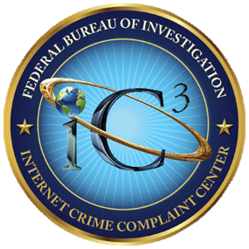

What is credit/debit card fraud?
IC3 – Fraudulent unauthorized charging of goods and services to a victim’s credit/debit card.
FTC – Account or billing issues, including interest rate changes, late fees, credit disputes, and overcharges; fraudulent credit card offers/phishing attempts; etc.
www.ic3.gov
www.ftc.gov
Notes:
There are a number of agencies and entities that have defined Credit/Debit Card Fraud, but we chose to present you with the definitions used by the Internet Crime Complaint Center (IC3) and the Federal Trade Commission (FTC). As you can see in both definitions it comes down to the illicit taking of another’s credit card information for the purpose of charging purchases or making cash withdrawals from the victim’s account.
(Accessed on September 25, 2019)
www.Ic3.gov
www.ftc.gov

Slide 7
How the cards/information is obtained
Simple thievery
Burglary of a residence, a vehicle, hotel room, etc.
Pick-pocketing and other forms of larceny
Dumpster diving
Process of going through trash to look for valuable items or information.
Access to records
Anyone in a position to obtain the personally identifiable information (PII) of another is in a position to perpetrate credit card fraud.
Notes:
There are a multitude of ways for thieves to gain access to credit/debit cards and/or the information need to cloned them. Over the next few slides we are going to take a look at some of the more common ways that credit/debit cards are stolen or cloned. Once we have covered these topics we will take a look at some ways we can protect ourselves against this type of fraud.
Credit Card Cloning (skimming)- is a technique whereby someone obtains your credit card details, copies them onto a bogus card and begins using the card.
Simple thievery: burglary of a residence, a vehicle, a personal briefcase, hotel room or even a gym locker, wherever someone might leave their wallet will likely provide access to the victims’ credit card collection and the personal information needed for a thief to successfully represent themselves as the legal owner of the credit card to run up the charges on a card and pick-pocketing and other forms of larceny that result in a thief obtaining possession of a credit/debit card fit into this same category. Theft of mail from one’s mailbox will provide easy access to credit card statements and other documents often containing enough information for a thief to obtain illicit access to their accounts.
Dumpster diving: Too often we receive information in the mail from our credit card company, that contains enough sensitive information to provide an identity thief the information needed to gain access to the account. One good place for a thief to look for this information is the trash. Unless the owner of the accounts is diligent about shredding their documents, credit card statements etc. they leave themselves vulnerable to having their account information compromised by any thief willing to sift through their discarded garbage.
Access to records: Essentially anyone in a position to obtain the personally identifiable information (PII) of another is in a position to perpetrate credit card fraud. The secretary at the personnel office, the records clerk at the hospital or doctor’s office, a bank teller, the clerical worker at your child’s school, a pharmacist or a clerical employee at a credit agency will have access to huge quantities of PII for the customers that business deals with.
(Accessed on September 25, 2019)
https://www.thoughtco.com/ways-identity-thieves-get-your-information-972208

Slide 8
How the cards/information is obtained
Change of address
Most credit card statements contain a box to check to request a change of address and/or a second card for a family member.
Shoulder surfing
The practice of looking over someone’s shoulder when they are at the ATM, or when they happen to be using their lap top to order something.
Social media
People who fill in too much detail in their personal profiles in whatever version of social media they may be using, often unwittingly provide some or all of the PII needed.
Notes:
Change of address: It is quite simple for a thief to take over someone’s account by obtaining copies of the monthly statements, either by stealing them from a mail box or searching through a person’s trash. Once the thief has a copy of the statement, they submit a change of address request and request a second card be issued. Credit card companies will often honor requests for a spouse’s card and even solicit customers to include other family members on their account. Such a request would typically not be investigated or verified by the credit agency and the thief would receive the new card and future statements at the new address. Unless the legal card holder happened to notice the absence of monthly statements, it’s unlikely that they would notice what had taken place in time to prevent serious damage to their account.
Shoulder surfing: This process can often produce enough information for a talented thief to gain access to a credit card or debit card account.
Social media: In today’s world of online social media, personal profiles can provide a substantial amount of information that a shrewd thief might find useful. One need not specifically state their date of birth in a profile form, if they post pictures of their latest birthday celebration for all their “friends” to see online. School and employment information can often be found, spouses and children’s names, even the names of parents which can then be searched via other sources to determine mother’s maiden name (one of the more frequently used methods of verification a credit/debit card agency uses to verify an identity of a client) can be obtained by a clever thief with a little effort and ingenuity. Adding to the vulnerability of social media as a source of PII, if the thief identifies a target that doesn’t have sufficient information readily available, they may actively engage that person in conversations, befriending them and persuading the target to provide through casual online conversations, the additional information needed to commit credit/debit card fraud.
(Accessed on September 25, 2019)
https://www.lifelock.com/learn-identity-theft-resources-what-is-shoulder-surfing.html
https://www.thoughtco.com/ways-identity-thieves-get-your-information-972208
https://www.eonetwork.org/octane-magazine/special-features/social-media-networks-facilitate-identity-theft-fraud
https://www.experian.com/blogs/ask-experian/what-is-personally-identifiable-information/

Slide 9
How the cards/information is obtained
Hotel scams
Guests receive a call from the front desk stating the hotel computer is reported to have crashed and the guest is asked verify their credit card information so the account can be updated.
Routine everyday use
Credit card information can be obtained by virtually any business by using a simple, commercially-available, palm-sized device that can read and record the information on the magnetic strip of most credit cards.
Hidden fees/Free trial offers
People who fill in too much detail in their personal profiles in whatever version of social media they may be using, often unwittingly provide some or all of the PII needed.
Notes:
Hotel scam: a recent (at the time of this writing) scam that is making itself known in the credit card fraud arena is the hotel scam. Guests staying at a hotel may receive a call in their room on the hotel phone from a person claiming to be the desk clerk. The hotel computer is reported to have crashed and the clerk on the phone is requesting that the guest verify their credit card information so the account can be updated. The guest, believing that this is a legitimate sounding request will more often than not, simply retrieve their credit card and read the account number and three digit key on the back of the card to the person on the phone.
Routine everyday use: Most people use their credit and debit cards many times a day for grocery shopping, gas for the car, or just lunch or a coffee at the local coffee house. Simple palm-sized devices are commercially available, that can read and record the information on the magnetic strip of most credit cards. Waiters, waitresses and clerks at retail stores, have been known to use these devices to obtain the information from customers credit cards when they pay for food, services or items they have obtained in the normal daily activities. The act of swiping the card through the device concealed in the palm of the clerk or waiters’ hand can be accomplished so quickly and discretely that few victims are able to catch the act. Once they have the information they can either use it to take over that person’s account, or they can make their money by selling large quantities of PII to organized groups specializing in trafficking such information. Today’s Smartphone technology makes it even easier by enabling the user of the device the ability to photograph both sides of a credit card in a matter of seconds and store literally thousands of such photos to their phone’s internal memory.
Hidden fees/Free trial offers: Offers from the credit card company that advertise services such as identity theft protection, reputation scanning, cash back offers etc. frequently will require the card holder to reply in the negative to avoid being enrolled in the service and thereby incurring the costs. Continuation of warranties, service contracts etc. often will involve an assessment of continuing fees at the end of an introductory period if the card holder fails to notify the company that the service is not desired. Shipping, handling and packaging fees may not be advertised in the original offer to purchase an item may appear on the purchasers statement when dealing with online purchases if the buyer is not careful to read the small print when making a purchase or participating in an online auction.
(Accessed on September 25, 2019)
https://www.tripsavvy.com/hotel-scams-to-avoid-3259975
https://www.eater.com/2017/12/27/13676606/credit-card-fraud-restaurant-how-to-protect-yourself
https://www.bbb.org/article/investigations/18929-subscription-traps-and-deceptive-free-trials-scam-millions-with-misleading-ads-and-fake-celebrity-endorsements

Slide 10
Credit/debit card fraud prevention
Could Dave have prevented the theft of his parent’s credit card information?
Maybe
Check the mail daily
Shred any documents or mail that contains personal identifiable information
Notes:
Let’s go back and take a look at Dave’s situation. Is there anything he could have done to prevent his parents from being victimized? YES. As you can see on the screen there are a few specific things he could have done that may have prevented this from occurring.
He could have:
Checked the mail daily versus every other day.
He could have shredded any documents or mail that contained personal identifiable information.

Slide 11

TIPS to avoid victimization
Shred documents containing Personally Identifiable Information
Be aware of when bills are due and if a statement seems late, call the credit card company and inquire.
Scrutinize all credit card statements when they arrive and be sure you know what every charge is for and that it’s something you charged.
Look for discrepancies, i.e. things that you don’t recognize as resulting from something you purchased or a service you signed up for.
Be sure to shred any statements when you are through with them, especially those that contain offers to transfer balances on document that look like pre-printed checks.
Notes:
Now that we have covered some of the ways that your information can be obtained, let’s look at some tips to avoid victimization of credit/debit card fraud.
Be aware that credit card statements often contain the necessary information for a thief to contact the card issuer, report the old card stolen, change the billing address, request a new card and exhaust your credit line before you are aware of the action.
(Accessed on September 25, 2019)
https://www.experian.com/blogs/ask-experian/what-is-personally-identifiable-information/
https://upgradedpoints.com/how-to-prevent-credit-card-fraud/

Slide 12
TIPS to avoid victimization
Other fraud protection practices
Never give your account number to anyone on the phone unless you’ve made the call to a company you know to be reputable. If you’ve never done business with them before, do an online search first for reviews or complaints.
Carry your cards separately from your wallet. It can minimize your losses if someone steals your wallet or purse.
During a transaction, keep your eye on your card. Make sure you get it back before you walk away.
Report any questionable charges to the card issuer.
Notify your card issuer if your address changes or if you will be traveling.
Don’t write your account number on the outside of an envelope.
Notes:
On this slide are some other ways to protect yourself against fraud.
Never give account information to anyone over the phone unless you have initiated the call.
Carry only the cards you need to use when going out to the mall, store, or restaurant.
Keep a close eye on your card when it is being used for a transactions.
Always keep a close eye out for questionable charges on your card statements and online banking.
Inform your bank or card issuer if you will be on travel.
Best practice is to not write your account information down on loose paper, envelopes, statements, etc.
In these types of cases, there isn’t a lot and individual can do to protect themselves from falling victim to Identity Theft.
(Accessed on September 25, 2019) ‘
https://upgradedpoints.com/how-to-prevent-credit-card-fraud/

Slide 13
How to report a lost or stolen card
Lost card
Call the card issuer as soon as you realize your card has been lost or stolen.
Stolen card and/or fraud
Call the card issuer as soon as you realize your card has been lost or stolen.
Report the incident to your local law enforcement agency.
File a complaint with Internet Crime Complaint center @ www.ic3.gov.
Notes:
This slide covers what you should do if you have a lost or stolen card. As you can see there are different measures to take for both. If you have lost your card, it is best practice to immediately call the bank or card issuer as soon as you realize you have lost your card.
For a stolen card or fraud, first call the bank to have the card disabled and then file a report with your local law enforcement. After those two tasks have been completed you should also file a complaint with Internet Crime Complaint Center.
(Accessed on September 25, 2019)
www.ic3.gov.

Slide 14

QUESTIONS
Photo Credits: “94686637 Copyright fotographic 1980, 2015 Used under license from Shutterstock.com“, “214296676 Copyright master_art, 2015 Used under license from Shutterstock.com“, "79512706 Copyright nobeastsofierce, 2015 Used under license from Shutterstock.com“, "223094779 Copyright wk1003mike, 2015 Used under license from Shutterstock.com“, "184849844 Copyright Monkey Business Images, 2015 Used under license from Shutterstock.com“, “131073617 Copyright Valentina Razumova, 2015 Used under license from Shutterstock.com“, "184855364 Copyright Monkey Business Images, 2015 Used under license from Shutterstock.com“, "85123540 Copyright ALMAGAMI, 2015 Used under license from Shutterstock.com“, " 155742992 Copyright albund, 2015 Used under license from Shutterstock.com“, " 134731886 Copyright style-photography, 2015 Used under license from Shutterstock.com“, “153213146 Copyright garriphoto, 2015 Used under license from Shutterstock.com“
Notes:
Ask the participants if they have any questions about credit/debit card fraud, prevention tips, or how to report this type of fraud.

Slide 15
Bibliography
Chamlee, Virginia. “How Does Credit Card Fraud Through a Restaurant Work?” Eater. Vox Media, 27 December, 2017. Accessed on September 25, 2019. https://www.eater.com/2017/12/27/13676606/credit-card-fraud-restaurant-how-to-protect-yourself
Cortez, Joe. “Don’t Fall for these 3 Hotel Scams.” Tripsavvy. 6 June, 2019. Accessed on September 25, 2019. https://www.tripsavvy.com/hotel-scams-to-avoid-3259975
Federal Bureau of Investigation. The Internet Crime Complaint Center (IC3). Accessed on September 19, 2019. www.ic3.gov
Federal Trade Commission Consumer Information. Federal Trade Commission, Accessed on September 19, 2019. www.ftc.gov
Lewis, Kent. “How Social Media Networks Facilitate Identity Theft and Fraud.” Entrepreneurs’ Organization. Entrepreneurs’ Organization, 2019. Accessed on September 25, 2019. https://www.eonetwork.org/octane-magazine/special-features/social-media-networks-facilitate-identity-theft-fraud
Miller, Alex. “The Best Ways to Prevent Credit Card Fraud & Theft.” Upgraded Points. Upgraded Points, LLC, 22 May, 2019. Accessed on September 25, 2019. https://upgradedpoints.com/how-to-prevent-credit-card-fraud/

Slide 16
Bibliography
Montaldo, Charles. “10 Ways Identity Thieves Can Get Your Information.” ThoughtCo, 8 January, 2019. Accessed on September 25, 2019. https://www.thoughtco.com/ways-identity-thieves-get-your-information-972208
Poremba, Sue. “What is Personally Identifiable Information?” Experian. Experian Information Solutions, 31 May, 2018. Accessed on September 25, 2019. https://www.experian.com/blogs/ask-experian/what-is-personally-identifiable-information/
“Subscription Traps and Deceptive Free Trials Scam Millions and Misleading Ads and Fake Celebrity Endorsements.” Better Business Bureau. International Association of Better Bureaus, Inc., 2019. Accessed on September 25, 2019. https://www.bbb.org/article/investigations/18929-subscription-traps-and-deceptive-free-trials-scam-millions-with-misleading-ads-and-fake-celebrity-endorsements
Symanovich, Steve. “What is Shoulder Surfing?” Life Lock. Symantec Corporation, 2019. Accessed on September 25, 2019. https://www.lifelock.com/learn-identity-theft-resources-what-is-shoulder-surfing.html

