Slide 1

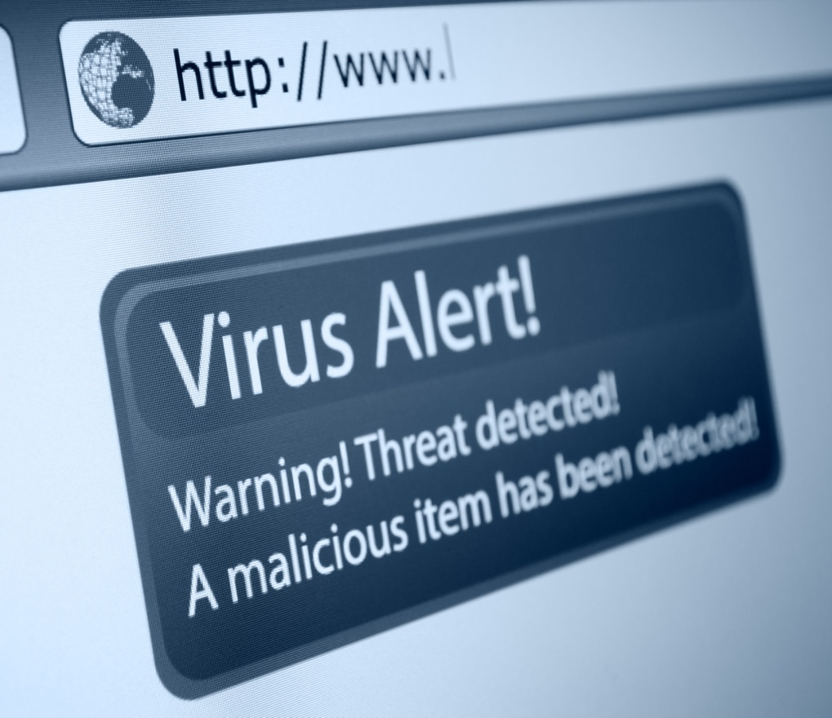





Computer Crimes
This project was supported by Cooperative Agreement Number 2013-CK-WX-K027 awarded by the Office of Community Oriented Policing Services, U.S. Department of Justice. The opinions contained herein are those of the author(s) and do not necessarily represent the official position or policies of the U.S. Department of Justice. Reference to specific agencies, companies, products, or services should not be considered an endorsement by the author(s) or the U.S. Department of Justice. Rather, the references are illustrations to supplement discussion of the issues.
Notes:
Notes

Slide 2


Meet Samantha
Architect for an engineering firm
Married
College educated
Computer savvy
Notes:
Meet Samantha, an architect who currently works for a large architectural firm.

Slide 3

Samantha receives an email from a friend
Email does not contain a message, only a link
She thought maybe her friend was trying share something
She clicks the link but it does not work
Notes:
Last week Samantha received an email from a friend on her work computer. When she opened the email there was a link in the email, but no message. She clicked the link thinking her friend was sharing something with her, but the link didn’t really go anywhere. At the time she really didn’t think anything about it.

Slide 4
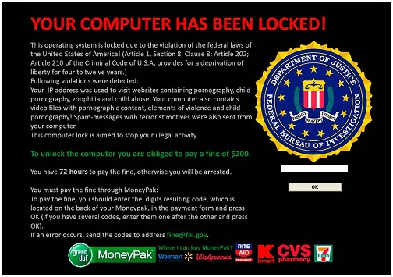
Message from the FBI
Samantha logs back onto her work computer
A message from the FBI stating her machine has been locked due to violations of U.S. law
In a panic, Samantha picks up a Green Dot card and loads it with $200 to pay the fine
Notes:
Later that day Samantha logs back onto her computer to get some work done and is presented with this notice from the FBI stating that her computer had been locked due to the violation of the federal laws of the United States of America. Samantha begins to panic and worries that maybe her husband did something he shouldn’t have or someone remotely accessed her machine. Afraid to contact her employer, Samantha purchases a Green Dot Card and loads it with $200 to pay the fine.

Slide 5

Samantha pays the fine
Following the directions on the screen, Samantha enters the card information
After entering her card information the message disappears and she is able to use her computer
Notes:
Samantha logs back on to her computer to pay the required fine in order to use her machine. After entering the card information, the message that appeared to be locking her machine disappears.

Slide 6

Samantha calls her husband
Samantha’s husband has only used the computer to check email
He tells her she shouldn’t have paid the money and to call the FBI
Samantha contacts the FBI only to find out that she was scammed out of $200
Notes:
Concerned, Samantha calls her husband and tells him what happened and asks him about his use of her computer. He tells her that the he only used her computer to check his email. He is concerned too and tells her she shouldn’t have paid the money and that she needs to contact the police.

Slide 7
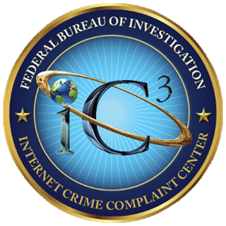

What is computer crime?
IC3 – Computer Crimes are (1) crimes that target computer networks or devices directly or (2) crimes facilitated by computer networks or devices.
FTC – Computer Equipment and Software – Problems with computer software, hardware, and computer equipment purchases; unwanted or unauthorized software installations and downloads; etc.
www.ic3.gov
www.ftc.gov
Notes:
Computer crime is a very broad term that can have several meanings:
A crime committed against a computer (computer as the target of a crime)
A crime committed using a computer (computer as the instrument of crime) such as fraud or identity theft
Cybercrime (another broad term—this presentation will use it to mean hacking and phishing)
(Accessed on September 25, 2019)
www.ic3.gov
www.ftc.gov

Slide 8

Cyber threats
Hacking
The unauthorized intrusion into the computer system of another, often with malicious intent.
Intrusion (Computer or Network)
The unauthorized access of computer system or network usually with the intent to obtain access to private information.
Malware
Malicious Software used to disrupt computer operation, gather sensitive information, or gain access to private computer systems.
Notes:
While cybercrime encompasses a broad spectrum of offenses, the threats most likely to be encountered by the average computer user include hacking, intrusion, and malware.
Hacking can include criminal intent for financial gain by stealing private financial information, corporate hacking company hacking to view their opponents, or intrusive spying on individuals, etc.
(Accessed on September 25, 2019)
https://www.malwarebytes.com/hacker/
https://www.dmts.biz/faqs-firewalls/what-are-computer-intrusions-or-attacks/
https://www.malwarebytes.com/malware/

Slide 9
Ransomware
A type of malware that encrypts the files on a computer’s hard drive and denies access to the user. A message on the screen offers to provide a decryption key when a ransom has been paid.
Tips to avoid victimization:
Back up your systems and storage frequently.
Beware of messages from senders you do not recognize.
Never open an attachment from a suspect source.
Keep your antivirus and malware protection up to date.
Do not pay. The scammers are very unlikely to undo the damage to your computer.
Do not reply. Communicating with criminals is always a bad idea.
Notes:
Ransomware is a version of malicious software that is designed to do exactly what the name implies. It is essential to keep your antivirus and malware protection updated while keeping your systems up to date. Be careful when opening anonymous emails because they can contain a virus set to take your information captive. Ransomware involves a payment in exchange for access to your information, but do not be tricked into paying them anything. Often times, the criminal is paid not the individuals do not regain access to their information.
(Accessed on September 25, 2019)
https://www.malwarebytes.com/ransomware/
https://phoenixnap.com/blog/preventing-detecting-ransomware-attacks

Slide 10
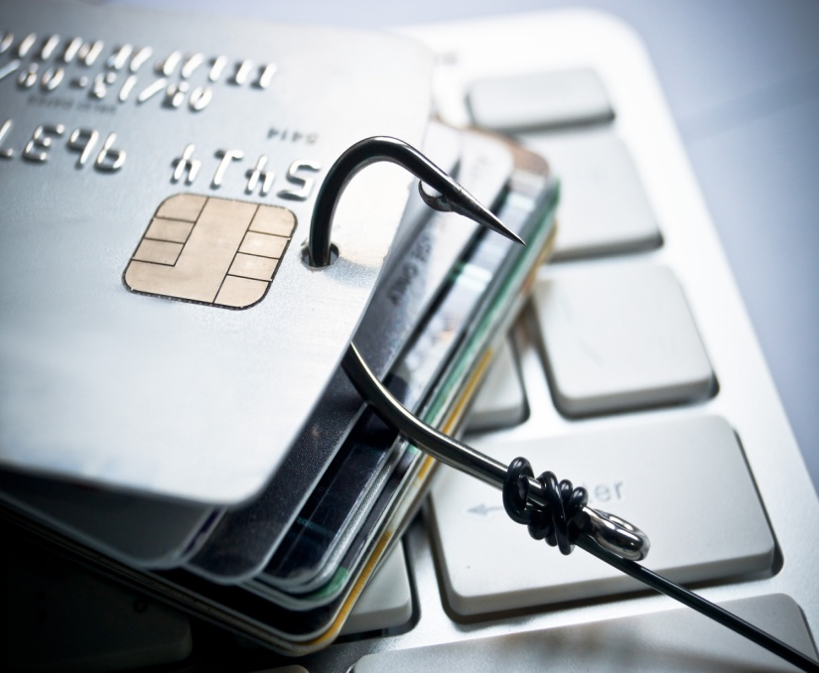
Phishing Scams
A type of scam in which a scammer attempts to obtain sensitive information, money, or access to your computer system by appearing to be a legitimate company or individual.
Phishing scams can look like:
Email from governmental agencies, banks, utility companies, etc.
Announcement that you have won the lottery, or inherited money from someone you don’t know.
Attachments or documents found in emails
Social media messages
Mobile text messages
Notes:
Most cyber threats and computer-related crimes are initiated by the use of some type of phishing scam. Phishing is a type of scam in which a scammer attempts to obtain sensitive information, money, or access to your computer system by appearing to be a legitimate company or individual. In some instances, email accounts are compromised and then phishing emails are sent out to the contacts within the compromised email account.
The end goal of all of these scams is to convince you to open their email, respond to their solicitation, and inquire as to how to go about collecting your winnings or take advantage of their free offer to rid your system of clutter and spyware. As the term suggests, once you have taken the bait, you are hooked. As with actual fishing, the person holding the fishing pole has no idea who or what will bite on their line.
(Accessed on September 25, 2019)
https://www.zdnet.com/article/what-is-phishing-how-to-protect-yourself-from-scam-emails-and-more/
https://www.consumer.ftc.gov/articles/how-recognize-and-avoid-phishing-scams

Slide 11
Social Engineering
Not all phishing attacks originate with a computer. Victims may get a phone call claiming to be from:
A bank, claiming that personal account information needs to be updated or changed.
An insurance company, threatening to drop coverage if personal information is not updated.
A computer company (often Microsoft), claiming that the victim’s computer has been infected with a virus.
During the phone call, the scammer attempts to gain personally identifiable information, computer access, or bank account information.
Notes:
Phishing scams don’t always arrive in the form of an email. Some can come in the form of a phone call which can be referred to as Social Engineering. The phone call will likely come from what seems to be a trusted source such as your bank, insurance company, or a large corporation. The intent of the phone call is to gain personally identifiable information, remote access to your computer, or the password to your bank account.
(Accessed on September 25, 2019)
https://pixelprivacy.com/resources/phishing-emails/
https://www.social-engineer.org/framework/general-discussion/common-attacks/phone/
https://www.consumer.ftc.gov/articles/how-recognize-and-avoid-phishing-scams

Slide 12

Could Samantha have prevented her situation?
YES
Before clicking the link, she could have contacted her friend to verify that she sent the email.
She could have called the FBI to verify the message before paying the fine.
Notes:
Let’s go back and take a look at Samantha’s situation. Is there anything she could have done to prevent being victimized? YES. As you can see on the screen there are a few specific things she could have done that could have prevented this from occurring.

Slide 13
TIPS to avoid victimization
Ensure bank, business, government, and personal email by contacting them directly about the topic rather than opening potential malware.
Turn on your email’s spam filter
Enable a system firewall
Be sure to have an anti-virus software installed
Back up valuable files frequently.
Use strong passwords and change them regularly.
Use a different password that each personal account.
Never click on a link or attachment from an email.
Keep all of your accounts monitored.
Do not give any person or financial information via phone or email unless it is a trusted source.
Notes:
In general the best way to avoid becoming a victim of most computer related crimes is to be suspicious of literally every communication that comes to you via the internet. If you don’t recognize the address of the communication, don’t open it. Shred any non essential papers, credit card solicitations, bank statements, monthly bills, and any account transfer offers.
(Accessed on September 25, 2019)
https://securityytrails.com/blog/types-of-cyber-crime
https://pixelprivacy.com/resources/phishing-emails/

Slide 14
TIPS to avoid victimization
Certain types of communications are always a scam designed to entrap and victimize people.
If you did not buy a lottery ticket, you did not win the lottery.
If you have never visited a foreign country, no one there would entrust legitimate financial transactions to you.
If you have never heard of the “uncle” who just passed away, you probably didn’t inherit his fortune.
If it seems too good to be true, it probably is.

Slide 15
What to do if you are a victim
Report the incident to your local law enforcement agency.
File a complaint with Internet Crime Complaint center @ www.ic3.gov.
Submit a consumer complaint with the Federal Trade Commission @ www.ftc.gov/complaint.
If you were scammed by someone claiming to represent a business, be sure to notify the actual business (bank, credit card company, etc).
Notes:
Here is a list of ways to report computer crimes.
(Accessed on September 25, 2019)
www.ic3.gov.
www.ftc.gov

Slide 16

QUESTIONS
Photo Credits: “94686637 Copyright fotographic 1980, 2015 Used under license from Shutterstock.com“, “214296676 Copyright master_art, 2015 Used under license from Shutterstock.com“,
"172084607 Copyright scyther5, 2015 Used under license from Shutterstock.com“, “127762841 Copyright JMiks, 2015 Used under license from Shutterstock.com“, “236197600 Copyright Solis Images, 2015 Used under license from Shutterstock.com“, " 230086318 Copyright Solis Images, 2015 Used under license from Shutterstock.com“, " 230086330 Copyright Solis Images, 2015 Used under license from Shutterstock.com“, “231646483 Copyright Solis Images, 2015 Used under license from Shutterstock.com“, “219799306 Copyright wk1003mike, 2015 Used under license from Shutterstock.com“, “153213146 Copyright garriphoto, 2015 Used under license from Shutterstock.com“
Notes:
**Instructor Note: Ask the participants if they have any questions about Computer Crimes, prevention tips, or how to report this type of fraud.**

Slide 17
Bibliography
Dobran, Bojana. “Definitive Guide for Preventing and Detecting Ransomware.” PhoenixNAP. PhoenixNAP, 15 February, 2019. Accessed on September 25, 2019. https://phoenixnap.com/blog/preventing-detecting-ransomware-attacks
Federal Bureau of Investigation. The Internet Crime Complaint Center (IC3). Accessed on September 25, 2019. www.ic3.gov
Federal Trade Commission Consumer Information. Federal Trade Commission, Accessed on September 25, 2019. www.ftc.gov
“Hacker.” Malwarebytes. Malwarebytes, 2019. Accessed on September 25, 2019. https://www.malwarebytes.com/hacker/
“How to Recognize and Avoid Phishing Scams.” Federal Trade Commission Consumer Information. Federal Trade Commission, 2019. Accessed on September 25, 2019. https://www.consumer.ftc.gov/articles/how-recognize-and-avoid-phishing-scams
“Malware.” Malwarebytes. Malwarebytes, 2019. Accessed on September 25, 2019. https://www.malwarebytes.com/malware/

Slide 18
Bibliography
Palmer, Danny. “What is Phishing? Everything you need to know to protect yourself from scam emails and more.” ZD Net. CBS Interactive Inc., 2019. Accessed on September 25, 2019. https://www.zdnet.com/article/what-is-phishing-how-to-protect-yourself-from-scam-emails-and-more/
“Phishing Emails.” Pixel Privacy. GeneratePress, 2019. Accessed on September 25, 2019. https://pixelprivacy.com/resources/phishing-emails/
“Ransomware.” Malwarebytes. Malwarebytes, 2019. Accessed on September 25, 2019. https://www.malwarebytes.com/ransomware
Security Trails Team. “Types of Cybercrime and How to Protect Yourself Against Them.” Security Trails. Security Trails, 9 July, 2019. Accessed on September 25, 2019. https://securitytrails.com/blog/types-of-cyber-crime
“The Social Engineering Framework.” Security Through Education. Social Engineer, Inc., 2019. Accessed on September 25, 2019. https://social-engineer.org/framework/general-discussion/common-attacks/phone/
“What are computer intrusions are attacks?” DMTS. Dryden Municipal Telephone System, 2019. Accessed on September 25, 2019. https://www.dmts.biz/faqs-firewalls/what-are-computer-intrusions-or-attacks/

